Slide 1
CELEBRATION

Slide 2
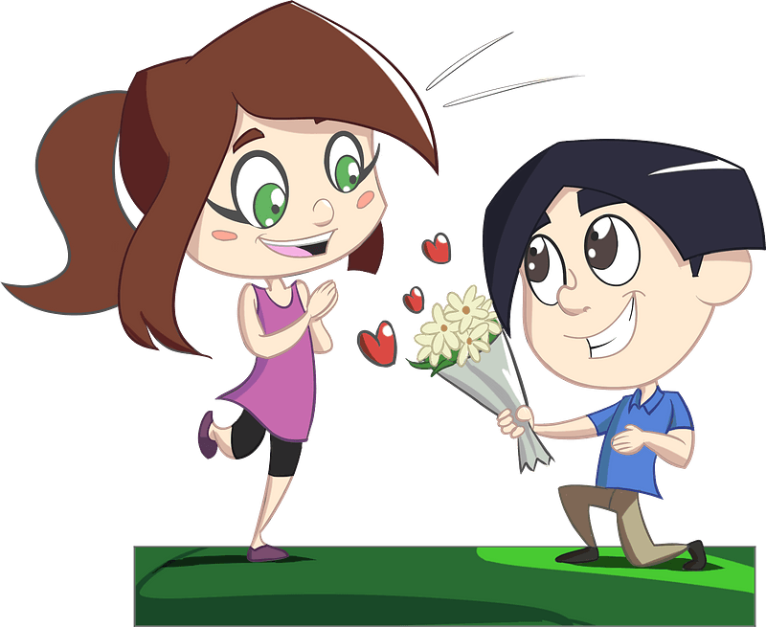
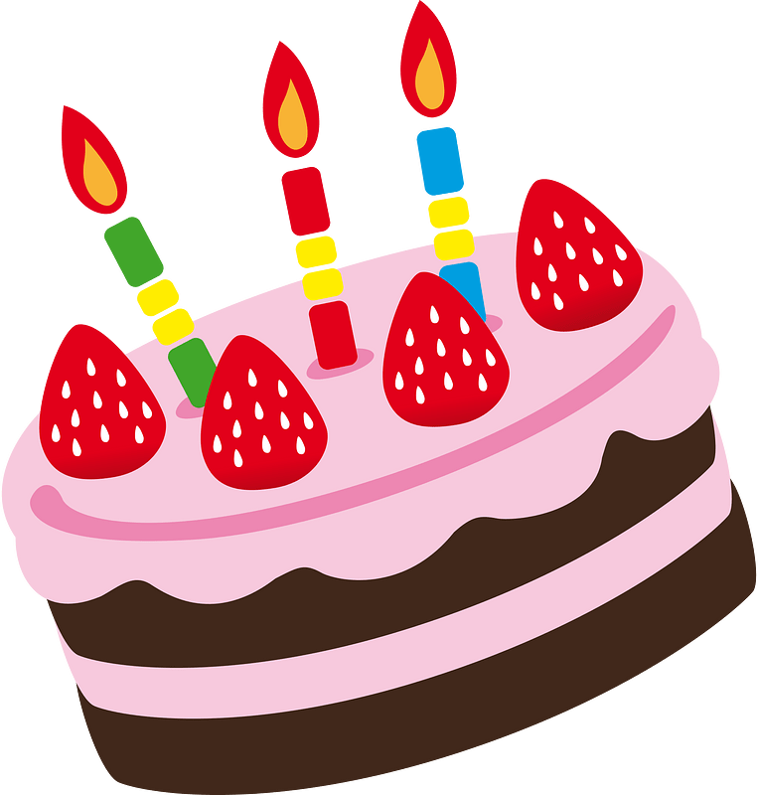
Share the joy …
What are some events that you and your family have celebrated?
Celebration produces joy and makes us strong.
“The joy of the Lord is your strength.” Nehemiah 8:10
Celebration results from the faithful practice of all other Spiritual Disciplines.

Slide 3
Isten for a “cheer” that was voiced.
John 12:12-15 (NIV) The next day the great crowd that had come for the Feast heard that Jesus was on his way to Jerusalem. [13] They took palm branches and went out to meet him, shouting, "Hosanna!" "Blessed is he who comes

Slide 4
Isten for a “cheer” that was voiced.
in the name of the Lord!" "Blessed is the King of Israel!"[14] Jesus found a young donkey and sat upon it, as it is written, [15] "Do not be afraid, O Daughter of Zion; see, your king is coming, seated on a donkey's colt."

Slide 5
Celebration Is the Heart of Christ
What did people shout as Jesus came into Jerusalem?
Here is a recent Worship song which echoes this “cheer”
Note that “Hosanna” means “Save now, we pray!”

Slide 6
Celebration Is the Heart of Christ
What items, actions, or sayings might celebrate Jesus’ triumphant arrival today?
Next week we will celebrate Christmas.
Jesus came as a little baby,
Confined Himself to time and space.
All for the purpose of setting us free.

Slide 7
Celebration Is the Heart of Christ
“Hosanna” ⬄ “Save now, we pray!”
What are some of the things from which Jesus has saved or rescued us that should cause us to celebrate?
What are some things the Messiah has set you free to be able to do for which you can rejoice and celebrate?

Slide 8
Listen for multiple mentions of “love”.
John 15:9-11 (NIV) "As the Father has loved me, so have I loved you. Now remain in my love. 10 If you obey my commands, you will remain in my love, just as I have obeyed my Father's commands and remain in His love. 11 I have told you this so that my joy may be in you and that your joy may be complete.

Slide 9
Begin with Obedience to Christ
What is Jesus’ desire concerning love?
What provides evidence that a person truly loves the Lord?
Now remain in my love. If you obey my commands, you will remain in my love, just as I have obeyed my Father's commands and remain in his love.

Slide 10
Begin with Obedience to Christ
Note Jesus’ reason for sharing this message with His disciples.
So that they (and we) experience the same joy Jesus does
So our joy will be complete

Slide 11
Begin with Obedience to Christ
How does obeying God’s commands demonstrate our love for Him?
What are some ways we can encourage one another to live lives of obedience to Christ so none of us miss His rich blessings of joy?

Slide 12
Listen for what guards your hearts.
Philippians 4:4-7, 11 – 13 (NIV) Rejoice in the Lord always. I will say it again: Rejoice! 5 Let your gentleness be evident to all. The Lord is near. 6 Do not be anxious about anything, but in everything, by prayer and petition, with thanksgiving, present your requests to God.

Slide 13
Listen for what guards your hearts.
And the peace of God, which transcends all understanding, will guard your hearts and your minds in Christ Jesus. … Philippians 4:11-13 (NIV) I am not saying this because I am in need, for I have learned to be content whatever the circumstances. 12 I know what it is to be in need, and I know what it

Slide 14
Listen for what guards your hearts.
is to have plenty. I have learned the secret of being content in any and every situation, whether well fed or hungry, whether living in plenty or in want. 13 I can do everything through him who gives me strength.

Slide 15
Celebration Strengthens Life with Christ
What is often people’s initial reaction to the command, “Rejoice”?
Paul was writing from a jail cell. What kinds of things could he have communicated?
Instead of this, what are Paul’s comments and exhortations.

Slide 16
Celebration Strengthens Life with Christ
Why do you think Paul repeats the command to “rejoice?”
How can we rejoice even when things aren’t going well?
Try counting your blessings! Let’s Sing!!

Slide 17
Celebration Strengthens Life with Christ
When upon life's billows you are tempest tossed,
When you are discouraged, thinking all is lost,
Count your many blessings, name them one by one,
And it will surprise you what the Lord hath done.
Refrain:
Count your blessings, name them one by one;
Count your blessings, see what God hath done;
Count your blessings, name them one by one;
Count your many blessings, see what God hath done.

Slide 18
Celebration Strengthens Life with Christ
Sports enthusiasts commonly rejoice over their teams’ successes. As believers, we have much more to celebrate.
Sins forgiven
God at work in our lives
The joy of the Lord
Knowing that God is in control
We know the end of the story … God wins!
Peace with God, peace within our selves

Slide 19
Application
Consider the examples of Old Testament saints.
Singing
Playing of instruments
Laughter, Shouting

Slide 20
Application
Incorporate creative imagination.
Children’s artwork
Family music
Compose your own lyrics to a familiar hymn tune.
Poems
Stories

Slide 21
Application
Keep a calendar of important events to celebrate throughout the year.
Take advantage of “built in” celebrations
Christmas
Easter
Thanksgiving

Slide 22
CELEBRATION

