Slide 1
A Life of Loyalty
March 13

Slide 2
Video Introduction
View Video

Slide 3
Think about it …
Who or what comes to mind when you think of “loyalty”?
Certainly, the Lord is loyal to us.
Connection to Christ calls for our consistent loyalty to Him.

Slide 4
Listen for Jesus’ Clue
John 13:21-27 (NIV) After he had said this, Jesus was troubled in spirit and testified, "I tell you the truth, one of you is going to betray me." 22 His disciples stared at one another, at a loss to know which of them he meant. 23 One of them, the disciple whom Jesus loved, was reclining next to him.

Slide 5
Listen for Jesus’ Clue
Simon Peter motioned to this disciple and said, "Ask him which one he means." 25 Leaning back against Jesus, he asked him, "Lord, who is it?" 26 Jesus answered, "It is the one to whom I will give this piece of bread when I have dipped it in the dish."

Slide 6
Listen for Jesus’ Clue
Then, dipping the piece of bread, he gave it to Judas Iscariot, son of Simon. 27 As soon as Judas took the bread, Satan entered into him. "What you are about to do, do quickly," Jesus told him,

Slide 7
Aware of Betrayal
The passage says that Jesus was “troubled in spirit.” What kinds of emotions do you think this phrase was describing? How have you felt when betrayed by a friend?
How did the disciples react to Jesus’ saying a betrayer was in their midst?

Slide 8
Aware of Betrayal
Judas had been with Jesus three years, following Him, watching the miracles, listening to the teachings. How do you think He was able to turn and betray Jesus?
In what ways do believers today betray Jesus? Why does this happen?
⇨ There is no doubt that this will hurt our Lord and cause Him to be “troubled in spirit” over us.

Slide 9
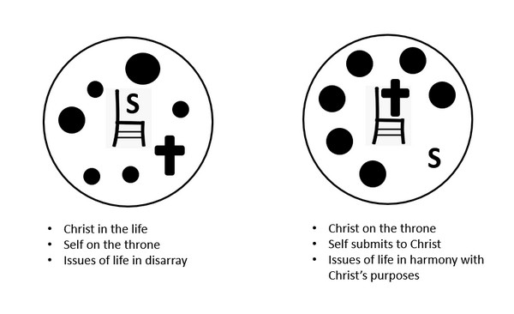
Aware of Betrayal
What specific things can we do to avoid falling into Satan’s trap of temptation to betray Jesus?

Slide 10
Listen for how God will be glorified.
John 13:31-33 (NIV) When he was gone, Jesus said, "Now is the Son of Man glorified and God is glorified in him. 32 If God is glorified in him, God will glorify the Son in himself,

Slide 11
Listen for how God will be glorified.
and will glorify him at once. 33 "My children, I will be with you only a little longer. You will look for me, and just as I told the Jews, so I tell you now: Where I am going, you cannot come.

Slide 12
Live for God’s Glory
Jesus stated that He will be glorified, and God the Father will be glorified. How would this happen?
Consider Philippians 2:9-11 (NIV)
Therefore God exalted him to the highest place and gave him the name that is above every name, that at the name of Jesus every knee should bow, in heaven and on earth and under the earth, and every tongue confess that Jesus Christ is Lord, to the glory of God the Father.

Slide 13
Live for God’s Glory
In the context of Phil. 2:9-11, how was Jesus glorified through the cross?
How is God the Father glorified in the cross?
Who or what does our culture glorify?
Instead of glorifying these kinds of things, how can we glorify God in our lives?

Slide 14
Listen for what is new.
John 13:34-35 (NIV) "A new command I give you: Love one another. As I have loved you, so you must love one another. 35 By this all men will know that you are my disciples, if you love one another."

Slide 15
Love One Another Loyally
Jesus previously confirmed this statement of the teacher of the law, 'Love your neighbor as yourself.' So what was new about this command (look at preceding verses)?
Jesus says, “Love as I have loved you.” How has God shown His love for you?
What is the benefit of demonstrating the love of God toward others?

Slide 16
Love One Another Loyally
How is love for one another one way to demonstrate loyalty to Jesus?
What are some tangible ways we can show that we love one another?
How does our love for one another point others to Christ?

Slide 17
Application
Confess.
Confess to God any way you’ve been disloyal to Him. Ask Him to forgive you.

Slide 18
Application
Memorize.
Consider choosing one of these verses about God’s glory to memorize this week:
John 1:14
2 Corinthians 4:6
Psalm 19:1
Philippians 2:10-11

Slide 19
Application
Share.
If you share on social media, consider posting about a brother or sister in Christ.
Share how someone has loved you, encouraged you, or helped you experience more joy in Christ.

Slide 20
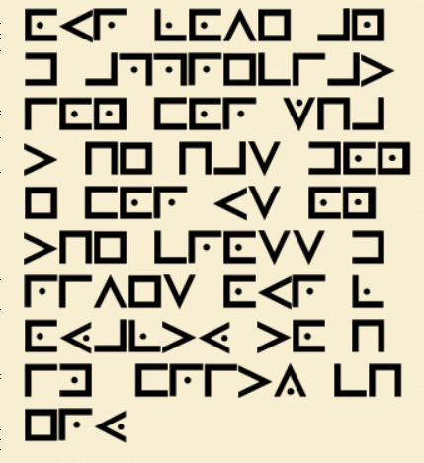
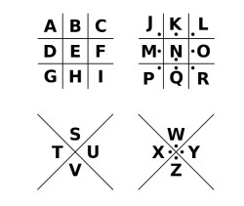
Family Activities
Your deacons are standing buy to spread this message. If you must, find technical help and the crossword puzzle at https://tinyurl.com/yuydmpvu

Slide 21
A Life of Loyalty
March 13

