Slide 1
A Love for Others
August 30

Slide 2

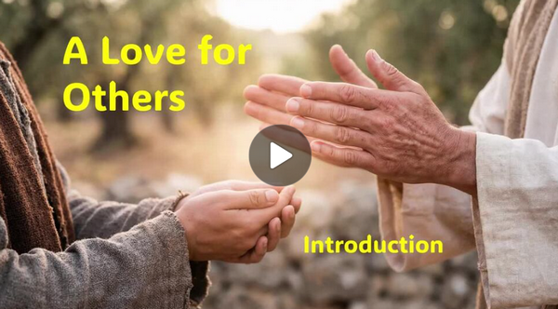
Video Introduction
View Video

Slide 3



I love it …
How many different ways might you complete the statement, “I love _______” ?
Note the different meanings of the word love:
  Preference for a particular flavor, activity, time, place
  Total dedication to someone
  This is an important part of your life

Slide 4
I love it …
How many different ways might you complete the statement, “I love _______” ?
Today ⇨ we investigate the kind of love God demonstrates
  We seek to learn ways to demonstrate that same kind of love for others

Slide 5
Listen for the necessity of love.
1 Corinthians 13:1-3 (NIV) If I speak in the tongues of men and of angels, but have not love, I am only a resounding gong or a clanging cymbal. 2 If I have the gift of prophecy and can fathom all

Slide 6
Listen for the necessity of love.
mysteries and all knowledge, and if I have a faith that can move mountains, but have not love, I am nothing. 3 If I give all I possess to the poor and surrender my body to the flames, but have not love, I gain nothing.

Slide 7
Love is Foundational
What hypothetical experiences or situations did Paul identify that could be an occasion for boasting about one’s spiritual gifts?
What results when I do these things with the wrong motive?
What kinds of wrong motives might we have?

Slide 8
Love is Foundational
Why might it be easy to use a spiritual gift without love?
How can using our resources and gifts without love minimize the value of their expression to others … to ourselves?
To Others | To Ourselves

Slide 9
Love is Foundational
The kind of love Paul is writing about here is that same love God has for us, agape love.
  Determined good will that has its object’s best interests at heart
  Self-giving (instead of self-serving)
  Expects nothing in return
  Goes on offering itself, even when rejected
  Acts on others’ behalf without considering their worthiness

Slide 10
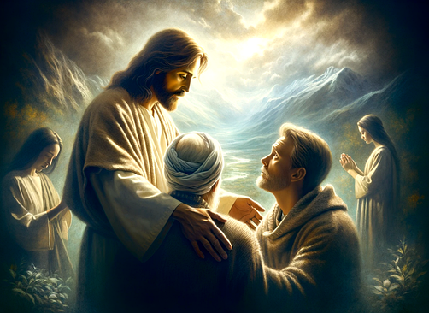
Love is Foundational
How did Jesus exemplify this kind of love?

Slide 11
Listen for how love reflects Christ’s character.
1 Corinthians 13:4-7 (NIV) Love is patient, love is kind. It does not envy, it does not boast, it is not proud. 5 It is not rude, it is not self-seeking, it is not easily angered, it keeps no record of wrongs. 6 Love does not delight in evil but rejoices with the truth. 7 It always protects, always trusts, always hopes, always perseveres.

Slide 12
Love Reflects Christ
What do you see that love is not or does not do?
Why are these things difficult not to do … or we could say too easy to do?
What words does Paul use to describe what love is or does?
How will agape love as we’ve defined it be demonstrated in some of these contexts?

Slide 13
Listen for spiritual gifts that will become obsolete.
1 Corinthians 13:8-13 (NIV) Love never fails. But where there are prophecies, they will cease; where there are tongues, they will be stilled; where there is knowledge, it will pass away. 9 For we know in part and we prophesy in

Slide 14
Listen for spiritual gifts that will become obsolete.
part, 10 but when perfection comes, the imperfect disappears. 11 When I was a child, I talked like a child, I thought like a child, I reasoned like a child. When I became a man, I put childish ways behind me. 12 Now we see but a

Slide 15
Listen for spiritual gifts that will become obsolete.
poor reflection as in a mirror; then we shall see face to face. Now I know in part; then I shall know fully, even as I am fully known.13 And now these three remain: faith, hope and love. But the greatest of these is love.

Slide 16
Love Does Not Diminish or Fade
What gifts are listed that will cease to exist or become obsolete?
Why won’t prophecy, knowledge, and tongues be necessary when Jesus returns?
How do these verses affirm that love (charity) is permanent, perfect, and preeminent?

Slide 17
Love Does Not Diminish or Fade
Why do you think Paul would say, “Love never fails”?
Why is love the greatest of these three—faith, hope, and love?

Slide 18
Application
Review.
  Make a list of the traits listed in
  1 Corinthians 13:4-7.
  Identify times when you have not loved others as defined in these verses.
  Confess that to God, thank Him for His love and forgiveness
  Commit to loving as Jesus loves.

Slide 19
Application
Embrace.
  In whatever way God has gifted you, evaluate how a self-giving agape love would make a significant difference in how you exercise that gift.
  Embrace your gift and service with a renewed vigor to do it with love.

Slide 20
Application
Act.
  Look for a specific way you can love someone this week without any thought of how it might benefit you.
  Choose to honor Christ by loving those God places in your path

Slide 21
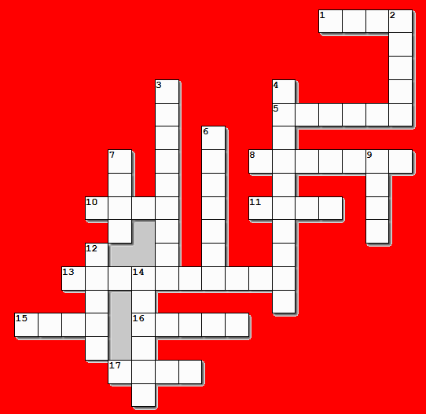
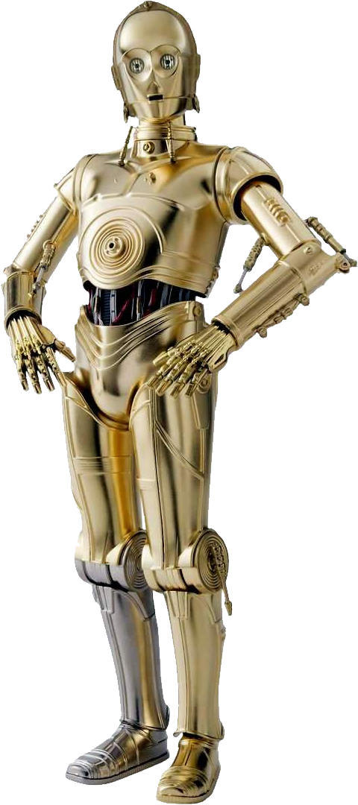
Family Activities
Oh delightful news! The crossword puzzle has returned this week. All clues and answers are drawn from 1 Corinthians 13, so do take a moment to review the chapter. If you require assistance — or the color page — you may access it at this convenient link: https://tinyurl.com/j6dbf6sz . Best of luck, though I suspect you won’t need it.

Slide 22
A Love for Others
August 30

