Slide 1
A Prayer of Praise
October 21

Slide 2
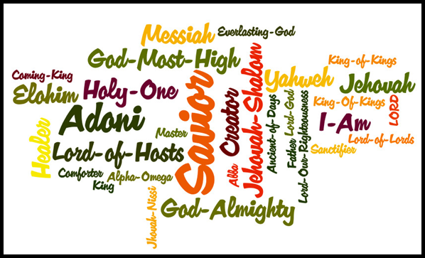
What’s in A Name?
View the Video

Slide 3
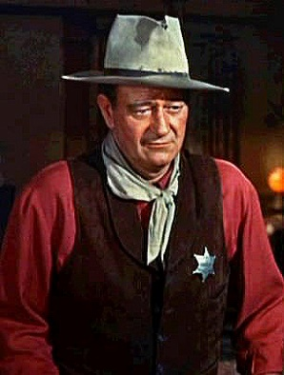
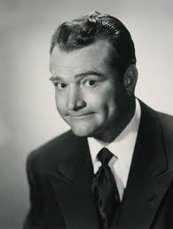
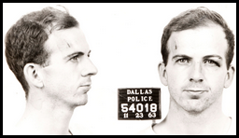
Think about it …
What are some names you associate with greatness? With infamy?
Names of great people are honored. Names of infamous people are scorned.
Consider how God’s name is honored or dishonored.
Our prayers should be driven by the desire to honor God and His name.
Greatness | Infamy

Slide 4
Listen for a reason to sing.
Matt. 6:9b (NIV) hallowed be your name … Psalm 96:1-3 Sing to the LORD a new song; sing to the LORD, all the earth. 2 Sing to the LORD, praise his name; proclaim his salvation day after day. 3 Declare his glory among the nations, his marvelous deeds among all peoples.

Slide 5
Desire to Honor God
What instructions for worship are given in this psalm?
What are some ways we can honor God’s name as holy (unique, distinctive, special)?
Why do we sometimes struggle with genuine praise in our prayers?

Slide 6
Desire to Honor God
What reasons does this passage give us to worship the Lord?
What should be our motivation in praising God?

Slide 7
Listen for a contrast.
Psalm 96:4-6 (NIV) For great is the LORD and most worthy of praise; he is to be feared above all gods. 5 For all the gods of the nations are idols, but the LORD made the heavens. 6 Splendor and majesty are before him; strength and glory are in his sanctuary.

Slide 8
God’s Splendor and Majesty
What attributes of the Lord does the psalmist single out as making Him worthy of honor?
What does it mean to “fear” the Lord?
Where do you see God’s splendor and majesty at work in the world today? What about nature inspires you to praise God?

Slide 9
God’s Splendor and Majesty
How does the God of heaven differ from earthly gods or idols?
People in the psalmist’s day had idols made of wood, stone, clay, or cast metal. What kinds of things are idols for us today?
How can praise of the great Creator and Savior God help you overcome discouragement or worry?

Slide 10
Listen for how to worship.
Psalm 96:7-9 (NIV) Ascribe to the LORD, O families of nations, ascribe to the LORD glory and strength. 8 Ascribe to the LORD the glory due his name; bring an offering and come into his courts. Worship the LORD in the splendor of his holiness; tremble before him, all the earth.

Slide 11
Acts of Worship
Whom did the psalm writer call to worship God? (check different translations)
The psalmist used the verb “ascribe”. What are some synonyms of this word?
What qualities are we to ascribe or attribute to the Lord?

Slide 12
Acts of Worship
What else does the passage say we are to do?
What do you think the phrase “worship in the splendor of holiness” means?
How can worship be God-honoring?
How can we practically make our lives offerings that honor God?
How can our prayers be offerings that honor God?

Slide 13
Application
Offer praise.
Every day this week let a specific praise to God be your first words of the day.
As you put your feet on the floor, praise the Lord for Who He is, thank Him for what He has done.

Slide 14
Application
List attributes.
Make a list of every attribute of God you can think of. (See 101 Reasons to Praise God, http://average-heros.tripod.com/id17.html)
Take time this week to praise God using the entire list. (Focus on 10 of the 101 Reasons to Praise God each day)

Slide 15
Application
Evaluate your requests.
Write out your prayer requests and evaluate them on whether they are focused on God’s honor or simply on what you want.
As needed, adjust the way you pray so you are seeking to honor Him.

Slide 16
Family Activities
Of course those Family Activities are free for everyone. Just go to https://tinyurl.com/yb4gbyt3
I’m telling you, it’s good stuff. And your crossword puzzle is there, too.

Slide 17
A Prayer of Praise
October 21

