Slide 1
A Prayer of Confession
November 18

Slide 2
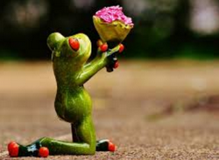
Admit it, now …
What makes it so hard to say, “I’m sorry”?
Confession and repentance are initial steps in our salvation experience
We need to agree with God that what we have done was sin and determine to turn away from that behavior
The Good News is that God forgives when we come to Him in repentance.

Slide 3
Listen for Jesus’ requests in prayer.
Matthew 6:12-13 (NIV) Forgive us our debts, as we also have forgiven our debtors. 13 And lead us not into temptation, but deliver us from the evil one.'

Slide 4
Asking for Forgiveness and Protection
Jesus prays about forgiveness. What is the relationship between receiving forgiveness and being forgiving?
What sins or offenses by others do we find especially difficult to forgive?
What are the benefits of forgiving others?
What are the dangers of unforgiveness?

Slide 5
Asking for Forgiveness and Protection
What are some ways the word temptation can be understood? What are some synonyms of temptation?
James 1:13 – 15 tells us that God is not the source of our temptation. So, how might we understand “lead us not into temptation”?

Slide 6
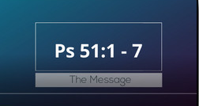
Listen for David’s requests.
View Scripture Video

Slide 7
Listen for David’s requests.
Psalm 51:1-7 (NIV) Have mercy on me, O God, according to your unfailing love; according to your great compassion blot out my transgressions. 2 Wash away all my iniquity and cleanse me from my sin. 3 For I know my transgressions, and my sin is always before me. 4 Against you, you only, have I sinned and done what is evil in your

Slide 8
Listen for David’s requests.
sight, so that you are proved right when you speak and justified when you judge. 5 Surely I was sinful at birth, sinful from the time my mother conceived me. 6 Surely you desire truth in the inner parts; you teach me wisdom in the inmost place. 7 Cleanse me with hyssop, and I will be clean; wash me, and I will be whiter than snow.

Slide 9
Confess Sin, Ask Forgiveness
For what does David, the psalmist, plead?
What attributes of God described in this psalm should give us confidence in confessing sin?
What three verbs does he use to describe what he wants the Lord to do in forgiving him?

Slide 10
Confess Sin, Ask Forgiveness
Consider the meaning of the different words used to describe what he has done:
Transgressions : stubborn refusal, rebellion
Iniquity : perverting God's will and commandments
Sin : missing the mark of what God wants one to be
What would be some examples of sins in each category?
Transgression | Iniquity | Sin

Slide 11
Confess Sin, Ask Forgiveness
1 John 1:9 (NIV) If we confess our sins, he is faithful and just and will forgive us our sins and purify us from all unrighteousness.
What is the result of confessing one’s sins?
What are some feelings David might have felt with his burden of sin?
How does our confession and repentance and God’s forgiveness relieve those feelings?

Slide 12
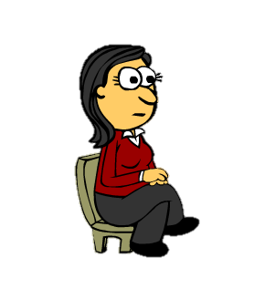
Confess Sin, Ask Forgiveness
People in today’s world have confused ideas about the confession of sin. How might these verses help you counsel this person?
I don’t worry about committing some sin. I know I always can go to God and confess my sin. When I do, He will forgive me.

Slide 13
Listen for restoration requests.
Psalm 51:10-12 (NIV) Create in me a pure heart, O God, and renew a steadfast spirit within me. 11 Do not cast me from your presence or take your Holy Spirit from me. 12 Restore to me the joy of your salvation and grant me a willing spirit, to sustain me.

Slide 14
Seek Restoration and Renewal
What are the appeals David made in these verses?
How do they represent inner change?
What suggests these are things only the Lord can do, not just a matter of self-adjustment?

Slide 15
Application
Confess sin.
Each time you pray, ask God to reveal any unconfessed sin.
As God reveals things to you, turn from them, seek His forgiveness, and thank Him for His cleansing.

Slide 16
Application
Read.
Read and pray through Psalm 51.
Ask God to give you a renewed dependence upon Him.

Slide 17
Application
Seek forgiveness.
If others have been hurt by some sin you’ve committed, …
Confess that sin to him and/or her and
Ask for forgiveness.

Slide 18
Family Activities
We’ve got letters everywhere from this week’s puzzle. I need your help getting them back in place. You can also find interesting activities for the whole family at https://tinyurl.com/y8vp3u8z But watch out for that old English teacher lady. “Humph !”

Slide 19
A Prayer of Confession
November 18

