Slide 1
A Way to Serve
August 23

Slide 2

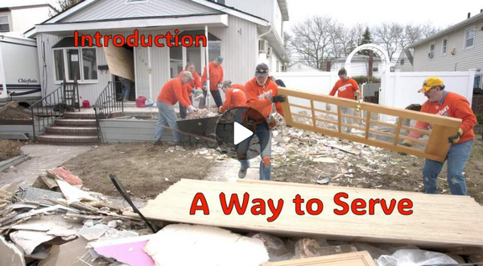
Video Introduction
View Video

Slide 3
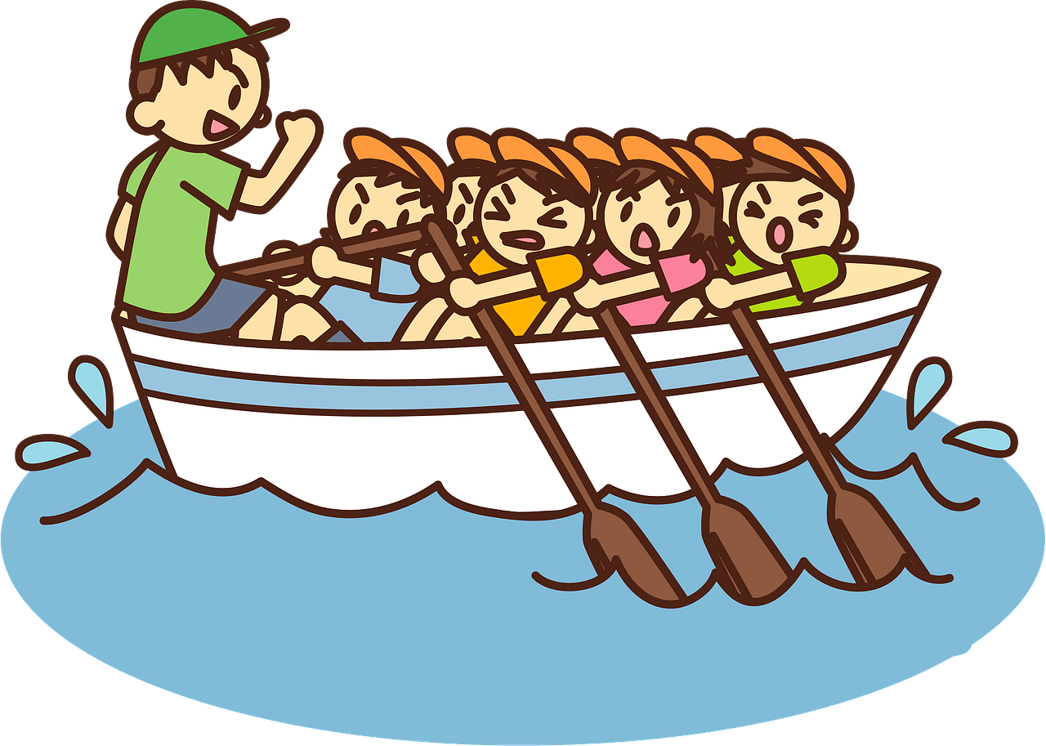
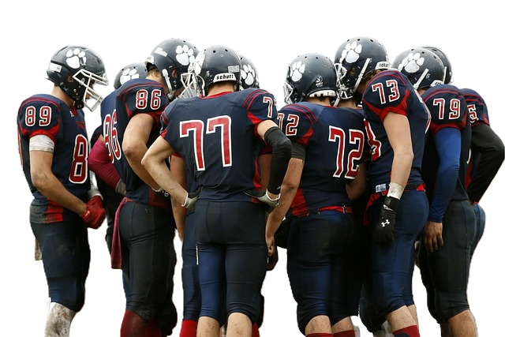

Think about it …
When has being part of a group really helped you succeed?
God has empowered and equipped us to serve His church.
  Today ⇨ we look at how we are interdependent
  Everyone needs everyone else

Slide 4

Listen for how the Church is One Body
1 Corinthians 12:12-13 (NIV) The body is a unit, though it is made up of many parts; and though all its parts are many, they form one body. So it is with Christ. 13 For we were all baptized by one Spirit into one body--whether Jews or Greeks, slave or free--and we were all given the one Spirit to drink.

Slide 5
Work and Serve Together
List the words and phrases Paul uses to compare Christians (the body of believers) like a human body?
The Human Body | The Body of Believers
The body is a unit
It is made up from many parts
Taken together, form one body

Slide 6

Work and Serve Together
In what way was the human
body an apt illustration?
In what ways are believers
bound together as one?
What are the benefits of unity
in the church?
What are some ways we can
maintain unity in the church?

Slide 7
Listen for talking body parts.
1 Corinthians 12:14-18 (NIV) Now the body is not made up of one part but of many. 15 If the foot should say, "Because I am not a hand, I do not belong to the body," it would not for that reason cease to be part of the body. 16 And if the ear should say, "Because I am not an eye, I do not

Slide 8
Listen for talking body parts.
belong to the body," it would not for that reason cease to be part of the body. 17 If the whole body were an eye, where would the sense of hearing be? If the whole body were an ear, where would the sense of smell be? 18 But in fact God has arranged the parts in the body, every one of them, just as he wanted them to be.

Slide 9
Roles and Responsibilities
Who arranged the parts of the body of Christ? Why is that significant?
What body parts come to action when you receive an injury such as a cut?
What body parts come to action when you drive children to an event or activity?

Slide 10
Roles and Responsibilities
What elements of the Body of Christ come to action when our church communicates the Gospel message?
Why is every member of the church important to the church’s ability to function effectively?
Why should members neither brag about nor disparage the gifts they have been given or minimize the value of the grace-gifts God has given to others?

Slide 11
Listen for more talking body parts.
1 Corinthians 12:19-24 (NIV) If they were all one part, where would the body be? 20 As it is, there are many parts, but one body. 21 The eye cannot say to the hand, "I don't need you!" And the head cannot say to the feet, "I don't need you!" 22 On the

Slide 12
Listen for more talking body parts.
contrary, those parts of the body that seem to be weaker are indispensable, 23 and the parts that we think are less honorable we treat with special honor. And the parts that are unpresentable are treated with special

Slide 13
Listen for more talking body parts.
modesty, 24 while our presentable parts need no special treatment. But God has combined the members of the body and has given greater honor to the parts that lacked it,

Slide 14
Each Believer is a Necessary Part
Why should members of the body of Christ not say to each other, "I don’t need you"?
Why do people often assume that certain duties in the church are more important?

Slide 15
Each Believer is a Necessary Part
Why should the “less honorable” parts be treated with special attention?
How can you honor the contributions of others in your church?

Slide 16
Application
Discover.
  If you’re not sure where you can best serve in the church, ask for feedback from others.
  Friends can often see your gifts and abilities before you do.
  Take a spiritual gifts inventory to assist you in determining how the Holy Spirit has gifted you. https://mintools.com/spiritual-gifts-test.htm

Slide 17
Application
Ask.
  Discuss with church leaders specific ways you can serve.
  They will know of opportunities to minister that might not be known or covered by others.

Slide 18
Application
Serve.
  If you see a need, step in and serve.
  Depending on the need and situation, you don’t always need an invitation.
  That “tug on your heart” to step in could be the Holy Spirit’s way of nudging you to use the gifts He has given you.

Slide 19

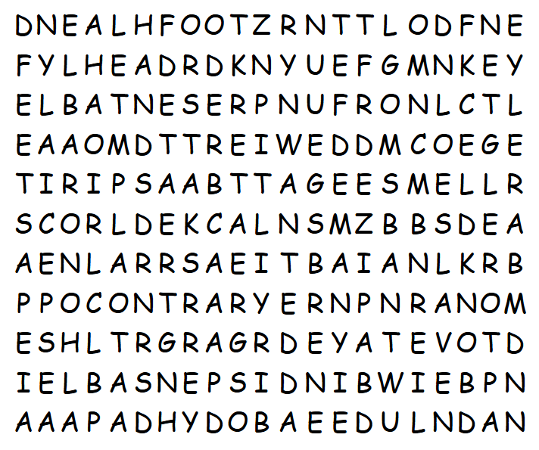

Family Activities
Ah, mon ami, it appears that Madame Wordsearch has exercised her little grey cells with great enthusiasm this week. She has constructed for you a puzzle most fiendish—words that twist and turn in every direction, even bottom up and on the diagonal!
Help and other Fun Family Activities found at https://tinyurl.com/mpj4cehh

Slide 20
A Way to Serve
August 23

