Slide 1

An Outward Focus
August 16

Slide 2


Introduction Video
View Video

Slide 3




Proud to say it …
What are some rights or freedoms as a citizen of the country you call home?

Slide 4
Proud to say it …
What are some rights or freedoms as a citizen of the country you call home?
Which of these rights (if any) would you be willing to give up if you believed that exercising it might harm someone else?

Slide 5
Proud to say it …
Personal freedom is a big deal in our culture
  Today we consider what we have the right to do
  AND how our actions in doing these things will impact others
  Let your responsibility to others drive how you exercise your rights.

Slide 6
Listen for a qualifying statement.
1 Corinthians 10:23-34 (NIV) "Everything is permissible"--but not everything is beneficial. "Everything is permissible"--but not everything is constructive. 24 Nobody should seek his own good, but the good of others.

Slide 7
Beneficial to Others
In what way is Paul’s opening statement in verse 23 true?
So, how did he qualify it?
Why might the statement need such qualifying or balance when applied to the life of a believer?

Slide 8
Beneficial to Others
When is it hard to seek the good of others over yourself in your daily life?
How does focus on the Kingdom of God change the way we see our rights?

Slide 9
Beneficial to Others
How does Christian use of freedom contrast with our society’s idea of freedom?
Society’s Concept of Freedom | The Believer’s Concept of Freedom

Slide 10
Listen for when not to offend unnecessarily
1 Corinthians 10:25 - 30 (NIV) Eat anything sold in the meat market without raising questions of conscience, 26 for, "The earth is the Lord's, and everything in it." 27 If some unbeliever invites you to a meal and you want to go, eat whatever is put before you without raising questions of conscience. 28 But if anyone says to you, "This has been

Slide 11
Listen for when not to offend unnecessarily
offered in sacrifice," then do not eat it, both for the sake of the man who told you and for conscience' sake-- 29 the other man's conscience, I mean, not yours. For why should my freedom be judged by another's conscience? 30 If I take part in the meal with thankfulness, why am I denounced because of something I thank God for?

Slide 12
Don’t Offend Unnecessarily
Paul asks the question, “Why should my freedom be judged by another’s conscience?” What does it mean for your freedom to be “judged by another person’s conscience”?
Why would being considerate of others be more important than knowing and claiming you are theologically correct in the actions you choose?

Slide 13
Don’t Offend Unnecessarily
How did Paul counsel the Corinthians to regard food sacrificed to idols?
How could weaker believers be hurt by seeing more mature Christians do something the weaker believers considered wrong?

Slide 14
Don’t Offend Unnecessarily
How should we limit our freedom out of sensitivity to weaker Christians?
How should we demonstrate loving our neighbor by limiting our freedom out of sensitivity to weaker Christians?

Slide 15
Listen for another reminder how to act.
1 Corinthians 10:31 - 33 (NIV) So whether you eat or drink or whatever you do, do it all for the glory of God. 32 Do not cause anyone to stumble, whether Jews, Greeks or the church of God-- 33 even as I try to please everybody in every way. For I am not seeking my own good but the good of many, so that they may be saved.

Slide 16
Glorify God, Benefit Others
In Contrast to Vs. 24
  Nobody should seek his own good, but the good of others.
  Consider the believer’s motivation
Verse 24 speaks of actions done with other people in mind
Do things for their good
Glorifying God as being the motivating factor
It is the overriding factor
Seek the good of others over yourself harmful to you?
  Thus, not glorifying to God

Slide 17
Glorify God, Benefit Others
Paul said, “I try to please everybody in every way.” So was he just a people pleaser, a politician?
As believers, whom are we trying to influence?
How can we know whether something we’re considering will bring God glory?
So what would be the right way to please people?

Slide 18
Application
Examine.
  Evaluate your views on church, politics, and other areas where you hold strong beliefs and opinions.
  If you identify areas where you are “pushy” or insistent on your rights or views, seek God’s forgiveness.

Slide 19
Application
Glorify.
  Live your life on mission,
  Living in such a way that you are intentional in giving God the glory in all aspects of your life.

Slide 20
Application
Engage.
  Connect with your neighbor or coworker, engaging him or her in a spiritual conversation.
  Invite the person to have coffee or lunch.
  Steward the relationship in such a way that you can paint an accurate picture of Jesus.

Slide 21
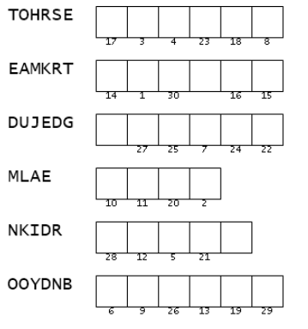
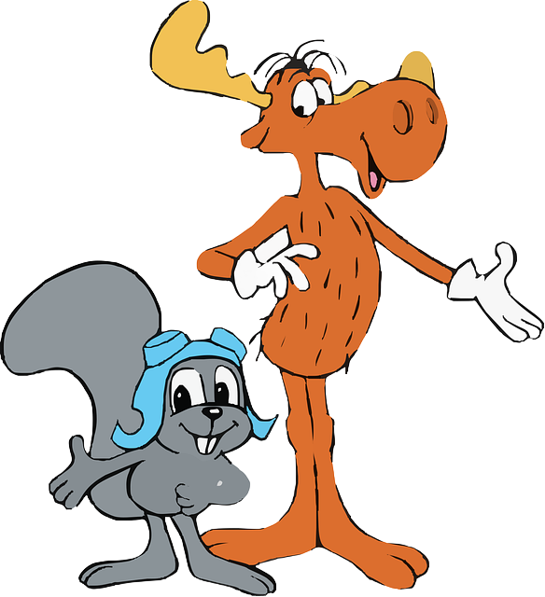
Family Activities
I bet we need to unscramble these words, Rocky.
Right, Bullwinkle. Then use the numbers to decode the message. And tell that other class the color page is at https://tinyurl.com/yc47upjs

Slide 22
An Outward Focus
August 16

