Slide 1
Barak
July 28

Slide 2
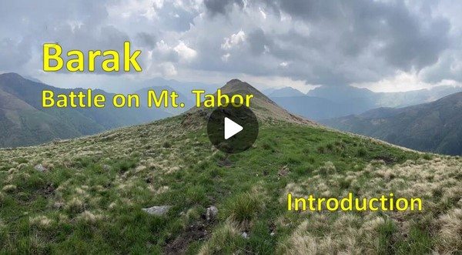
Video Introduction
View Video

Slide 3
Cannot imagine …
What is an invention you cannot imagine living without?
There are many items that are very valuable to us.
Today we consider what God values.
Your service to God is valuable, no matter who gets the credit.

Slide 4
Listen for a challenge and a response.
Judges 4:4-8 (NIV) Deborah, a prophetess, the wife of Lappidoth, was leading Israel at that time. 5 She held court under the Palm of Deborah between Ramah and Bethel in the hill country of Ephraim, and the Israelites came to her to have

Slide 5
Listen for a challenge and a response.
their disputes decided. 6 She sent for Barak son of Abinoam from Kedesh in Naphtali and said to him, "The LORD, the God of Israel, commands you: 'Go, take with you ten thousand men of Naphtali and Zebulun and lead the way to

Slide 6
Listen for a challenge and a response.
Mount Tabor. 7 I will lure Sisera, the commander of Jabin's army, with his chariots and his troops to the Kishon River and give him into your hands.'" 8 Barak said to her, "If you go with me, I will go; but if you don't go with me, I won't go."

Slide 7
Allow Yourself to Be Challenged
Whom did Deborah call and of what did she remind him? Note how specific the commands were.
What assurances of victory are promised by God, communicated by Deborah?
How did Barak respond to her? What “line in the sand” did he declare?

Slide 8
Allow Yourself to Be Challenged
What do you think was the rationale behind his “line in the sand”?
When has God used someone to encourage you to step into a ministry opportunity?
Who are some people in your circle of influence, whom you could be encouraging in matters of faith?

Slide 9
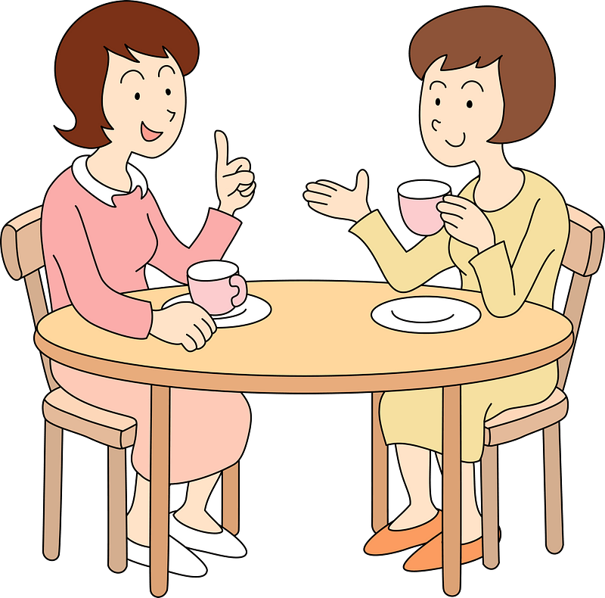
Allow Yourself to Be Challenged
How can you encourage those same people to take on leadership responsibilities? In what ways can we be an influence for God where we live?

Slide 10
Listen for who to trust.
Judges 4:12-16 (NIV) When they told Sisera that Barak son of Abinoam had gone up to Mount Tabor, 13 Sisera gathered together his nine hundred iron chariots and all the men with him, from Harosheth Haggoyim to the Kishon River. 14 Then Deborah

Slide 11
Listen for who to trust.
said to Barak, "Go! This is the day the LORD has given Sisera into your hands. Has not the LORD gone ahead of you?" So Barak went down Mount Tabor, followed by ten thousand men. 15 At Barak's advance, the LORD routed

Slide 12
Listen for who to trust.
Sisera and all his chariots and army by the sword, and Sisera abandoned his chariot and fled on foot. 16 But Barak pursued the chariots and army as far as Harosheth Haggoyim. All the troops of Sisera fell by the sword; not a man was left.

Slide 13
Do What You Are Called to Do
According to Deborah, why could Barak move forward with confidence?
How effective was Barak in carrying out what he had been set aside to do?
How can we discern when God is calling us to a task?

Slide 14
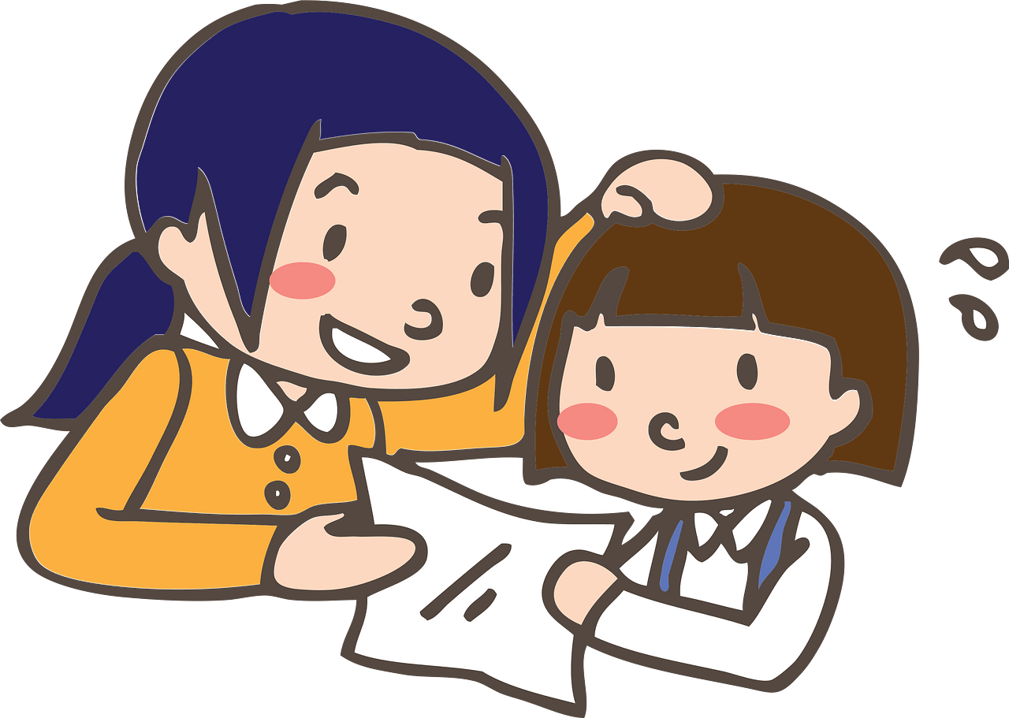
Do What You Are Called to Do
How can we encourage others to walk in obedience even under difficult circumstances?

Slide 15
Listen for who gets the credit for victory.
Judges 5:1-5 (NIV) On that day Deborah and Barak son of Abinoam sang this song: 2 "When the princes in Israel take the lead, when the people willingly offer themselves-- praise the LORD! 3 "Hear this, you kings! Listen, you rulers! I will sing to the LORD, I will sing; I will

Slide 16
Listen for who gets the credit for victory.
make music to the LORD, the God of Israel. 4 "O LORD, when you went out from Seir, when you marched from the land of Edom, the earth shook, the heavens poured, the clouds poured down water. 5 The mountains quaked before the LORD, the One of Sinai, before the LORD, the God of Israel.

Slide 17
Give God Honor and Praise
For what does Deborah praise the Lord?
What imagery suggests that the Lord goes before His people? How does He demonstrate His power?
If you wrote a song about God’s work in your life, what would be its theme? What kinds of victories (should) cause us to praise the Lord?

Slide 18
Give God Honor and Praise
What could you do this week to praise the Lord for His faithfulness in your life?
How does praising God affect our view of victory? What are the benefits of celebrating what God has done?

Slide 19
Application
Identify obstacles.
Say “yes” to whatever God is asking of you, regardless of the odds against you.
What obstacles are you facing?
What iron wall is standing between you and what God wants you to do? God will give you what you need to be victorious.
Be willing to step out on faith, even when you can’t “see” it.

Slide 20
Application
Worship God.
Worship Him even through the tough times, in the wins and losses of life.
God uses us to accomplish His will but remember that all the credit belongs to Him.
Plan a time each day this week to spend time with the Lord.

Slide 21
Application
Work together.
What project has God asked you to lead or participate in?
Be a team player knowing that when you work as team, when the team wins, everyone wins.
Most importantly, God is glorified.

Slide 22
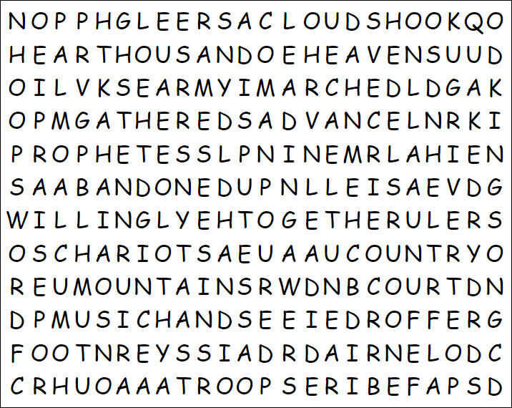
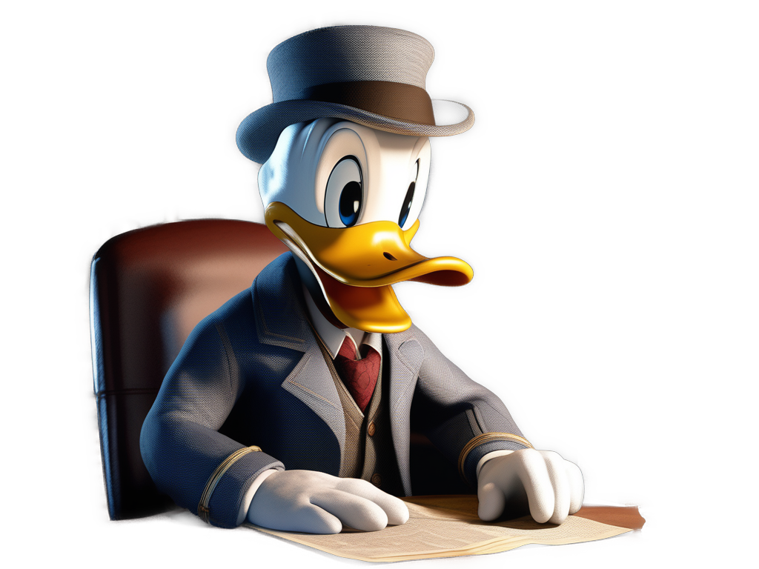
Family Activities
Can’t understand what a “GLEERSAC” is. Is that even a word? Well, I can see lots of others there. The Word Search Lady says they all go left to right, down, or diagonal. But no backwards words. Can you find more than that other class does? Get help and more fun stuff at https://tinyurl.com/3r9c5suh

Slide 23
Barak
July 28

