Slide 1
Confidence in Seasons of Uncertainty
November 7

Slide 2
Video Introduction
View Video

Slide 3
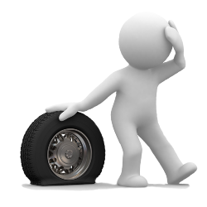
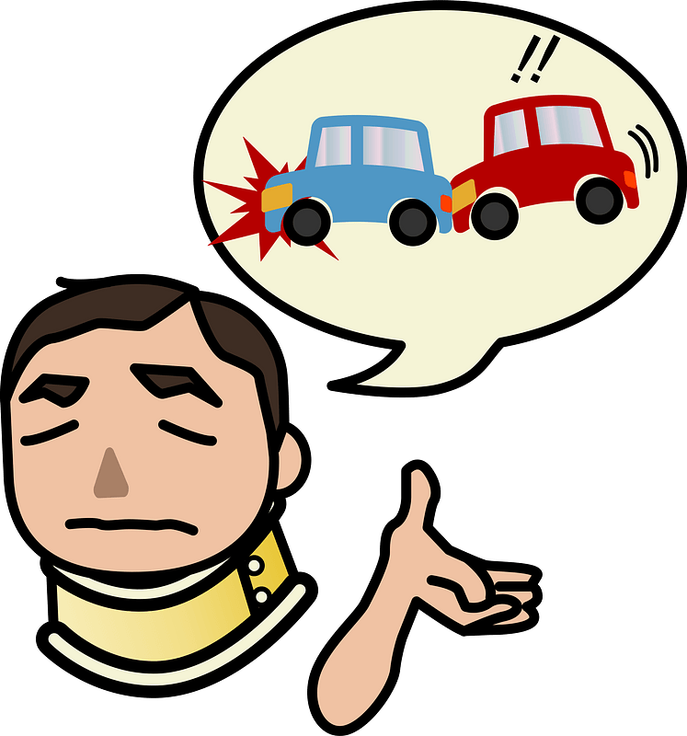
Remember that time?
When have you seen best-laid plans fall apart?
In the real world not everything happens like we hope and plan for.
Today we learn that God’s plans do work out in His time and His way.
Trust God when we don’t have all the answers.

Slide 4
Listen for encouragement given.
Genesis 15:1-5 (NIV) After this, the word of the LORD came to Abram in a vision: "Do not be afraid, Abram. I am your shield, your very great reward." 2 But Abram said, "O Sovereign LORD, what can you give me since I remain childless and the one who will inherit my estate is Eliezer of Damascus?" 3 And Abram said, "You have given me no

Slide 5
Listen for encouragement given.
no children; so a servant in my household will be my heir." 4 Then the word of the LORD came to him: "This man will not be your heir, but a son coming from your own body will be your heir." 5 He took him outside and said, "Look up at the heavens and count the stars--if indeed you can count them." Then he said to him, "So shall your offspring be."

Slide 6
Trust when the Way Isn’t Clear
What promises did God make, and to whom did He make them?
What do you know about Abram and his wife that would have made it difficult to believe what God was telling him?
How do we determine the difference between worry and legitimate concern?
Worry | Legitimate Concern

Slide 7
Trust when the Way Isn’t Clear
God took Abram out to view the night sky as an object lesson to encourage him to trust God. What kind of images help or encourage you to trust God?
Notice that God did not give much detail of His plan and promise to Abram and Sarai. How can we obey without knowing much of the plan?

Slide 8
Trust when the Way Isn’t Clear
We infer that God spoke directly, audibly to Abram. How do Gods intentions and plans come to us today?
Why can we trust God even if His method of communicating is not as overt as to Abram?

Slide 9
Listen for the result of trusting God.
Genesis 15:6 (NIV) Abram believed the LORD, and he credited it to him as righteousness.

Slide 10
Trusting God Results in Righteousness
What did Abram do that pleased God so much?
We are told that Abram believed God and God credited to him as righteousness. How does that relate to believers today?
In addition to our salvation, what truths about God or from God should we be trusting in?
What obstacles get in the way of believing God? Why is it sometimes hard to trust God?

Slide 11
Listen for long term promises.
Genesis 15:12-16 (NIV) As the sun was setting, Abram fell into a deep sleep, and a thick and dreadful darkness came over him. 13 Then the LORD said to him, "Know for certain that your descendants will be strangers in a country not their own, and they will be enslaved and mistreated four hundred years. 14 But I will punish the nation they serve as

Slide 12
Listen for long term promises.
slaves, and afterward they will come out with great possessions. 15 You, however, will go to your fathers in peace and be buried at a good old age. 16 In the fourth generation your descendants will come back here, for the sin of the Amorites has not yet reached its full measure."

Slide 13
Trust God to Work in His Time
To what future events did the Lord allude in assuring Abram that one day the promise of the inheritance of the land would be fulfilled?
What are some things that help us build trust in God?
What makes it so hard to wait for God’s timing?

Slide 14
Trust God to Work in His Time
When have you experienced the reliability of God’s timing?
How has the Lord communicated to you to reassure you that His plan and promises are best and trustworthy?

Slide 15
Application
Look at your hands.
Uncertainty has the ability to make us act irrationally and take matters into our hands.
Take some time and evaluate where you might need to let go and place something back into the hands of God.

Slide 16
Application
Look at the stars.
Uncertainty can make us forgetful.
Before the day is over go outside if possible and look up in the sky.
Be reminded of the many promises of God that you may have forgotten over time.

Slide 17
Application
Look at your faith.
Uncertainty in our faith affects the way we respond to uncertainty in life.
Take some time and assess the foundation of your faith.
Then share your faith with someone else.

Slide 18
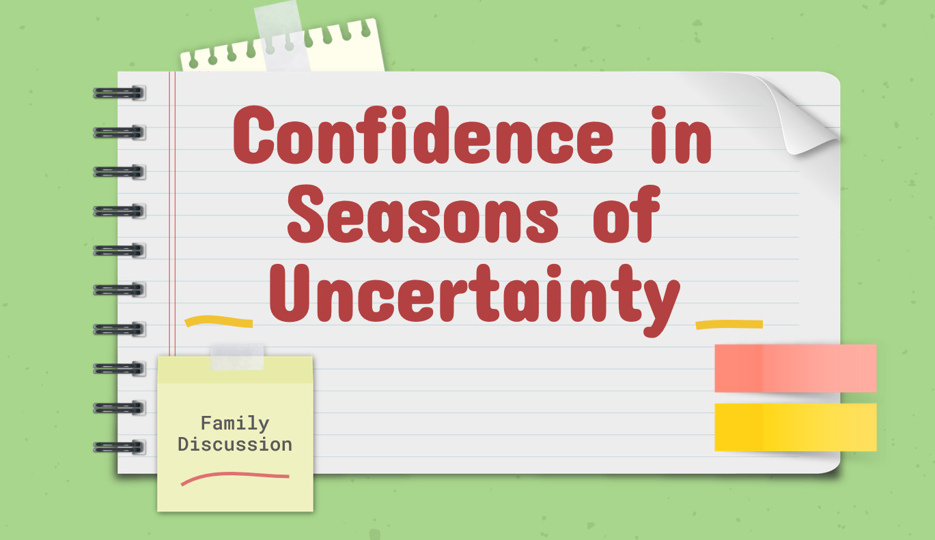
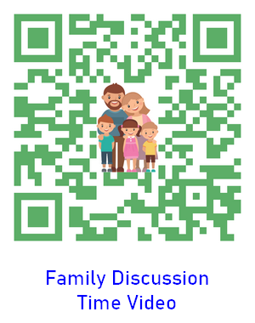
How can we have a family devotional time?
Consider the family discussion video which goes with this lesson!

Slide 19
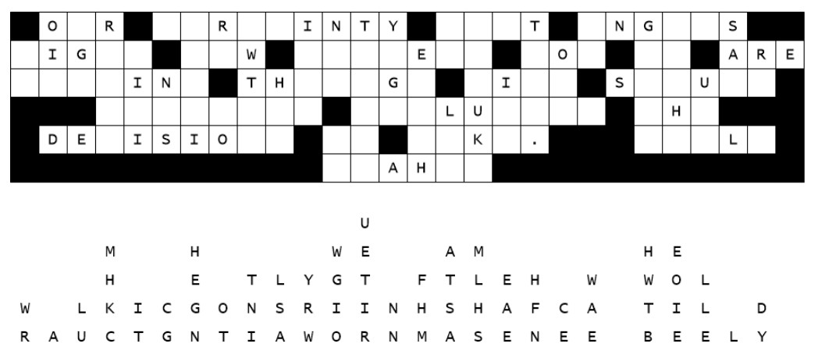
Family Activities
Hmmm … there are letters to move back into place. If you need help go to https://tinyurl.com/87fur6xb No doubt there are other mysteries to solve there as well.

Slide 20
Confidence in Seasons of Uncertainty
November 7

