Slide 1
Depend on God
July 28

Slide 2
Introduction
View Introduction Video

Slide 3
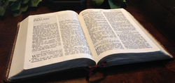
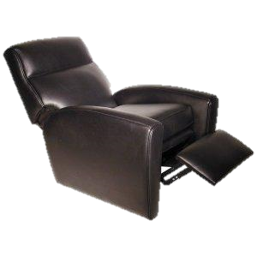
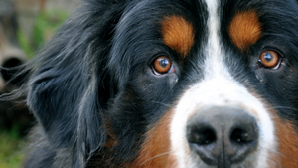
Think about it …
What’s the most dependable thing you’ve owned?
We depend on lots of different things … things we’ve listed … and things like electricity, water, and internet.
We need to learn to always depend on God.
God is greater than any challenge we face

Slide 4
Listen for King Asa’s response to trouble.
2 Chronicles 14:9-11 (NIV) Zerah the Cushite marched out against them with a vast army and three hundred chariots, and came as far as Mareshah. 10 Asa went out to meet him, and they took up battle positions in the Valley of Zephathah near Mareshah. 11 Then Asa called to the LORD his God and said,

Slide 5
Listen for King Asa’s response to trouble.
"LORD, there is no one like you to help the powerless against the mighty. Help us, O LORD our God, for we rely on you, and in your name we have come against this vast army. O LORD, you are our God; do not let man prevail against you."

Slide 6
When Problems Arise
After the ten-year period of peace, who came forward to threaten the peace and security Asa and the people of Judah enjoyed?
How was Asa’s going out to face Zerah an expression of his loyalty to the Lord?
Even as he positioned himself for battle, what did Asa choose to do first?

Slide 7
When Problems Arise
What words or statements in his prayer are affirmations of his faith in the Lord as his God?
When might you feel like the odds were stacked against you? When have you faced the reality of your own limitations?
What are possible meanings of the appeal “do not let man prevail against you”?

Slide 8
When Problems Arise
How does crying out to God actually help a person overcome his or her problems and enemies?
What does dependence on God look like in the daily routine of a believer?

Slide 9
When Problems Arise
One of our teacher resources says, “Rather than be passive against the threats of evil, people of God are to rise up and confront them.” What would be some examples of “threats of evil” God wants us to confront in our society?

Slide 10
Listen for the result of Asa’s dependence on God in this situation.
2 Chronicles 14:12-15 (NIV) The LORD struck down the Cushites before Asa and Judah. The Cushites fled, 13 and Asa and his army pursued them as far as Gerar. Such a great number of Cushites fell that they could not recover; they were crushed before the LORD and his forces. The men of Judah carried off a large amount of plunder.

Slide 11
Listen for the result of Asa’s dependence on God in this situation.
They destroyed all the villages around Gerar, for the terror of the LORD had fallen upon them. They plundered all these villages, since there was much booty there. 15 They also attacked the camps of the herdsmen and carried off droves of sheep and goats and camels. Then they returned to Jerusalem.

Slide 12
Facing Your Problems
Who is credited with the victory over the Ethiopians?
What essential role did Asa and his army play in the military campaign?
What words and phrases describe the utter defeat of the Ethiopians?

Slide 13
Facing Your Problems
Why do you think Asa and the people attacked and plundered Gerar and the other settlements of the region?
What was the return to Jerusalem a sign of?
What is the relationship between our role and God’s role in a crisis?
Our Role | God’s Role

Slide 14
Facing Your Problems
So, what does it mean and how does it work to depend on the Lord?
Maybe it’s not you struggling with a great challenge or difficulty. Perhaps someone close to you is the struggling one. What can you glean from this session that will help you offer encouragement to that individual?

Slide 15
Facing Your Problems
Even as your point them toward the Lord, refrain from …
Imposing guilt,
Minimizing the problem, or
Reprimanding him or her for her feelings of despair.

Slide 16
Application
Share.
Share with your group one of the challenges you are facing that, from your perspective, is an impossible challenge.
Ask them to pray with you regarding that situation.

Slide 17
Application
Invite.
Invite someone else to walk alongside you in a difficulty you’re facing.
Ask this person to “check in” with you regularly and encourage your continued trust in God.

Slide 18
Application
Retreat.
Take some dedicated time this week to have a personal prayer retreat.
Get away from any distractions. Leave your cell phone in your car.
Spend a few hours—or a full day—in dedicated prayer about the challenges you are facing.

Slide 19
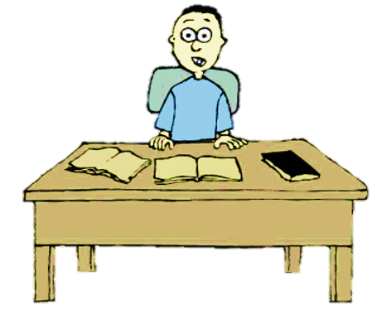
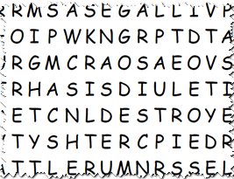
Family Activities
Whoa … even if I turn that around, it’s still all messed up. We need your help to find all the words taken from the Bible Study. If you need help, don’t ask the angry old lady. Go to https://tinyurl.com/y3kbm85k for assistance and for other interesting family activities.
Humph!

Slide 20
Depend on God
July 28

