Slide 1
Develop Strong Convictions
September 3

Slide 2
Video Introduction
Show Video

Slide 3
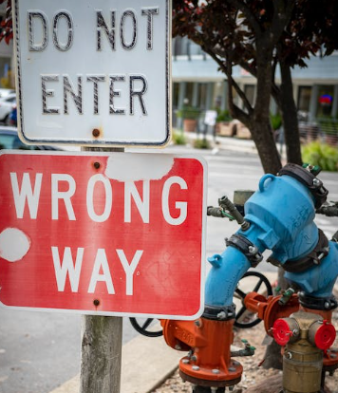
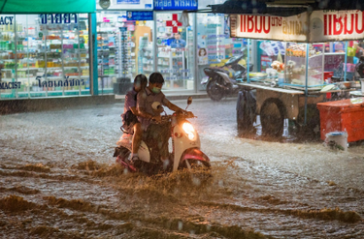
Think about it …
When have you felt you were going against the flow?
God calls us to live our lives with uncompromising conviction.
Daniel and three other young Jewish boys faced a culture that was totally different
Our convictions, not our circumstances, define who we are.

Slide 4
Listen for criteria for royal service.
Daniel 1:3-7 (NIV) Then the king ordered Ashpenaz, chief of his court officials, to bring in some of the Israelites from the royal family and the nobility-- 4 young men without any physical defect, handsome, showing aptitude for every kind of learning, well informed, quick to understand,

Slide 5
Listen for criteria for royal service.
and qualified to serve in the king's palace. He was to teach them the language and literature of the Babylonians. 5 The king assigned them a daily amount of food and wine from the king's table. They were to be trained for three years, and after that they were to

Slide 6
Listen for criteria for royal service.
enter the king's service. 6 Among these were some from Judah: Daniel, Hananiah, Mishael and Azariah. 7 The chief official gave them new names: to Daniel, the name Belteshazzar; to Hananiah, Shadrach; to Mishael, Meshach; and to Azariah, Abednego.

Slide 7
Culture Expects Conformity
What were the king’s qualifications for choosing young Israelite men?
What was the training plan for the young men chosen?
The training and environment was meant to “lull” the Hebrew captives into blending with his culture. How does our society lull us to blend in with the world’s mindset?

Slide 8
Culture Expects Conformity
How do we counter these cultural influences in a Christian home?
Consider the admonition of Deut. 6:6-7 (NIV) These commandments that I give you today are to be upon your hearts. [7] Impress them on your children. Talk about them when you sit at home and when you walk along the road, when you lie down and when you get up.
All the time
Wherever you go
Whatever you are doing

Slide 9
Listen for how Danial took a risk.
Daniel 1:8-13 (NIV) But Daniel resolved not to defile himself with the royal food and wine, and he asked the chief official for permission not to defile himself this way. 9 Now God had caused the official to show favor and sympathy to Daniel, 10 but the official told Daniel,

Slide 10
Listen for how Danial took a risk.
"I am afraid of my lord the king, who has assigned your food and drink. Why should he see you looking worse than the other young men your age? The king would then have my head because of you." 11 Daniel then said to the guard whom the chief official had appointed over Daniel,

Slide 11
Listen for how Danial took a risk.
Hananiah, Mishael and Azariah, 12 "Please test your servants for ten days: Give us nothing but vegetables to eat and water to drink. 13 Then compare our appearance with that of the young men who eat the royal food, and treat your servants in accordance with what you see."

Slide 12
Draw the Line
What was Daniel’s resolve?
The official over Daniel was reluctant to change their diet. He was responsible for their good health. How did Daniel respond to the officials reservations.

Slide 13
Draw the Line
Daniel drew the line. In what kinds of situations might you have to draw the line to avoid adopting habits of the prevailing culture …
At Your Work? | In Your Neighborhood? | In a Social Organization?

Slide 14
Draw the Line
What risks do we run if we “draw the line” over a cultural issue we think is wrong for us to do?
How do you see that Daniel demonstrates both flexibility and strength in this situation?
Flexibility | Strength

Slide 15
Listen for the results of Daniel’s experiment.
Daniel 1:17-19 (NIV) To these four young men God gave knowledge and understanding of all kinds of literature and learning. And Daniel could understand visions and dreams of all kinds. 18 At the end of the time set by the king

Slide 16
Listen for the results of Daniel’s experiment.
to bring them in, the chief official presented them to Nebuchadnezzar. 19 The king talked with them, and he found none equal to Daniel, Hananiah, Mishael and Azariah; so they entered the king's service.

Slide 17
Trust the Lord
What skills did God give to the four men?
In evaluating the four men at the end of their training, what did Nebuchadnezzar conclude concerning them?
Note that they used their God given skills for the foreign king and in the midst of a pagan culture … without compromising their first allegiance to God.

Slide 18
Trust the Lord
What are some ways in which God equips us (as believers) to make a positive contribution to our culture ?
In what ways do you think their (and our) battle against culture is never over?
How might others benefit when we stand our ground?

Slide 19
Application
Analyze your own life situation.
Is God working in an unexpected way?
If so, pray and ask for His wisdom to see the bigger picture of what He is doing in your life.

Slide 20
Application
Think about your own life.
Is there an area in which you have compromised and adopted the world’s unbiblical values?
Pray and ask God for strength to know what to do in this situation.

Slide 21
Application
Tell your story.
Share with your family or friends, details of a time God led you into an unexpected or even uncomfortable place, opportunity, or situation.
But you later saw His hand at work.
Explain how this experience affected your life and your family.
Pray with them, thanking God for letting them be part of your faith journey.

Slide 22
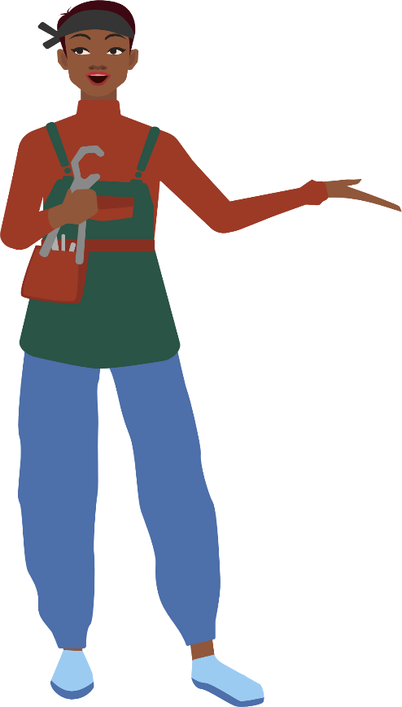
Family Activities
No, my dear, it is a coded message from the Deca Fanited consulate. Spiros sent it over for our group to decipher. You can find helps at https://tinyurl.com/ysp9y2sr Also, there are other fun Family Activities.
It looks like Klingon to me.

Slide 23
Develop Strong Convictions
September 3

