Slide 1
Does Absolute Truth Exist?
December 15

Slide 2
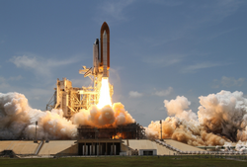
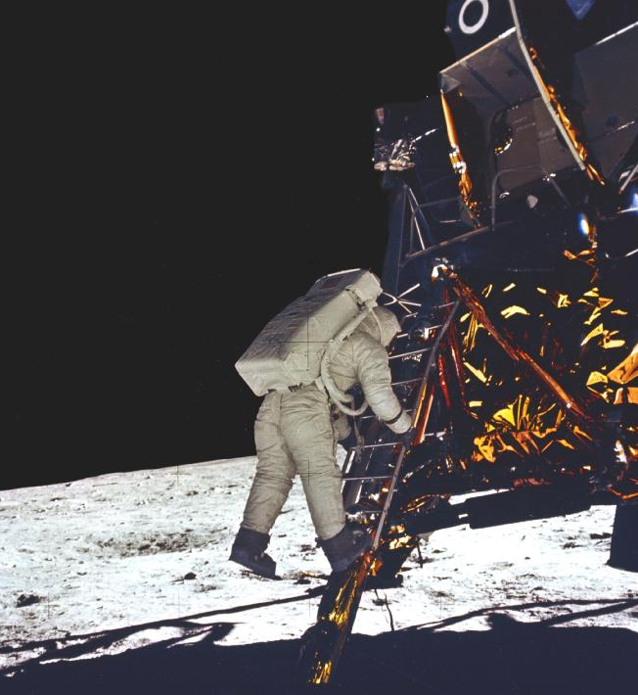
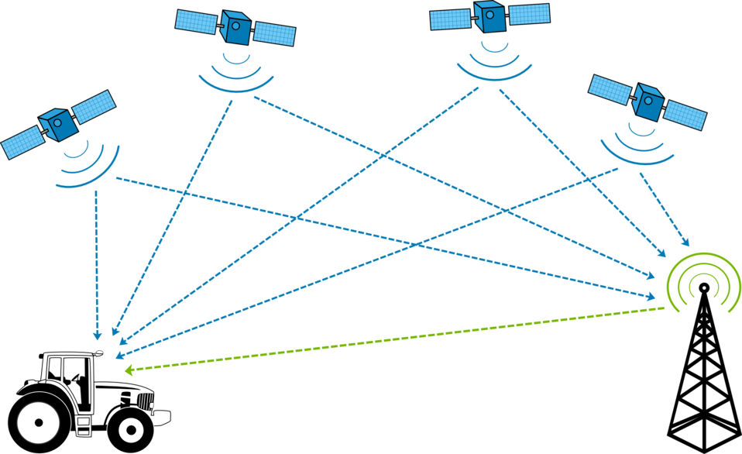
Think about it …
What fascinates you most about the space program?

Slide 3
The Point
Consider when it comes to a space launch, we must have everything absolutely correct.
You can’t “wing it” and do what feels OK
We require this form of absolute truth in science and physics
Yet many people believe Truth is subjective and personal for behavior or religion
Today we study the concept that absolute TRUTH is found in Jesus Christ

Slide 4
Listen for Pilate’s dilemma.
John 18:36-38 (NIV) Jesus said, "My kingdom is not of this world. If it were, my servants would fight to prevent my arrest by the Jews. But now my kingdom is from another place." 37 "You are a king, then!" said Pilate. Jesus answered

Slide 5
Listen for Pilate’s dilemma.
"You are right in saying I am a king. In fact, for this reason I was born, and for this I came into the world, to testify to the truth. Everyone on the side of truth listens to me." 38 "What is truth?" Pilate asked.

Slide 6
Can We Really Know the Truth?
Based on your memory of the Easter story, what is the setting of this conversation between Jesus and Pilate?
How did Jesus describe His kingdom (kingship)?
Why did He say He had come?

Slide 7
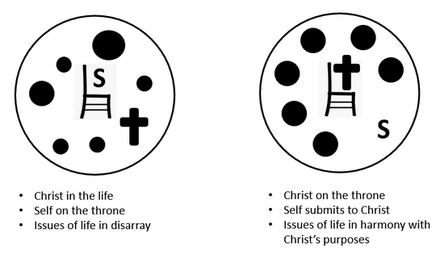
Can We Really Know the Truth?
Consider again the diagram from Campus Crusade which illustrates how Jesus desires to be King of our lives

Slide 8
Can We Really Know the Truth?
How does our culture answer the question: ‘What is truth?
What other sources of truth do people depend on today?
How would you answer the question, "What is truth?"

Slide 9
Can We Really Know the Truth?
Consider these definitions for Truth …
Truth is that which aligns with reality
Absolute truth is true for all people, for all places, and for all time.

Slide 10
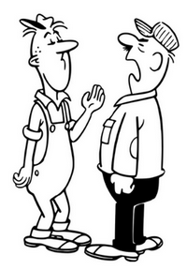
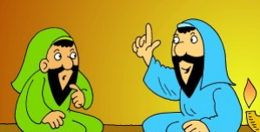
Can We Really Know the Truth?
Based on that definition, which of the following commands would be “Absolutely True” – for all people, all places, all time?
“No Right Turn on Red”
“Thou shalt not kill”
“Love your neighbor”
“You must be born again”

Slide 11
Listen for who reveals Truth.
John 1:14-18 (NIV) The Word became flesh and made his dwelling among us. We have seen his glory, the glory of the One and Only, who came from the Father, full of grace and truth. 15 John testifies concerning him. He cries out, saying, "This was he of whom I said, 'He who comes after me has surpassed me because he was before me.'"

Slide 12
Listen for who reveals Truth.
From the fullness of his grace we have all received one blessing after another. 17 For the law was given through Moses; grace and truth came through Jesus Christ. 18 No one has ever seen God, but God the One and Only, who is at the Father's side, has made him known.

Slide 13
Jesus Revealed Truth
What Old Testament image for the presence of the Lord is found in verse 14?
What was John the Baptist’s witness concerning Jesus?
What is the only way we are able to know God, see His glory, receive His grace, and know His truth?

Slide 14
Jesus Revealed Truth
How are grace and truth demonstrated in Christ?
How did Jesus reveal God’s glory and truth to us?
John 1:12 says, “Yet to all who did receive him, to those who believed in his name, he gave the right to become children of God” How should being a child of God affect our lives?
Grace | Truth

Slide 15
Listen for the impact of Truth.
John 8:30-36 (NIV) Even as he spoke, many put their faith in him. [31] To the Jews who had believed him, Jesus said, "If you hold to my teaching, you are really my disciples. [32] Then you will know the truth, and the truth will set you free." [33] They answered him, "We are Abraham's descendants and have

Slide 16
Listen for the impact of Truth.
never been slaves of anyone. How can you say that we shall be set free?" [34] Jesus replied, "I tell you the truth, everyone who sins is a slave to sin. [35] Now a slave has no permanent place in the family, but a son belongs to it forever. [36] So if the Son sets you free, you will be free indeed.

Slide 17
Truth Sets Us Free
So what is the impact or the result of holding to Christ’s teachings
Jesus’ Jewish listers were confused about becoming “free”. According to Jesus, what kind of slavery was He talking about? What was Jesus’ line of reasoning?

Slide 18
Truth Sets Us Free
In what way are people enslaved to sin today?
According to the passage, what will set us free from this kind of slavery?

Slide 19
Application
View Video

Slide 20
Application
Know.
Because the Bible teaches us how to live and points to the truth in Jesus, commit to read it through.
Discover what it says about matters of faith, ethics, and morality.

Slide 21
Application
Read.
Learn more about our need for truth in the book Unimaginable: What Our World Would Be Like Without Christianity by Jeremiah J. Johnston (Minneapolis, MN: Bethany House, 2017).

Slide 22
Application
Engage.
Talk with a friend who is not yet a believer.
Listen to his or her views on absolute truth and share how you found the truth in Christ.

Slide 23
Family Activities
No, the crossword puzzle was last week. This week it’s got some guy from the Food Channel with scrambled words along with his scrambled eggs. If you want to get the crossword puzzle, or do the color page, you can go to https://tinyurl.com/wtngtlw This is absolutely true!

Slide 24
Does Absolute Truth Exist?
December 15

