Slide 1
Does God Really Understand My Suffering?
February 9

Slide 2
Introduction Video
View Video

Slide 3
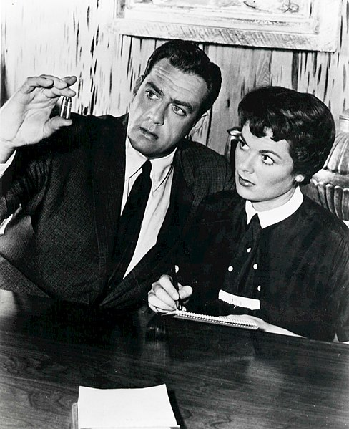
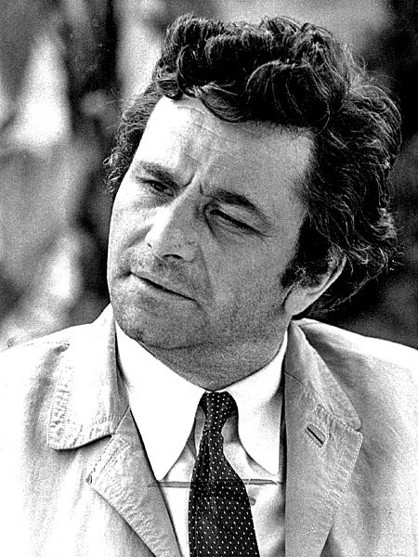
Think about it …
When has the ending to a story totally surprised you?

Slide 4
The Point
The Jews were totally surprised by the actual role of the Messiah
They were expecting a political and/or military hero for Israel
Instead He would win a spiritual victory for all peoples.
Today we consider the prophecy that Jesus would willingly experience pain and suffering for our salvation.

Slide 5
Listen for rejection.
Isaiah 53:2-4 (NIV) He grew up before him like a tender shoot, and like a root out of dry ground. He had no beauty or majesty to attract us to him, nothing in his appearance that we should desire him. 3 He was despised and rejected by men, a man of sorrows, and familiar with suffering

Slide 6
Listen for rejection.
Like one from whom men hide their faces he was despised, and we esteemed him not. 4 Surely he took up our infirmities and carried our sorrows, yet we considered him stricken by God, smitten by him, and afflicted.

Slide 7
Jesus Suffered from Rejection
What negative qualities of the Servant are described in this passage?
What are at least two benefits that came to the people because of the Servant’s suffering?
How do these verses remind you of events surrounding the death of Jesus?
What does rejection look like in our culture?

Slide 8
Jesus Suffered from Rejection
Note the phrase “we esteemed him not” … what are some synonyms of esteemed ?
Why do you think some people tend to despise or scorn those who suffer?
How does Jesus life and ministry on earth as a “suffering person” (not a conquering hero at the head of a heavenly army) help to encourage you with suffering in your life?

Slide 9
Listen for similarities to Jesus’ death.
Isaiah 53:5-9 (NIV) 5 But he was pierced for our transgressions, he was crushed for our iniquities; the punishment that brought us peace was upon him, and by his wounds we are healed. 6 We all, like sheep, have gone astray, each of us has turned to his own way; and the LORD has laid on him the iniquity of us all. 7 He was oppressed and afflicted, yet

Slide 10
Listen for similarities to Jesus’ death.
he did not open his mouth; he was led like a lamb to the slaughter, and as a sheep before her shearers is silent, so he did not open his mouth. 8 By oppression and judgment he was taken away. And who can speak of his descendants?

Slide 11
Listen for similarities to Jesus’ death.
For he was cut off from the land of the living; for the transgression of my people he was stricken. 9 He was assigned a grave with the wicked, and with the rich in his death, though he had done no violence, nor was any deceit in his mouth.

Slide 12
Jesus Suffered Affliction and Death
What are benefits noted here that come to people because of the Servant’s suffering?
How words or phrases remind you of events surrounding the death of Jesus?
Based on this passage and your knowledge about Jesus life, how was He misunderstood?

Slide 13
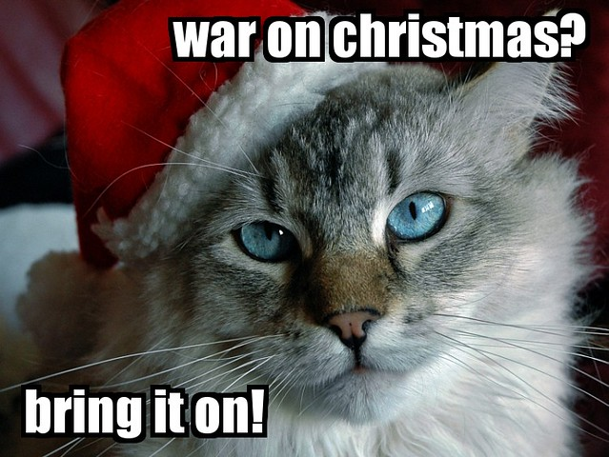
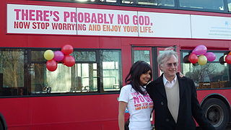
Jesus Suffered Affliction and Death
How is Jesus misunderstood in today’s culture?

Slide 14
Listen for further examples of suffering.
Isaiah 53:10-12 (NIV) Yet it was the LORD's will to crush him and cause him to suffer, and though the LORD makes his life a guilt offering, he will see his offspring and prolong his days, and the will of the LORD will prosper in his hand. 11 After the suffering of his soul, he will see the light [of life] and be satisfied; by his knowledge

Slide 15
Listen for further examples of suffering.
my righteous servant will justify many, and he will bear their iniquities. 12 Therefore I will give him a portion among the great, and he will divide the spoils with the strong, because he poured out his life unto death, and was numbered with the transgressors. For he bore the sin of many, and made intercession for the transgressors.

Slide 16
Jesus Suffered for Our Benefit
What is stated to be the Lord’s will?
Why did the Servant’s suffering to the point of death “please” the Lord? What did the Servant accomplish for transgressors by His suffering?
How does the description of Jesus’ suffering help us better understand Jesus as a human person?

Slide 17
Jesus Suffered for Our Benefit
Consider ways in which people suffer … sickness, tragedy, broken relationships, financial reversals, oppression, abuse. Why do you think Jesus is able to identify with suffering you might be experiencing?
How can we communicate God’s love and understanding when others are suffering?

Slide 18
Application
Give Thanks
As you pray, thank God for the suffering Christ endured for your salvation.
Thank Him that one day you will be free of all suffering and pain because of Christ.

Slide 19
Application
Accept Christ.
If you’ve never trusted in Christ and accepted His death on your behalf, pray and seek His forgiveness.
Trust Jesus to save you. Talk to your group leader or look on the inside front cover of your Bible Study guide for help.

Slide 20
Application
Share.
If you have a friend or family member whose circumstances make him or her cynical to the truth that God cares, tell that individual about the suffering of Christ.
Encourage this person to see God’s love and care as evidenced by the death of Jesus.

Slide 21
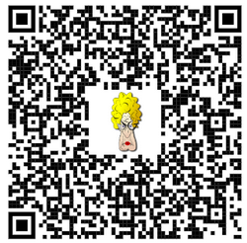
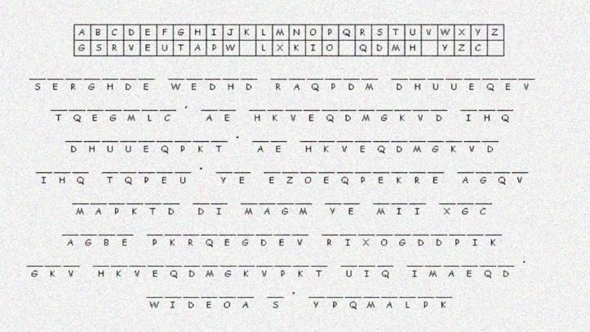
Family Activities
Your church security officer found this encrypted message. You are tasked with decoding it. Share it with everyone you can. And point them to the Family Activities page for more cool stuff.

Slide 22
Does God Really Understand My Suffering?
February 9

