Slide 1
Does It Lead You to Be More Like Jesus?
February 26

Slide 2
Video Introduction
View Video

Slide 3
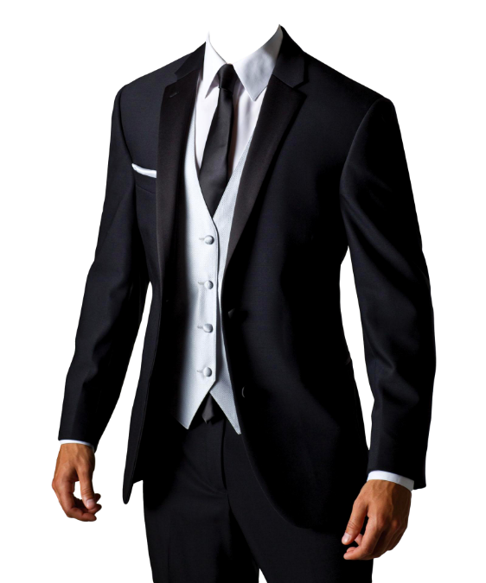
Think About It …
When have you seen someone undergo a complete transformation?
God wants to transform our lives.
God’s desire is to conform us to the image of Christ.

Slide 4
Hearts Set on Things Above
What kinds of things can change your perspective on an issue?
Listen for why to have a new perspective.

Slide 5
Listen for why to have a new perspective.
Colossians 3:1-4 (NIV) Since, then, you have been raised with Christ, set your hearts on things above, where Christ is seated at the right hand of God. 2 Set your minds on things

Slide 6
Listen for why to have a new perspective.
not on earthly things. 3 For you died, and your life is now hidden with Christ in God. 4 When Christ, who is your life, appears, then you also will appear with him in glory

Slide 7
Hearts Set on Things Above
What are Christians to desire (seek)?
What is the significance of Christ being at the right hand of God?
What are these “things above” that we should set our minds on?

Slide 8
Hearts Set on Things Above
Paul said in verse 3 “you died,” your “old self” is dead. That is true, but its influence is still often felt.
It is part of our physical, emotional make up
As long as we are still physically alive, desires still exist
Experientially, we still live with a sinful nature
Positionally, we stand before God as “new creations” – forgiven, justified, righteous
God promises freedom from both the penalty and the power of sin in our lives
Only when we get to heaven will we be free from the presence of sin

Slide 9
Hearts Set on Things Above
What evidence would cause people to say someone is more focused on things above and not on what’s here on earth?
How did God change your perspective, your focus after you became a Christian?
Saved as a teenager …
Saved as an adult …
Saved as a young child …

Slide 10
Listen for what to remove from your life.
Colossians 3:5-9 (NIV) Put to death, therefore, whatever belongs to your earthly nature: sexual immorality, impurity, lust, evil desires and greed, which is idolatry. 6 Because of these, the wrath of God is coming. 7 You used to walk in

Slide 11
Listen for what to remove from your life.
these ways, in the life you once lived. 8 But now you must rid yourselves of all such things as these: anger, rage, malice, slander, and filthy language from your lips. 9 Do not lie to each other, since you have taken off your old self with its practices.

Slide 12
Earthly Nature Put to Death
List the things which the believer is to put off, put to death, rid yourself of?
Put to Death | Rid Yourselves of

Slide 13
Earthly Nature Put to Death
Why do you think Paul equated greed with idolatry?
How/why do we sometimes justify holding on to aspects of our earthly nature?
How do you “put to death” things like lust or greed?

Slide 14
Listen for how to clothe ourselves.
Colossians 3:10-14 (NIV) and have put on the new self, which is being renewed in knowledge in the image of its Creator. 11 Here there is no Greek or Jew, circumcised or uncircumcised, barbarian, Scythian, slave or free, but Christ is all, and is in all. 12 Therefore, as God's chosen people,

Slide 15
Listen for how to clothe ourselves.
holy and dearly loved, clothe yourselves with compassion, kindness, humility, gentleness and patience. 13 Bear with each other and forgive whatever grievances you may have against one another. Forgive as the Lord forgave you. 14 And over all these virtues put on love, which binds them all together in perfect unity.

Slide 16
Cultivate Godly Character
What instructions do we see in verse 10?
Paul says to “put on” the new self … why would just “putting off” the old self not be enough?

Slide 17
Cultivate Godly Character
With what qualities of life should we clothe ourselves, according to this passage?
Note the similarity of this list with the Fruit of the Spirit found in Gal. 5:22
Clothe Yourselves with …

Slide 18
Cultivate Godly Character
If these are, indeed, Fruit of the Spirit, how do we “put them on” when they are qualities that are produced by God’s Holy Spirit? What is the Holy Spirit’s role? What is my role?
The Spirit’s Role | The Believer’s Role

Slide 19
Application
Put away.
Review the list of sins in this passage that you are called to remove.
Identify any you still need to eliminate, confess those sins to God, and choose to follow Him in obedience.

Slide 20
Application
Put on.
Review the list of traits in this passage that you are called to put on.
Identify specific ways you can exhibit these qualities to specific individuals.
Ask God to empower you to live these traits out for His glory.

Slide 21
Application
Reflect and share.
Meditate on the fact that you are chosen, holy, and dearly loved.
Write a paragraph describing how these three truths ought to influence how you live.
Share it with someone this week

Slide 22
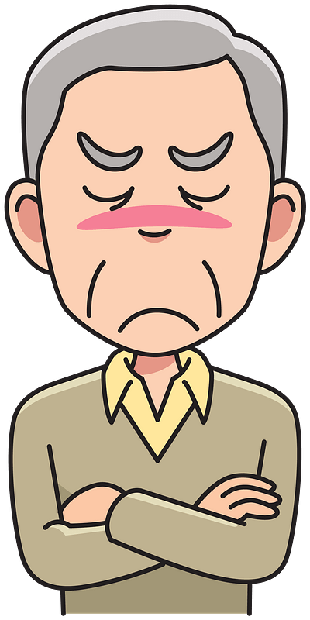
Family Activities
Have I got a CROSS word for you! Oh .. Oops. It’s a CROSSWORD. Sorry. Well, anyway, help is available at https://tinyurl.com/mrx2u2ya along with some other Fun Family Activities.

Slide 23
Does It Lead You to Be More Like Jesus?
February 26

