Slide 1
Eli and Samuel
June 18

Slide 2
Video Introduction
View Video

Slide 3
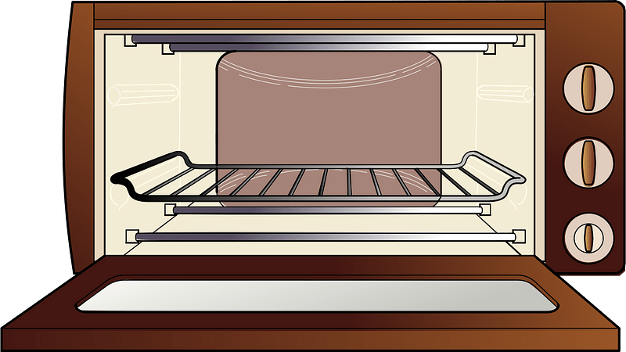
Remember that time?
What is something you learned through failure?
Today we consider Eli’s initial failure.
Yet he did do well in one task – mentoring Samuel.
Don’t let past mistakes prevent you from being an effective mentor.
This 60-page report is due tomorrow!

Slide 4
Listen for a response to reprimand.
1 Samuel 2:22-26 (NIV) Now Eli, who was very old, heard about everything his sons were doing to all Israel and how they slept with the women who served at the entrance to the Tent of Meeting. 23 So he said to them, "Why do you do such things? I hear from

Slide 5
Listen for a response to reprimand.
all the people about these wicked deeds of yours. 24 No, my sons; it is not a good report that I hear spreading among the LORD's people. 25 If a man sins against another man, God may mediate for him; but if a man sins against the LORD, who will

Slide 6
Listen for a response to reprimand.
intercede for him?" His sons, however, did not listen to their father's rebuke, for it was the LORD's will to put them to death. 26 And the boy Samuel continued to grow in stature and in favor with the LORD and with men.

Slide 7
Listening to Wise Counsel – or Not
Eli’s sons were involved in sexual misconduct. What did Eli do about his sons’ sinful practices?
How would you evaluate Eli’s response to the problem?
How might Eli have responded differently to reports of his sons’ behavior?
They rejected their father’s rebuke. What would be the inevitable result?

Slide 8
Listening to Wise Counsel – or Not
Eli’s sons rejected their father’s counsel. Where do some people in our culture prefer to find counsel?
Why do people ignore wise counsel?

Slide 9
Listen for Eli’s direction to Samuel.
1 Samuel 3:7-10 (NIV) Now Samuel did not yet know the LORD: The word of the LORD had not yet been revealed to him. 8 The LORD called Samuel a third time, and Samuel got up and went to Eli and said, "Here I am; you called me." Then Eli realized that the LORD was calling the boy. 9 So Eli

Slide 10
Listen for Eli’s direction to Samuel.
told Samuel, "Go and lie down, and if he calls you, say, 'Speak, LORD, for your servant is listening.'" So Samuel went and lay down in his place. 10 The LORD came and stood there, calling as at the other times, "Samuel! Samuel!" Then Samuel said, "Speak, for your servant is listening."

Slide 11
Helping to Discern God’s Counsel
We are told of the status of communication with God in those days.
Little direct personal communication with God
Samuel was young and inexperienced
God had yet to reveal Himself personally to Samuel

Slide 12
Helping to Discern God’s Counsel
Why might Samuel have mistakenly identified the call of the Lord for the cry of Eli?
How will God speak to us today?
What favorable advice did Eli offer?

Slide 13
Helping to Discern God’s Counsel
How can others help you discern God’s voice, God’s message to you?
How can we distinguish between God speaking and other voices competing for our attention?

Slide 14
Listen for Eli’s response to God’s message.
1 Samuel 3:15-18 (NIV) Samuel lay down until morning and then opened the doors of the house of the LORD. He was afraid to tell Eli the vision, 16 but Eli called him and said, "Samuel, my son." Samuel answered, "Here I am." 17 "What was it he said to you?“ Eli asked.

Slide 15
Listen for Eli’s response to God’s message.
"Do not hide it from me. May God deal with you, be it ever so severely, if you hide from me anything he told you." 18 So Samuel told him everything, hiding nothing from him. Then Eli said, "He is the LORD; let him do what is good in his eyes."

Slide 16
Share God’s Words with Others
How did Samuel feel about the message revealed from the Lord concerning the house of Eli?
How did Eli urge Samuel to speak openly and honestly?
How did Eli respond to the truth he heard?

Slide 17
Share God’s Words with Others
How can we follow Samuel’s example in sharing God’s Truth regardless of the consequences to us?
God continues to speak. What spiritual practices do you have in place to help you to continue recognizing the voice of the Lord when He speaks to you?

Slide 18
Application
Evaluate.
Evaluate how well you are listening for the voice of God.
Make a commitment to read God’s Word daily to gain insight and direction from His Word.

Slide 19
Application
Thank.
Thank others who have shared God’s Word with you and helped you discern God’s direction for your life.
In a note, email, or text, be specific how they have helped you.

Slide 20
Application
Speak up.
When you see others going astray from Scripture and God’s will for his or her life, talk with this person.
With gentleness and respect, encourage this individual to seek God, trust Him, and be obedient to Him.

Slide 21
Family Activities
A message and this decoding key was passed to one of our Baptist operatives in Slandsja Falombral. We require your help in decrypting the message. Help and further Family Activities can be found at https://tinyurl.com/yckmxbaz. The Color page is available for you folks there in the back row.

Slide 22
Eli and Samuel
June 18

