Slide 1
Embracing Joy
December 20

Slide 2
Video Introduction
View Video

Slide 3
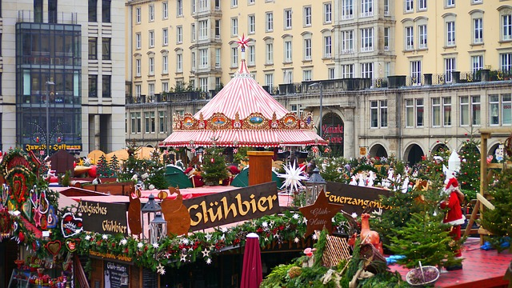
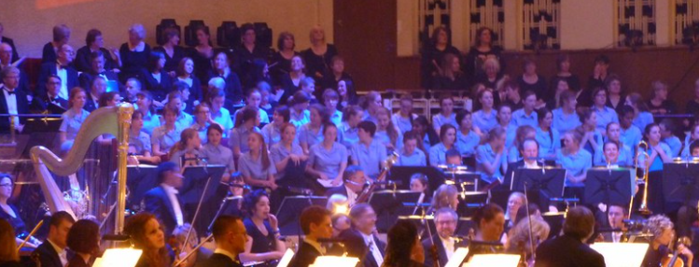
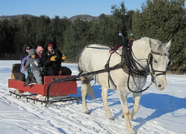
Just imagine …
What’s something you’d love to add to your celebration of Christmas?
Many of our wishes and our actual celebrations can bring us joy
We can experience true joy because Jesus saves.

Slide 4
Listen for an invitation.
Psalm 95:1-3 (NIV) Come, let us sing for joy to the LORD; let us shout aloud to the Rock of our salvation. 2 Let us come before him with thanksgiving and extol him with music and song. 3 For the LORD is the great God, the great King above all gods.

Slide 5
God, Our Salvation, Brings Joy
What is the nature of the invitation in these verses?
What words or phrases express the type of worship the psalmist urges?
Why is God to be worshiped?

Slide 6
God, Our Salvation, Brings Joy
What ways might this passage suggest that we worship God personally or privately?
What has recently led you to praise God? What motivates you to offer praise and thanksgiving to God today, right now?
How can believers express joy to the Lord in our daily lives?

Slide 7
Listen for difficulties of the trip described.
Luke 2:4-7 (NIV) So Joseph also went up from the town of Nazareth in Galilee to Judea, to Bethlehem the town of David, because he belonged to the house and line of David. 5 He went there to register with Mary, who was pledged to be married to him

Slide 8
Listen for difficulties of the trip described.
and was expecting a child. 6 While they were there, the time came for the baby to be born, 7 and she gave birth to her firstborn, a son. She wrapped him in cloths and placed him in a manger, because there was no room for them in the inn.

Slide 9
Jesus, Born to Bring Us Salvation
What event provided historical context for the account of Jesus’ birth?
What were the difficulties involved in this trip?
What suggests the birth was normal and common?

Slide 10
Jesus, Born to Bring Us Salvation
Yet, what elements in these verses suggest the birth was unusual? What are some things that are incongruous about the birth of the King of Kings?
If the birth of Jesus was so momentous, why was He born in such humble circumstances?

Slide 11
Listen for an important message.
Luke 2:8-14 (NIV) And there were shepherds living out in the fields nearby, keeping watch over their flocks at night. 9 An angel of the Lord appeared to them, and the glory of the Lord shone around them, and they were terrified. 10 But the angel said to them, "Do not be afraid. I bring you

Slide 12
Listen for an important message.
good news of great joy that will be for all the people. 11 Today in the town of David a Savior has been born to you; he is Christ the Lord. 12 This will be a sign to you: You will find a baby wrapped in cloths and

Slide 13
Listen for an important message.
lying in a manger." 13 Suddenly a great company of the heavenly host appeared with the angel, praising God and saying, 14 "Glory to God in the highest, and on earth peace to men on whom his favor rests."

Slide 14
Jesus’ Birth, Cause for Great Joy
List words of encouragement, joy, and celebration that appear in the angel’s announcement.
Why do you think God chose to reveal the birth of the Son of God to mere shepherds? (They were not considered high society – couldn’t even act as a witness in the courts)
⇨Jesus came for the rich and the poor, for the Jews and the Gentiles

Slide 15
Jesus’ Birth, Cause for Great Joy
Note the three titles given to the Baby. What is the significance of these titles?
Title | Significance
Savior
Christ
The Lord

Slide 16
Jesus’ Birth, Cause for Great Joy
How does God's sending the Christ Child 2000 years ago bring you joy today?
The shepherds received a joyful personal announcement about Jesus. How can we make the joy of Christmas personal to those around us?

Slide 17
Application
Accept.
Christ came to forgive you, restore you, and give you hope and a future.
If you have never trusted Christ for salvation, do so now.
Talk to your group leader or read the inside cover of your Personal Study Guide.

Slide 18
Application
Praise.
Make praise a regular part of your prayer time.
Don’t let your joy in Christ fade; instead, continually praise Him and remember all He has done.

Slide 19
Application
Share.
The greatest gift you can give someone this Christmas is the good news of why Jesus came to earth.
During this season, plan to tell someone in your family or a life-long friend who is yet to believe about the salvation and joy you experience because of Christ.

Slide 20
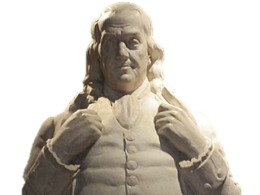
Family Activities
Ho, Ho, Ho … as it were. You can make Christmas more joyful if you take a look at the Family Activities page. Go to https://tinyurl.com/y5et6bl2 for help with your Double Puzzle and for other well thought out things to do. As I’ve said, “Be always ashamed to catch thyself idle.”

Slide 21
Embracing Joy
December 20

