Slide 1
Extending Grace
July 12

Slide 2

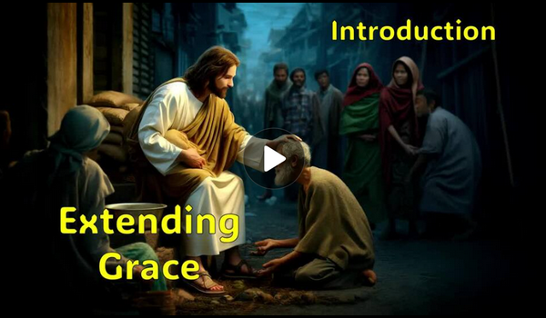
Video Introduction
View Video

Slide 3
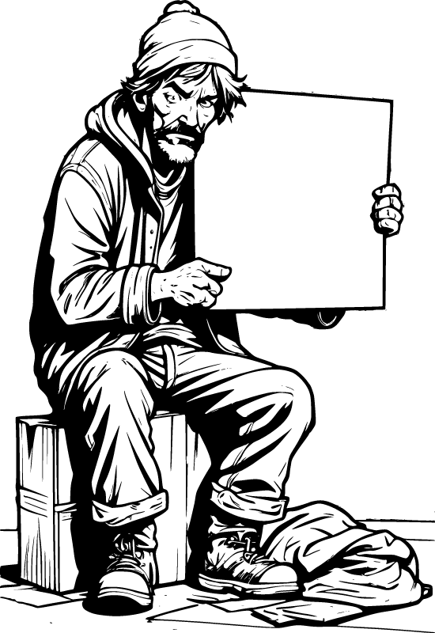


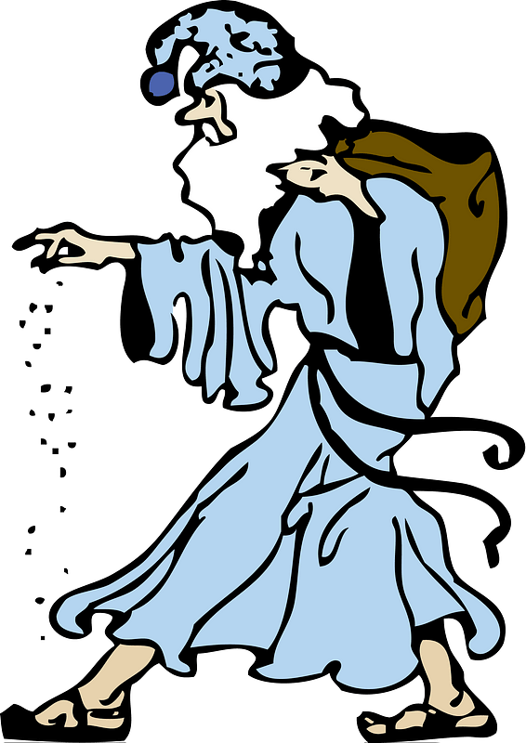

I can’t believe it …
What kind of reactions would you anticipate if a highly respected community leader chose to spend time with someone everyone else disliked?
That would be an example of one person extending grace to the other. That is, doing something nice that the other person did not deserve.
  Today we look at how Jesus extended grace.
  God calls us to do likewise.
Just meeting with my constituents …

Slide 4
Listen for vertical challenge.
Luke 19:1-4 (NIV) Jesus entered Jericho and was passing through. 2 A man was there by the name of Zacchaeus; he was a chief tax collector and was wealthy. 3 He wanted to see who Jesus was, but being a short man he could not, because of the crowd. 4 So he ran ahead and climbed a sycamore-fig tree to see him, since Jesus was coming that way.

Slide 5
A Seeker Looking for Jesus
How did Luke describe Zacchaeus?
Tax collectors were despised.
  Actually worked for the Roman government
  Thus were considered traitors
  Collected the specified tax but added their cut on top

Slide 6
A Seeker Looking for Jesus
Zacchaeus was wealthy and powerful. Why might someone with those advantages still be searching for something more?
What are some modern-day obstacles that keep people from getting a clear view of Jesus?

Slide 7
A Seeker Looking for Jesus
Zacchaeus was not well-liked by many people. How might our assumptions about certain people keep us from extending grace to them?
If Zacchaeus were living in our town today, what or who might keep him from getting to Jesus?

Slide 8
Listen for an invitation.
Luke 19:5-6 (NIV) When Jesus reached the spot, he looked up and said to him, "Zacchaeus, come down immediately. I must stay at your house today." 6 So he came down at once and welcomed him gladly.

Slide 9
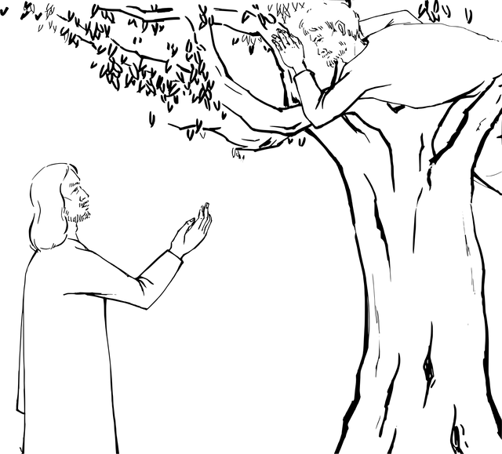
A Savior Looking for a Relationship
What specific words or phrases show that Jesus is taking the initiative?
Zacchaeus, come down immediately. I must stay at your house today

Slide 10
A Savior Looking for a Relationship
Why do you suppose Jesus stopped and invited Himself to Zacchaeus’ house, knowing people’s attitude about tax collectors?
What might Zacchaeus have been feeling when Jesus called his name?

Slide 11
A Savior Looking for a Relationship
In what ways does Jesus extend grace to Zacchaeus before Zacchaeus has done anything to deserve it?
Why do some people find it hard to believe that God wants a personal relationship with them?

Slide 12
Listen for a confession.
Luke 19:7-10 (NIV) All the people saw this and began to mutter, "He has gone to be the guest of a 'sinner.'" 8 But Zacchaeus stood up and said to the Lord, "Look, Lord! Here and now I give half of my possessions to the poor, and if I have

Slide 13
Listen for a confession.
cheated anybody out of anything, I will pay back four times the amount." 9 Jesus said to him, "Today salvation has come to this house, because this man, too, is a son of Abraham. 10 For the Son of Man came to seek and to save what was lost."

Slide 14
A Transformed Life Extending Grace
What are some ways we can tell that someone we know has been spiritually transformed?
How do we know Zacchaeus was serious, genuine about deciding to follow Jesus?
What do the actions of Zacchaeus reveal about the power of God to change hearts?

Slide 15



A Transformed Life Extending Grace
How can Christians encourage transformation in others without becoming judgmental? What practical ways can we show grace to someone who is trying to change?

Slide 16
Application
Walk.
  Avoiding sin is good, but we mustn’t isolate ourselves from unbelievers.
  We must guard against the view that some people are beyond God’s grace.
  If there are people you view that way, pray and ask God to forgive you.

Slide 17
Application
Run.
  Do you have any friends who are unbelievers?
  Make the effort to build a new relationship with an unbeliever.
  Be ready to be God’s conduit for His grace.

Slide 18
Application
Soar.
  Speak with your pastor or someone on church staff about possible mission opportunities.
  The North American Mission Board (NAMB) has short-term opportunities that can connect you with unbelievers.
  Commit to an opportunity that will allow you to share God’s grace with others.

Slide 19

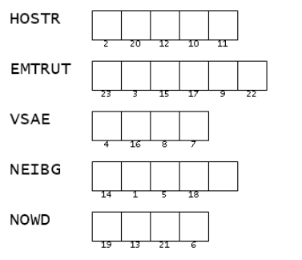

Family Activities
The Fonz
says, “Ayyyy,
just unscramble
the key words (from your
Bible passage) use the
numbers to decrypt the
message. Ayyyy !"

Slide 20
Extending Grace
July 12

