Slide 1
Faith on Display in Hard Times
Sept. 9

Slide 2
Video Introduction
View Video

Slide 3
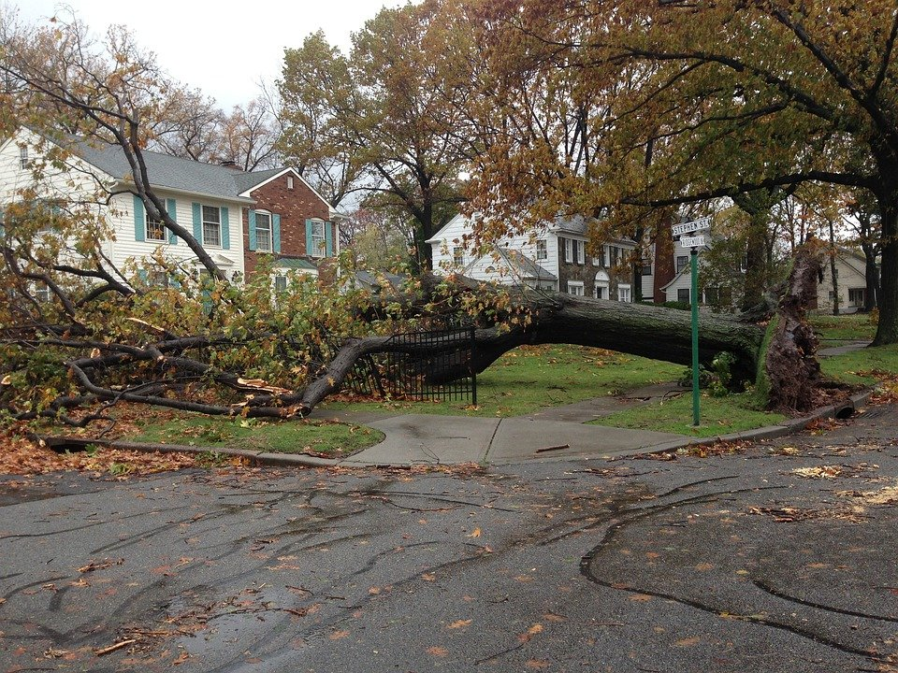
Think about it …
What’s an important lesson you’ve learned after coming through a tough experience?
Today we look at what James has to say about problems
How to respond
How God uses trials to mature your faith.

Slide 4
Listen for a source of joy.
James 1:2 – 4 (NIV) James, a servant of God and of the Lord Jesus Christ, To the twelve tribes scattered among the nations: Greetings. 2 Consider it pure joy, my brothers and sisters, whenever you face trials of many kinds,

Slide 5
Listen for a source of joy.
because you know that the testing of your faith produces perseverance. 4 Let perseverance finish its work so that you may be mature and complete, not lacking anything.

Slide 6
Trials Strengthen Your Faith
How are we to understand “temptations” or “trials”? How did James encourage his readers to respond to difficult times?
James says to “consider it pure joy” when you face trials. What keeps us from reacting with joy when pressures of life are overwhelming?

Slide 7
Trials Strengthen Your Faith
What are some common trials people experience in our world today?
James says the testing of your faith develops perseverance. Why do schoolteachers give tests?

Slide 8
Trials Strengthen Your Faith
God also allows us to go through times of testing. According to this passage, how are our “tests” from God different from a schoolteacher’s tests?
What good can you experience when you go through a difficult situation in your life?

Slide 9
Listen for God’s promise.
James 1:5 – 8 (NIV) If any of you lacks wisdom, you should ask God, who gives generously to all without finding fault, and it will be given to you. 6 But when you ask, you must believe and not doubt, because the one who

Slide 10
Listen for God’s promise.
doubts is like a wave of the sea, blown and tossed by the wind. 7 That person should not expect to receive anything from the Lord. 8 Such a person is double-minded and unstable in all they do.

Slide 11
Trials Require God’s Wisdom
James says we can pray for wisdom. Just what is wisdom?
What is God’s response when we ask for wisdom?
Why might you need God’s wisdom when you are in a difficult situation, a time of trial?

Slide 12
Trials Require God’s Wisdom
What might keep us from approaching God for help during a trial?
How can doubting affect a person’s prayer life?
What can a believer do to overcome doubts and discouragements as we seek God’s wisdom?

Slide 13
Listen for eternal rewards.
James 1:9 – 12 (NIV) Believers in humble circumstances ought to take pride in their high position. 10 But the rich should take pride in their humiliation—since they will pass away like a wild flower. 11 For the sun rises with scorching heat and withers the plant; its blossom falls and its beauty is

Slide 14
Listen for eternal rewards.
destroyed. In the same way, the rich will fade away even while they go about their business. 12 Blessed is the one who perseveres under trial because, having stood the test, that person will receive the crown of life that the Lord has promised to those who love him.

Slide 15
Trials Help Us Keep the Right Perspective.
Why do you think James says humble circumstances are a “high position”?
Why is dependence on wealth living a life of uncertainty?
What is the blessing promised to those who love the Lord?

Slide 16
Trials Help Us Keep the Right Perspective.
How does a view of eternity change the way you respond to trials?
If an unbeliever asked you why you still believe in God after a season of hardship, what would be your answer?

Slide 17
Application
Pray for strength.
In whatever trial you are facing, cry out to God for help.
“Seek the Lord while he may be found; call to him while he is near” (Isa. 55:6).
Our Lord has experienced trials just as we have, and He is sympathetic about our human weaknesses (Heb. 4:15).

Slide 18
Application
Ask for help.
It is easier for most believers to offer help to others than it is to ask for help.
If you are experiencing a difficult trial, reach out to a close friend, your Bible study leader, or pastor, and ask for their help.
They will be willing to help carry your burden (Gal. 6:2) just as you are willing to help others carry theirs.

Slide 19
Application
Look for the ministry opportunity in your pain.
After his career-ending amputation, Dave Dravecky and his wife began a ministry, endurance.org, to minister to people who are facing their own trials.
Find a way to use your pain to benefit others.

Slide 20
Family Activities
I heard the clue words were found in James 1:1 – 12 in the NIV. Otherwise, the clues are pretty vague. You can do this! Help is available at https://tinyurl.com/2bwten4m Oh yes, there’s a double puzzle available for those who always chew Double Bubble gum there on the back row.

Slide 21
Faith on Display in Hard Times
Sept. 9

