Slide 1
Faith on Display in Your Actions
September 18

Slide 2
Video Introduction
View Video

Slide 3
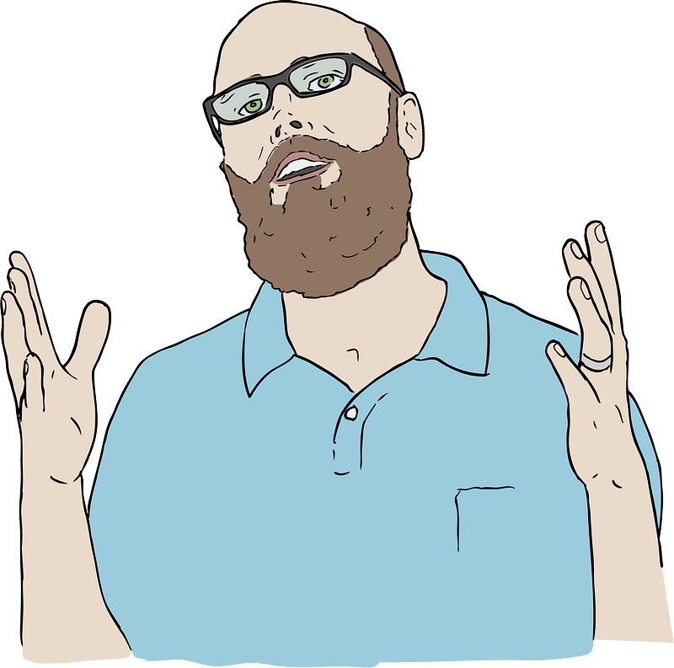
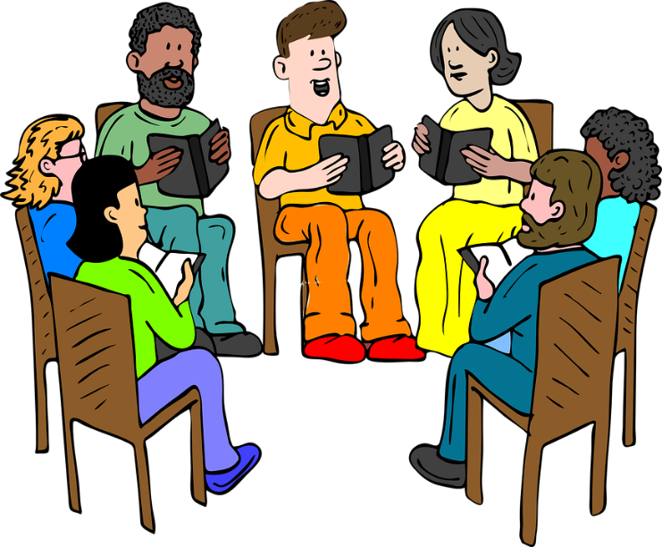
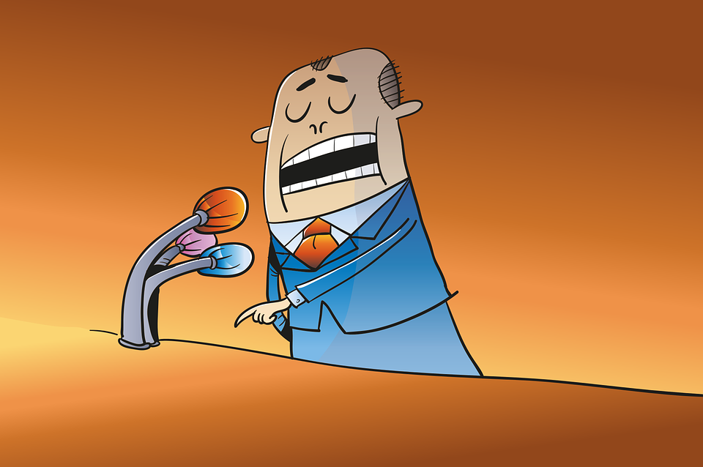
Tell us your definition …
What does it mean to “practice what you preach”?
Today our Bible study looks at what James says about faith and how you live.
What you believe is seen in what you do.

Slide 4
Listen for a warning about faith.
James 2:14-17 (NIV) What good is it, my brothers, if a man claims to have faith but has no deeds? Can such faith save him? 15 Suppose a brother or sister is without clothes and daily food. 16 If one of you says to him, "Go, I

Slide 5
Listen for a warning about faith.
wish you well; keep warm and well fed," but does nothing about his physical needs, what good is it? 17 In the same way, faith by itself, if it is not accompanied by action, is dead.

Slide 6
Faith without Action Is Useless
What two important theological concepts did James juxtapose in these verses?
Note some things Paul said about works or earning salvation
2 Tim 1:9 – “Saved us … not according to our works …”
Titus 3:5 – “Not by works of righteousness which we have done, but according to His mercy He saved us”

Slide 7
Faith without Action Is Useless
Ephesians 2:8-9 (NIV) For it is by grace you have been saved, through faith--and this not from yourselves, it is the gift of God-- 9 not by works, so that no one can boast.
Romans 3:20 – no one will be justified in His sight by the works of the law
Gal. 2:16 – know that a man is not justified by observing the law, but by faith in Christ

Slide 8
Faith without Action Is Useless
So, according to James, how are believers to understand the relationship of faith and works?
What illustration did James use to explain how real faith affects a person’s deeds?
How did James characterize faith that did not demonstrate itself with action? (check different Bible versions)

Slide 9
Faith without Action Is Useless
How is being a Christian supposed to change the way we live? What are the characteristics of faith that is not “dead” or “useless”, but “alive”?
James challenges us not to ignore needs of people around us. What kinds of help can believers provide others in need?

Slide 10
Listen for how actions demonstrate faith.
James 2:18-20 (NIV) But someone will say, "You have faith; I have deeds." Show me your faith without deeds, and I will show you my faith by what I do. 19 You believe that there is one God. Good! Even the demons believe that--and shudder. 20 You foolish man, do you want evidence that faith without deeds is useless?

Slide 11
Faith Is More Than Words or Ideas.
⇨Your belief about this person should be demonstrated by your actions.
James poses an imaginary debate. What was the assertion of James’s fictional opponent?
How did James respond to the supposed claim?
Suppose you claim, “I believe Henderson Dunkeld is the only man fit to be president.” How would you demonstrate your faith in that person for the office?

Slide 12
Faith Is More Than Words or Ideas.
We declare that Jesus is “the way, the truth, and the life.” What are some healthy ways we can demonstrate our faith in Jesus to a skeptical world?

Slide 13
Listen for examples of faith and works in action.
James 2:21-26 (NIV) Was not our ancestor Abraham considered righteous for what he did when he offered his son Isaac on the altar? 22 You see that his faith and his actions were working together, and his faith was made complete by what he did.

Slide 14
Listen for examples of faith and works in action.
23 And the scripture was fulfilled that says, "Abraham believed God, and it was credited to him as righteousness," and he was called God's friend. 24 You see that a person is justified by what he does and not by faith alone

Slide 15
Listen for examples of faith and works in action.
25 In the same way, was not even Rahab the prostitute considered righteous for what she did when she gave lodging to the spies and sent them off in a different direction? 26 As the body without the spirit is dead, so faith without deeds is dead.

Slide 16
Faith Leads to Obedience
Why was Abraham an apt example for showing the relationship between faith and works?
Why would Rahab be an unusual, yet appropriate example of a person with active faith?
How might faith impact our decisions or actions in today’s world?

Slide 17
Faith Leads to Obedience
Why do you suppose Abraham was called “God’s friend”?
What changes can we make in our lives to be seen as “God’s friend”?

Slide 18
Application
Read and Pray
Read Psalm 139:23-24: “Search me, God, and know my heart; test me and know my concerns. See if there is any offensive way in me; lead me in the everlasting way.”
Pray, asking God to expose areas in your life where you are not living what you claim to believe. After praying, develop a plan for life change to help align your actions with your faith.

Slide 19
Application
Write and reflect.
Create a “faith-in-action journal” in which you list at least five of your core beliefs.
Over the next week, write ways your actions show (or do not show) that you are applying those beliefs in your life.

Slide 20
Application
Ask and listen.
Ask a trusted friend to speak into your life and tell you how consistent you are at living your faith.
Listen to what they tell you.
Avoid getting defensive.
Prepare to make some life changes based on what you hear.

Slide 21
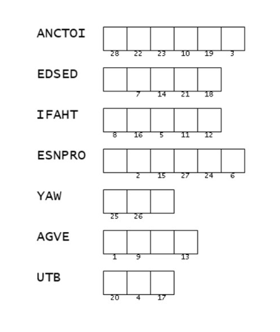
Family Activities
Aiee Cucaracha! What happened to those words. If you can rearrange them, it will help figger out the message. Those words are from today’s Bible passage. Help and more good stuff is at https://tinyurl.com/3tbhymzb

Slide 22
Faith on Display in Your Actions
September 18

