Slide 1
Faith on Display in Your Conversations
September 25

Slide 2
Video Introduction
View Video

Slide 3
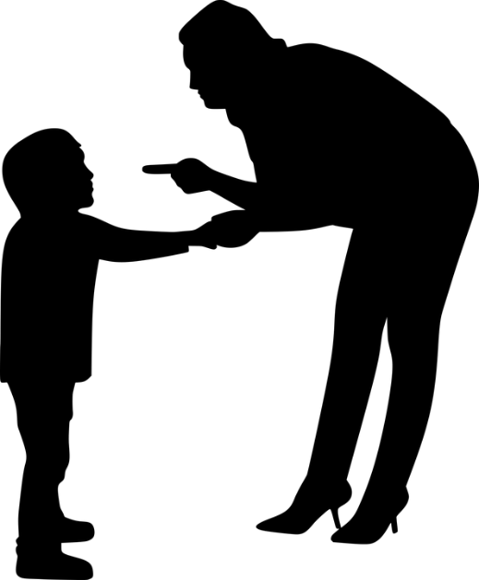
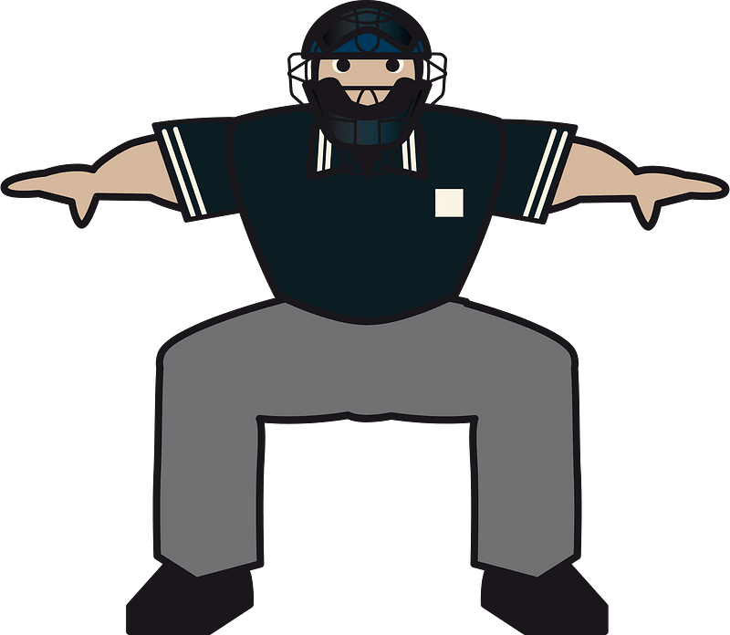
Admit it now …
If you could hear a tape recording of everything you said last week, what would you want to edit out?
Maybe you remember your parents saying “If you don’t have anything good to say, don’t say anything at all”
Today we look at how what we say needs to be more carefully controlled
When you rely on God, your words reflect His character.
He’s OUT! You’re a blind idiot! How stupid!

Slide 4
Listen for small things controlling big things.
James 3:1-5a (NIV) Not many of you should presume to be teachers, my brothers, because you know that we who teach will be judged more strictly. 2 We all stumble in many ways. If anyone is never at fault in what he says, he is a perfect man, able to keep his whole body in check. 3 When we put bits into the mouths of horses to make them

Slide 5
Listen for small things controlling big things.
obey us, we can turn the whole animal. 4 Or take ships as an example. Although they are so large and are driven by strong winds, they are steered by a very small rudder wherever the pilot wants to go. 5 Likewise the tongue is a small part of the body, but it makes great boasts.

Slide 6
There is Power in Your Words
Why do you think teachers are subject to a stricter accountability before the Lord?
What images did James employ to describe the power of the spoken word?
When have you seen the power of words impact someone in positive ways?
What does it mean to “control” something (for example a radio-controlled model airplane)?

Slide 7
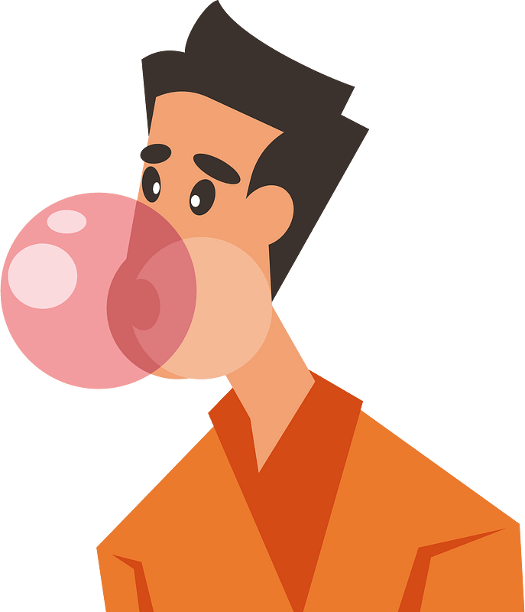
There is Power in Your Words
Why are the things we say hard to control ?
Consider the practice of chewing gum … What is the role of the tongue as you chew gum?

Slide 8
There is Power in Your Words
Maybe there are parallels between gum chewing and tongue mastery!
Keeping gum in mouth
Chewed gum sticks to things
Aid in blowing a “beautiful” bubble
Positioning gum
Keeping harmful words in
Harmful words stick in people’s minds
Aid in saying beautiful things
Declaring our position on an important issue

Slide 9
Listen for the incongruity of use of the tongue.
James 3:9-10 (NIV) With the tongue we praise our Lord and Father, and with it we curse men, who have been made in God's likeness. 10 Out of the same mouth come praise and cursing. My brothers, this should not be.

Slide 10
Inconsistent Words
Why is our blessing God and cursing others inconsistent?
How do inconsistencies show up in what we verbalize?
What can James’ mention of a “curse” mean?
How has technology amplified the power of words in recent years?

Slide 11
Inconsistent Words
Consider the word sins of criticism, gossip, and arguing. What should we do which are the opposite … things we say which result in praise and blessing, not evil and cursing?
Instead of criticism?
Instead of gossiping?
Instead of arguing?

Slide 12
Listen for different forms of wisdom.
James 3:13-18 (NIV) Who is wise and understanding among you? Let him show it by his good life, by deeds done in the humility that comes from wisdom. 14 But if you harbor bitter envy and selfish ambition in your hearts, do not boast about it or deny the truth. 15 Such "wisdom" does not come down from heaven but is earthly, unspiritual,

Slide 13
Listen for different forms of wisdom.
of the devil. 16 For where you have envy and selfish ambition, there you find disorder and every evil practice. 17 But the wisdom that comes from heaven is first of all pure; then peace-loving, considerate, submissive, full of mercy and good fruit, impartial and sincere. 18 Peacemakers who sow in peace raise a harvest of righteousness.

Slide 14
Wise Words
How can a truly wise person be identified?
Let’s list what James says about the traits of earthly wisdom.
Now list the traits of wisdom from above.

Slide 15
Wise Words
How do these instructions relate to the instructions concerning the use of the tongue?
What life experiences increase our heavenly wisdom?

Slide 16
Application
Memorize
Philippians 4:8. “Finally brothers and sisters, whatever is true, whatever is honorable, whatever is just, whatever is pure, whatever is lovely, whatever is commendable—if there is any moral excellence and if there is anything praiseworthy—dwell on these things.”

Slide 17
Application
Keep a gratitude journal.
Research showed that keeping a gratitude journal for two weeks decreased gossip in the workplace.
Spend a few minutes each day writing about people you are grateful for.

Slide 18
Application
Apologize to someone you know you have hurt through gossip or sarcasm.
Do what you can with a letter, phone call, or face-to-face meeting to seek forgiveness for words you have spoken.

Slide 19
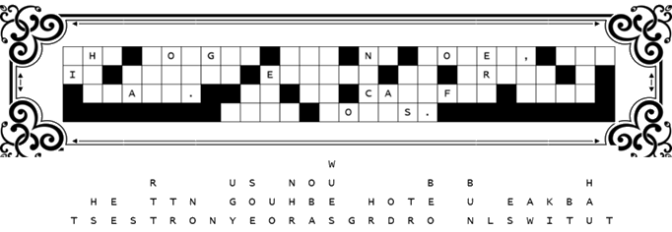
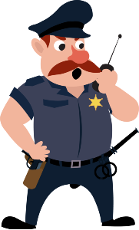
Family Activities
We need you to replace the letters which fell straight down. Go for short words. Figure out which letters make words that make sense. Help is available at https://tinyurl.com/35nmdmac Oh yes, the color page is available for you folks over there on the left.

Slide 20
Faith on Display in Your Conversations
September 25

