Slide 1
Fellowship with Believers
July 19

Slide 2

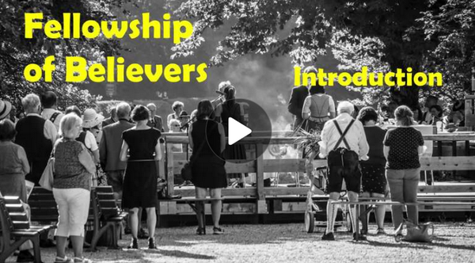
Video Introduction
View Video

Slide 3

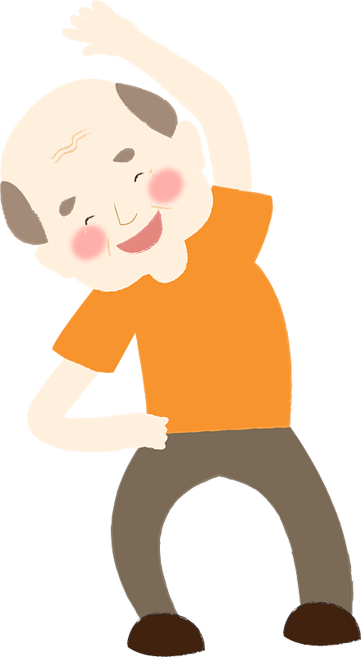
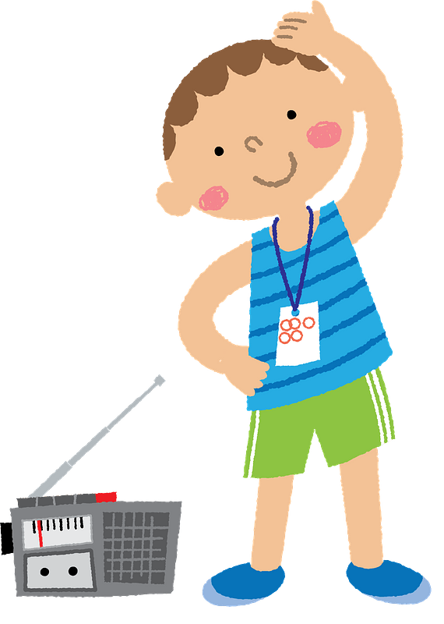
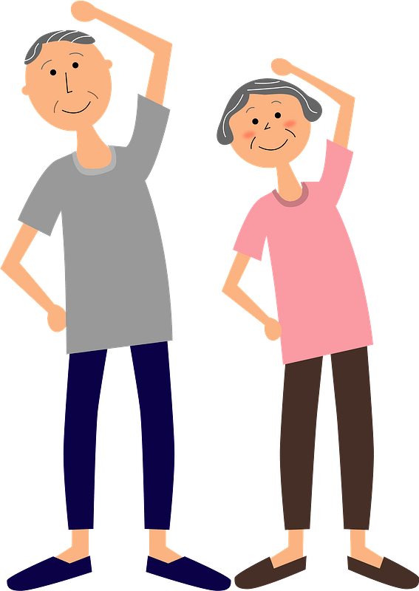

Think about it …
What are the benefits of exercising with others?
Believers who join together experience similar benefits.
  Accountability
  Encourage one another
  Appreciate the spiritual growth together
  A life in Christ is a life of fellowship with other believers.

Slide 4
Listen for a salutation.
1 Corinthians 1:1-3 (NIV) Paul, called to be an apostle of Christ Jesus by the will of God, and our brother Sosthenes, 2 To the church of God in Corinth, to those sanctified in Christ Jesus

Slide 5
Listen for a salutation.
and called to be holy, together with all those everywhere who call on the name of our Lord Jesus Christ--their Lord and ours: 3 Grace and peace to you from God our Father and the Lord Jesus Christ.

Slide 6
Shared Trust and Commitment to Jesus
Why was Paul doing what he was doing as an apostle?
To whom was Paul writing and how did he describe them?
What is his opening prayer for the Corinthian believers

Slide 7
Shared Trust and Commitment to Jesus
Paul prayed for grace and peace. In what ways do we experience these two qualities from God?
Grace | Peace

Slide 8
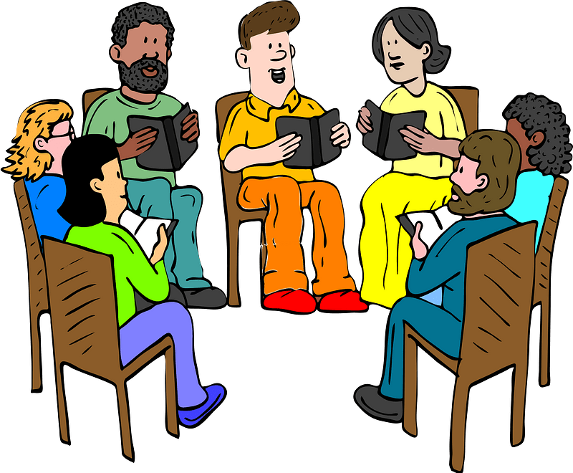
Shared Trust and Commitment to Jesus
Paul is writing to a church, a gathering of believers. What creates fellowship among followers of Jesus?

Slide 9
Listen for encouragement.
1 Corinthians 1:4-9 (NIV) I always thank God for you because of his grace given you in Christ Jesus. 5 For in him you have been enriched in every way--in all your speaking and in all your knowledge-- 6 because our testimony about Christ was confirmed in you. 7 Therefore you do

Slide 10
Listen for encouragement.
not lack any spiritual gift as you eagerly wait for our Lord Jesus Christ to be revealed. 8 He will keep you strong to the end, so that you will be blameless on the day of our Lord Jesus Christ. 9 God, who has called you into fellowship with his Son Jesus Christ our Lord, is faithful.

Slide 11
In Fellowship with Jesus
Paul begins by thanking God for the Corinthians. Why do you think he starts with gratitude rather than criticism, even though the church had many problems?
Paul says the Corinthians were "enriched in every way." What blessings do believers receive through Christ?

Slide 12
In Fellowship with Jesus
How can fellowship with Jesus affect our relationships with other believers?
What are some ways Christians can use their gifts to help others grow in their relationship with Christ?

Slide 13
In Fellowship with Jesus
Why is it important for our actions to support the message we profess to believe?
Paul describes believers as eagerly waiting for Jesus' return. How should that expectation affect the way we live today?

Slide 14
Listen for problems.
Why is it important for our actions to support the message we profess to believe?
Paul describes believers as eagerly waiting for Jesus' return. How should that expectation affect the way we live today?

Slide 15
Listen for problems.
1 Corinthians 1:10-13 (NIV) I appeal to you, brothers, in the name of our Lord Jesus Christ, that all of you agree with one another so that there may be no divisions among you and that you may be perfectly united in mind and thought. 11 My brothers, some from Chloe's household have

Slide 16
Listen for problems.
informed me that there are quarrels among you. 12 What I mean is this: One of you says, "I follow Paul"; another, "I follow Apollos"; another, "I follow Cephas"; still another, "I follow Christ." 13 Is Christ divided? Was Paul crucified for you? Were you baptized into the name of Paul?

Slide 17
Division over Preferences and Opinions
What specific problem were the Corinthian Christians having?
Why do you think these different factions or alignments happened?
How can division among Christians empty Christ’s message of its power?

Slide 18
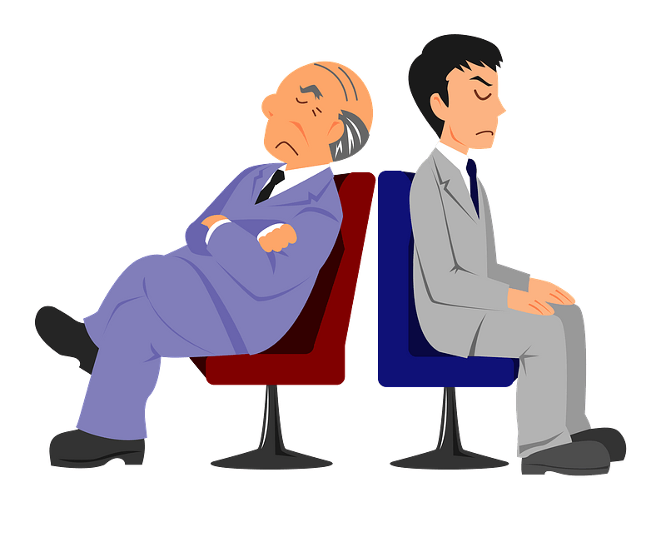
Division over Preferences and Opinions
In contrast, what witness does a unified church give to a lost world?
How can Christians avoid becoming distracted by petty disagreements?

Slide 19
Application
Confess.
  Have you looked down on someone with different preferences or interests than you?
  Confess that to God.
  Ask Him to help you see the individual as a fellow believer who loves Jesus.

Slide 20
Application
Meet.
  Choose someone in your church family you don’t know well.
  Start a conversation. Ask questions.
  Find common ground in your shared faith.

Slide 21
Application
Invite.
  As a group, write down ways you can deepen fellowship beyond your meeting time
  Like sharing meals, serving together, or praying for one another throughout the week.

Slide 22
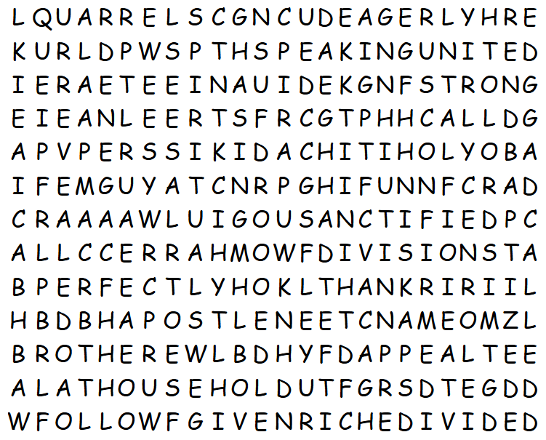
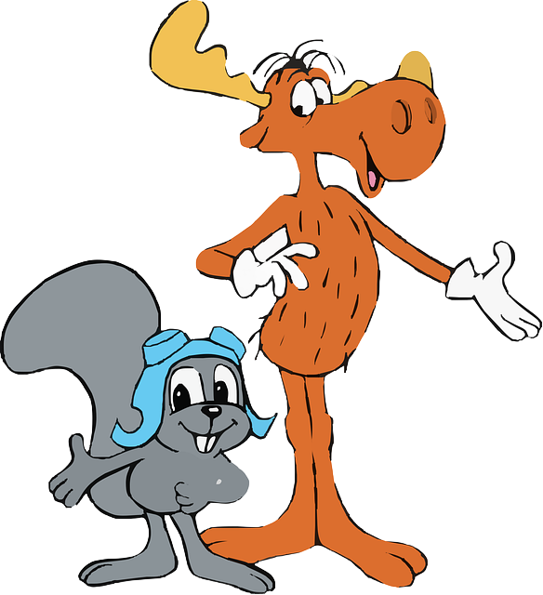
Family Activities
Bullwinkle, that’s not a word … and it’s not on the list. Not even a word in the Bible. If you need help, go to https://tinyurl.com/3ccmbzkc If you’d rather do the crossword, it is there also.
What’s a “YOBA”, Rocky?

Slide 23
Fellowship with Believers
July 19

