Slide 1

God Speaks
Through Circumstances
September 27

Slide 2

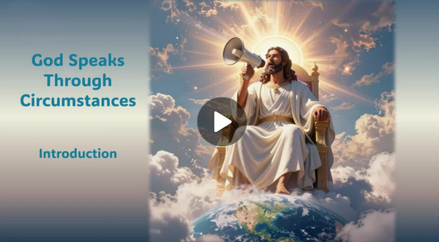
Video Introduction
View Video

Slide 3

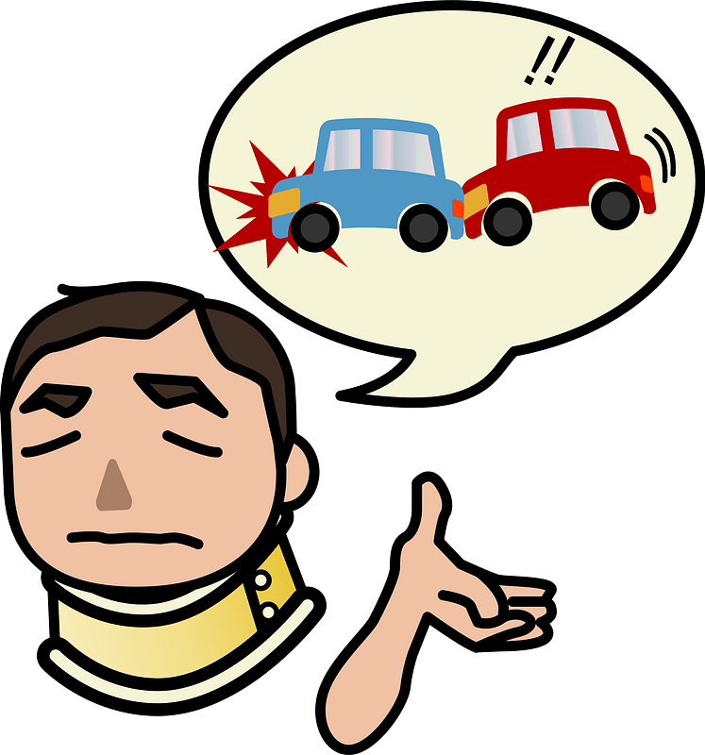
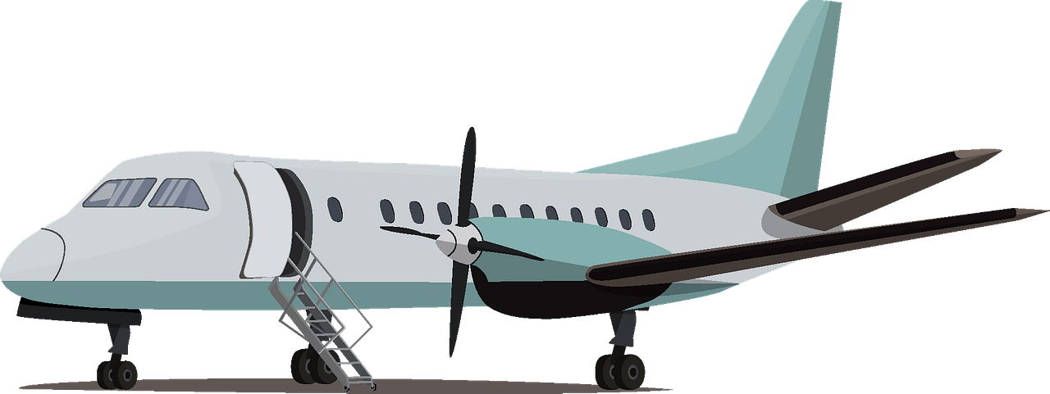

Remember that time?
When has an unexpected change of plans worked in your favor?

Slide 4
Listen for the Holy Spirit’s work on our behalf.
Romans 8:26-27 (NIV) In the same way, the Spirit helps us in our weakness. We do not know what we ought to pray for, but the Spirit himself intercedes for us with

Slide 5
Listen for the Holy Spirit’s work on our behalf.
groans that words cannot express. 27 And he who searches our hearts knows the mind of the Spirit, because the Spirit intercedes for the saints in accordance with God's will.

Slide 6
The Spirit Helps Us Pray
List the tasks of the Holy Spirit working for us.
The Spirit “intercedes” for us. What are some synonyms for the term “intercede”?
Why is such a person sometimes needed?
How might any of these things be true between us and God?

Slide 7
The Spirit Helps Us Pray
What kinds of situations do we face where we need God's Spirit to intervene for us?
How does the Spirit intercede on our behalf? What elements are described in the passage?
So, what should we do when we just don’t know how to pray?

Slide 8




The Spirit Helps Us Pray
Consider this prayer exercise:
  Imagine the problem being held in your closed hand
  Open your hand and tell God you are releasing it to Him
  In faith hold your open hand before you, telling God you are trusting Him to provide the resolution to the situation
  Hold your hand aloft in praise for His power, authority, and love at work in your life

Slide 9
Listen for all that God does for us.
Romans 8:28-30 (NIV) And we know that in all things God works for the good of those who love him, who have been called according to his purpose. 29 For those God foreknew he also predestined to be

Slide 10
Listen for all that God does for us.
conformed to the likeness of his Son, that he might be the firstborn among many brothers. 30 And those he predestined, he also called; those he called, he also justified; those he justified, he also glorified.

Slide 11
God Uses Our Circumstances
Sometimes the King James version of these verses are misquoted or misinterpreted.
  “We know all things work together for good …”
  Leaving off the qualifying phrase of who this is for.
  The assurance is given to “those who love God,” those “Called according to His purpose”

Slide 12
God Uses Our Circumstances
What does it mean to be “conformed to the image of his Son”?
What role does “circumstance” or “coincidence” play in determining God’s will?
How might you explain to a child or grandchild that can God produce good results out of bad situations?

Slide 13
Listen for how God is for us.
Romans 8:31-35 (NIV) What, then, shall we say in response to this? If God is for us, who can be against us? 32 He who did not spare his own Son, but gave him up for us all--how will he not also, along with him, graciously give us all things? 33 Who will bring any charge against those whom God has

Slide 14
Listen for how God is for us.
chosen? It is God who justifies. 34 Who is he that condemns? Christ Jesus, who died--more than that, who was raised to life--is at the right hand of God and is also interceding for us. 35 Who shall separate us from the love of Christ? Shall trouble or hardship or persecution or famine or nakedness or danger or sword?

Slide 15
Trust God to Work for Your Benefit.
According to this passage, what made Paul confident that God takes care of His people?
At what cost have we been declared righteous?
Who might Paul mean when he mentions those who might be “against us”?
How would you interpret the “all things” that Paul says God graciously gives us?

Slide 16
Application
View of God:
  Identify a circumstance that God used in your life to cause you to grow in Him.
  Pause and thank Him for His activity in your life.
  Write such things down in a book of remembrance.

Slide 17
Application
View of Self:
  What circumstance are you struggling to understand?
  Invite God to help you understand how He is redeeming it to make you more like Christ.

Slide 18
Application
View of Others:
  Share with others a series of circumstances God used to shape you and the direction of your life.
  Invite them to consider what God might be doing in their own lives right now.

Slide 19


Family Activities
This message came to us from a small church in Ashton-under-Flete. The congregation has sent us this communication to assure us of their firm and unwavering faith in God's power and sovereignty. Watson and I are presently occupied therefore, we must enlist your assistance. Dr. Watson informs me that technical help and further Fun Family Activities can be found at https://tinyurl.com/nerjnsdm

Slide 20
God Speaks
Through Circumstances
August 27

