Slide 1
God Speaks Through
His Holy Spirit
September 20

Slide 2


Video Introduction
View Video

Slide 3



Don’t miss that call …
When have you wished you’d realized when someone was trying to get your attention or communicate with you?

Slide 4
Don’t miss that call …
When have you wished you’d realized when someone was trying to get your attention or communicate with you?
Sometimes it is God who is trying to communicate with you.
  You want to be able to know what He is communicating.
  Today we consider the Truth of that the Holy Spirit will ensure God’s message is communicated.

Slide 5
Listen for the source of God’s message.
1 Corinthians 2:6-8 (NIV) We do, however, speak a message of wisdom among the mature, but not the wisdom of this age or of the rulers of this age, who are coming to nothing. 7 No, we speak of God's

Slide 6
Listen for the source of God’s message.
secret wisdom, a wisdom that has been hidden and that God destined for our glory before time began. 8 None of the rulers of this age understood it, for if they had, they would not have crucified the Lord of glory.

Slide 7
God Works in Us What We Cannot Do
How did Paul describe or define the substance of the message he and his coworkers preached in Corinth?
What are some different kinds of “wisdom” of this age?
What truths or wisdom about God seem hard to believe for people in our culture? How is it mysterious?

Slide 8
God Works in Us What We Cannot Do
What did Paul mean in describing the wisdom of God as mystery?
So who originated the message Paul preached, and when?
God’s Spirit did not reveal this “mystery” to religious leaders of Jesus day, did not convict/convince them of this reality. Why not?

Slide 9


Why?
Why are you sometimes able to almost “read the mind” of your spouse or your best friend? You can often predict what they will say, or both say the same thing together.

Slide 10
Listen for how you can know what God is thinking.
1 Corinthians 2:9-11 (NIV) However, as it is written: "No eye has seen, no ear has heard, no mind has conceived what God has prepared for those who love him"-- 10 but God has revealed it to us by his Spirit. The Spirit searches all things, even

Slide 11
Listen for how you can know what God is thinking.
the deep things of God. 11 For who among men knows the thoughts of a man except the man's spirit within him? In the same way no one knows the thoughts of God except the Spirit of God

Slide 12
Know the Mind of God
What do you think God has prepared for you that you can hardly imagine?
What is the essence of verse 9 and why is verse 10a essential to understanding Paul’s intent?
Who enables us to know and understand what God reveals?

Slide 13
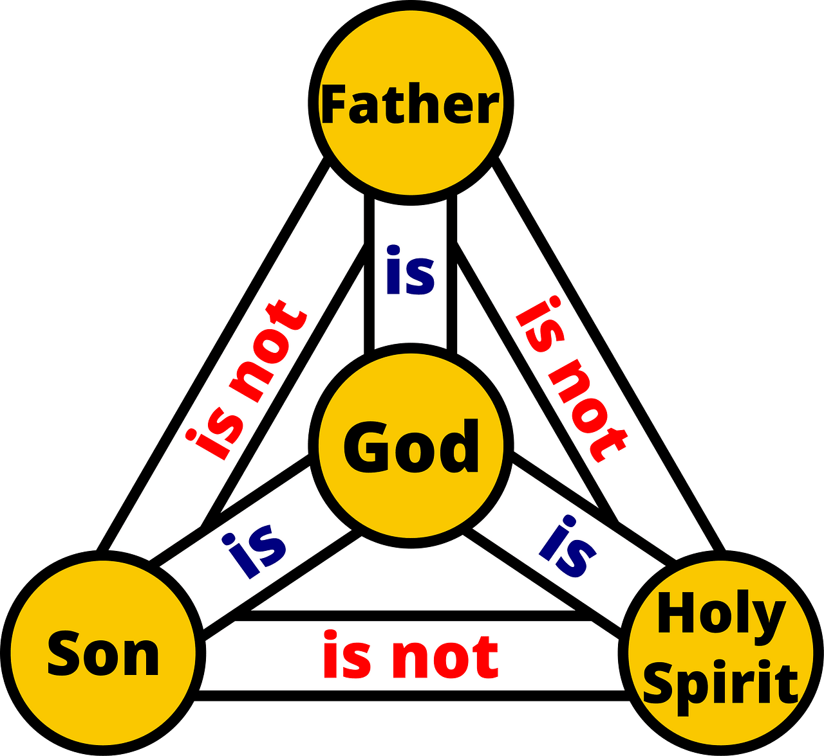
Know the Mind of God
Why is the Spirit capable of making known the things of God to us?
How do we put ourselves in a position to receive Truth from God?

Slide 14
Listen for a contrast, two kinds of people.
1 Corinthians 2:12-16 (NIV) We have not received the spirit of the world but the Spirit who is from God, that we may understand what God has freely given us. 13 This is what we speak, not in words taught us by human wisdom but in words taught by

Slide 15
Listen for a contrast, two kinds of people.
the Spirit, expressing spiritual truths in spiritual words. 14 The man without the Spirit does not accept the things that come from the Spirit of God, for they are foolishness to him, and he cannot understand them, because they

Slide 16
Listen for a contrast, two kinds of people.
are spiritually discerned. 15 The spiritual man makes judgments about all things, but he himself is not subject to any man's judgment: 16 "For who has known the mind of the Lord that he may instruct him?" But we have the mind of Christ.

Slide 17
The Spirit Helps Us Apply Scripture
How would you describe the “spirit of the world”?
Note the characteristics of the wisdom that the Spirit teaches us.
  Spiritual Truth has its own vocabulary
  It is not human wisdom, it is God’s wisdom
  It is not a case of the persuasion of logic or debate
  It is Truth that is revealed by God, that we accept by faith, because God said it

Slide 18
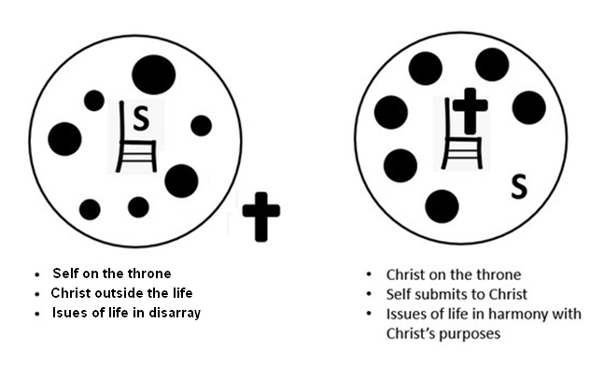
The Spirit Helps Us Apply Scripture
According to this passage, how are spiritual and unspiritual people different?
The “Natural” Man | The Spiritual Man

Slide 19

The Spirit Helps Us Apply Scripture
How can you know if you have the mind of Christ?

Slide 20
Application
View of God:
  Look over your checkbook and your calendar.
  Does your current sequence of choices reflect the wisdom of this world or the wisdom of God?

Slide 21
Application
View of Self:
  The Holy Spirit gives you understanding through God’s Word.
  Do you allow Him to guide your application, or do you rush off on your own?
  Write down some specific things He is calling you to.

Slide 22
Application
View of Others:
  What can you share with others about God’s activity in your life and what He may want to do in their lives?
  Schedule a coffee or lunch with someone God has placed on your heart this week and share what you’ve learned.

Slide 23



Family Activities
Pastor’s gettin’ twitchy, folks are gatherin’, and that sign’s gotta make sense again. Know what I mean, Vern?” Oh … another thing … don’t tell, but there’s a cheat sheet found at https://tinyurl.com/3tpnttk5 Me, I’m gonna’ try the color page.

Slide 24
God Speaks Through
His Holy Spirit
September 20

