Slide 1
God Speaks
Through the Bible
September 13

Slide 2

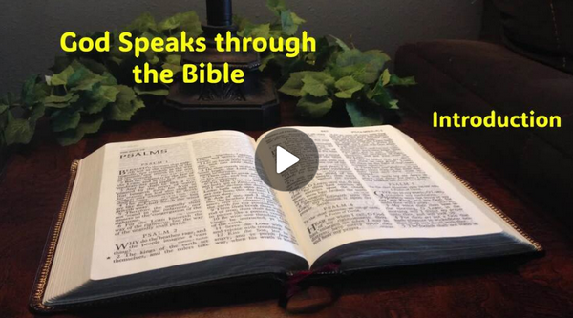
Video Introduction
View Video

Slide 3




Remember that time?
When have you really needed reliable instructions?
Often in our lives we feel the need for important directions or instructions for our lives
  What college major, who to marry, what job to take, what house to buy, …
  Today we consider how God speaks to us through His Word.

Slide 4
Listen for synonyms for the spoken/written word of God.
Psalm 19:7-9 (NIV) The law of the LORD is perfect, reviving the soul. The statutes of the LORD are trustworthy, making wise the simple. 8 The precepts of the LORD are right, giving

Slide 5
Listen for synonyms for the spoken/written word of God.
joy to the heart. The commands of the LORD are radiant, giving light to the eyes. 9 The fear of the LORD is pure, enduring forever. The ordinances of the LORD are sure and altogether righteous.

Slide 6
God’s Word is Powerful
So, what synonyms do you see for God’s Word?
What adjectives or descriptive words did David use in talking about God’s Word?
Why is this revelation from the Lord worthy of being studied and applied in our lives? What attitude did David have toward God’s law?

Slide 7
God’s Word is Powerful
What effects can it have? What role did God’s law play in David’s life?
Why do you think God has chosen to reveal His character and nature to us in His Word?

Slide 8
God’s Word is Powerful
How might God’s Word provide reliable guidance for your life? How have you experienced the benefits and blessings described in these verses?
What role can God’s Word play in your everyday life?

Slide 9
Listen for two metaphors.
Psalm 19:10-11 (NIV) They are more precious than gold, than much pure gold; they are sweeter than honey, than honey from the comb. 11 By them is your servant warned; in keeping them there is great reward.

Slide 10
God’s Word Brings Pleasure, Warning
The two metaphors suggest that God’s Word is like sweet honey and pure gold. How does each apply?
Honey | Pure Gold

Slide 11
God’s Word Brings Pleasure, Warning
What promises are associated with keeping the Word of God?
What kind of warnings does God give us in His Word?

Slide 12

God’s Word Brings Pleasure, Warning
So what rewards come to you as you keep God’s Word?
What steps could you take to be more open to the sweetness and high value of God’s Word?

Slide 13
Listen for David’s confession.
Psalm 19:12-14 (NIV) Who can discern his errors? Forgive my hidden faults. 13 Keep your servant also from willful sins; may they not rule over me. Then will I be blameless, innocent of great transgression. 14 May the words of my mouth and the meditation of my heart be pleasing in your sight, O LORD, my Rock and my Redeemer.

Slide 14
God’s Word Convicts and Guides
What commitment and confession does the psalmist make in concluding the psalm?
What does the psalmist (and we) need the Lord to do in relationship to his (our) sin?
What results from reading and applying or keeping God’s laws?

Slide 15

God’s Word Convicts and Guides
How is Scripture effective in keeping us from hidden faults and willful sins?
What facts do you know about a compass (not the device used in school for drawing circles)?
How does the Bible, God’s
Word act in a similar fashion?

Slide 16
Application
View of God:
  What Scripture verses has God used in your life to clearly demonstrate His will and His ways?
  Write these things down in a journal.
  What major adjustments need to happen so you can join Him in His agenda?

Slide 17
Application
View of Self:
  What passage of Scripture has God used to get your attention about your heart and your lifestyle?
  Write these things down in a journal.
  How has that impacted the way you are now living?

Slide 18
Application
View of Others:
  Gather with a few fellow Christians.
  What common themes emerge from your study of God’s Word?
  Is there a common application that can inform group action?
  If so, encourage one another in this journey.

Slide 19

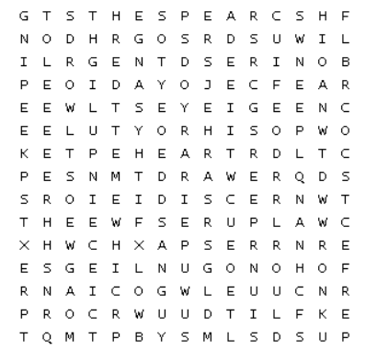
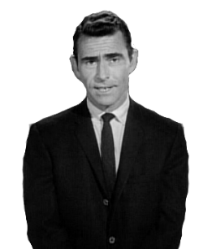
Family Activities
Somewhere within this innocent-looking word search lies a message—one meant to edify, to encourage, perhaps even to strengthen the soul. But evil Dr. Dufus has other ideas. He has hidden that message among the letters, challenging you to find it before it disappears into the shadows … in The Twilight Zone. Assistance (and other Fun Family Activities) available at https://tinyurl.com/5fjbb5mr

Slide 20
God Speaks
Through the Bible
September 20

