Slide 1
God Speaks to His People
September 6

Slide 2

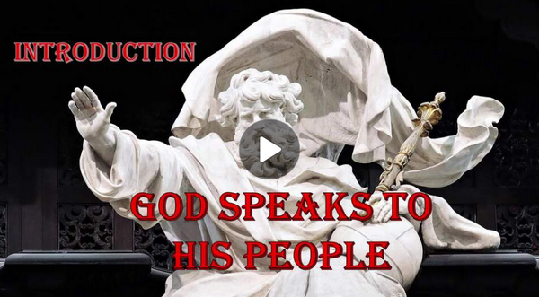
Video Introduction
View Video

Slide 3
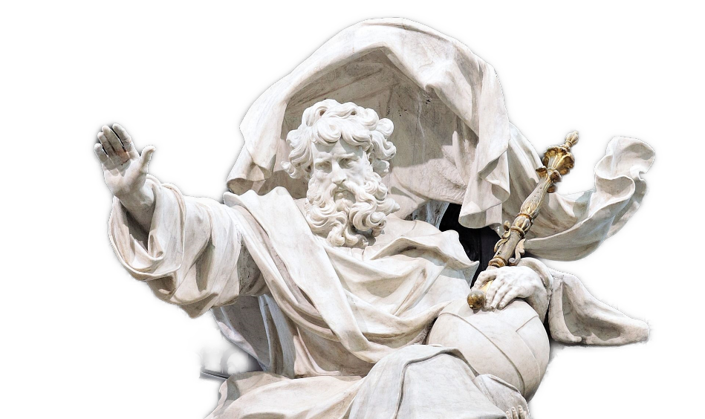
Just imagine …
When someone says “God is speaking,” what do you imagine that might look or sound like?
Be assured, God does not ignore us …
  He loves us enough to speak to us.
  He wants to communicate.

Slide 4
Listen for a fire alarm.
Exodus 3:1-6 (NIV) Now Moses was tending the flock of Jethro his father-in-law, the priest of Midian, and he led the flock to the far side of the desert and came to Horeb, the mountain of God. 2 There the angel of the LORD appeared to him in flames of fire from within a bush. Moses saw that

Slide 5
Listen for a fire alarm.
though the bush was on fire it did not burn up. 3 So Moses thought, "I will go over and see this strange sight--why the bush does not burn up." 4 When the LORD saw that he had gone over to look, God called to him from within the bush, "Moses! Moses!" And Moses said, "Here I am."

Slide 6

Listen for a fire alarm.
"Do not come any closer," God said. "Take off your sandals, for the place where you are standing is holy ground." 6 Then he said, "I am the God of your father, the God of Abraham, the God of Isaac and the God of Jacob." At this, Moses hid his face, because he was afraid to look at God.

Slide 7
God Takes the Initiative
Recall Moses’ history up to now:
  Raised as son of Pharaoh’s daughter
  In defending a fellow Israelite he commits 2nd degree murder against an Egyptian
  Fearing arrest, he flees to Midian, lives there 40 years, marries daughter of a priest
  Works as a shepherd

Slide 8
God Takes the Initiative
Where and how does God miraculously appear to Moses?
Moses is told to remove his sandals … “this is holy ground”. What does holy mean in reference to God?
What does it tell us about a holy God that He chose to speak to Moses while he was tending sheep in the wilderness?

Slide 9
God Takes the Initiative
The story seems to show that God came looking for Moses rather than Moses looking for God. In what ways does God reveal Himself to us to get our attention (other than burning bushes)?
What are some things which distract us from hearing what God has to say?
What can we do to make sure we are hearing God, even with all the distractions around us?

Slide 10
Listen for excuses.
Exodus 3:11-15 (NIV) But Moses said to God, "Who am I, that I should go to Pharaoh and bring the Israelites out of Egypt?" 12 And God said, "I will be with you. And this will be the sign to you that it is I who have sent you: When you have brought the people out of Egypt, you will

Slide 11
Listen for excuses.
worship God on this mountain." 13 Moses said to God, "Suppose I go to the Israelites and say to them, 'The God of your fathers has sent me to you,' and they ask me, 'What is his name?' Then what shall I tell them?" 14 God said to Moses, "I AM WHO I AM. This is what you are to say to

Slide 12
Listen for excuses.
the Israelites: 'I AM has sent me to you.'" 15 God also said to Moses, "Say to the Israelites, 'The LORD, the God of your fathers--the God of Abraham, the God of Isaac and the God of Jacob--has sent me to you.' This is my name forever, the name by which I am to be remembered from generation to generation.

Slide 13
Listen when God Speaks
What was the first question Moses raised with the Lord in response to God’s call?
How did God answer him?
What was the second question Moses asked?
What are some of the fears you think Moses was feeling?

Slide 14
Listen when God Speaks
How did God reassure Moses that he could face his challenge?
How can we know that God is there communicating to us, even if we don’t sense it or “feel” his presence?
When The God WHO IS speaks – pay attention!

Slide 15
Listen for God’s message communicated.
Exodus 4:28-31 (NIV) Then Moses told Aaron everything the LORD had sent him to say, and also about all the miraculous signs he had commanded him to perform. 29 Moses and Aaron brought together all the elders of the Israelites, 30 and Aaron told

Slide 16
Listen for God’s message communicated.
them everything the LORD had said to Moses. He also performed the signs before the people, 31 and they believed. And when they heard that the LORD was concerned about them and had seen their misery, they bowed down and worshiped.

Slide 17
Believe and Obey God
How did Aaron find out what God was doing?
What did Aaron and Moses communicate to the Israelite leadership
What was the response of the people?
How did this show that God speaks to comfort and encourage His people?

Slide 18
Believe and Obey God
How does worship express your confidence to God of His promises?
How does recalling God’s faithfulness to us inspire us to continue to listen to and obey Him?

Slide 19
Application
View of God:
  Reflect on a time when you sensed God speaking.
  What did that moment reveal about His character, His purposes, or His presence?
  Write down what you learned about
  who God is.

Slide 20
Application
View of Self:
  Trace a sequence of choices you made in response to God.
  How did your choices shape you?
  What do they reveal about how you see yourself?

Slide 21
Application
View of Others:
  Meet with a friend willing to share how God worked in his or her life.
  Consider: What does their story reveal about how God works?

Slide 22
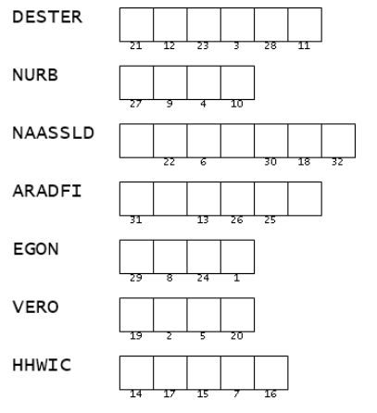

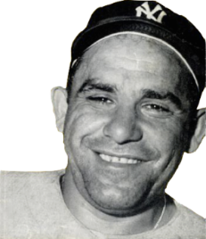
Family Activities
Don’t be a “NURB” … rearrange the letters and use the matching numbers to fill in the letters of the message.
If you are a NURB you can go to https://tinyurl.com/mw8k5mxp for help … and for the color page.
I think the clue words are from your scripture passage

Slide 23
God Speaks to His People
September 6

