Slide 1
God’s Hand in Restoring Lives
May 18

Slide 2
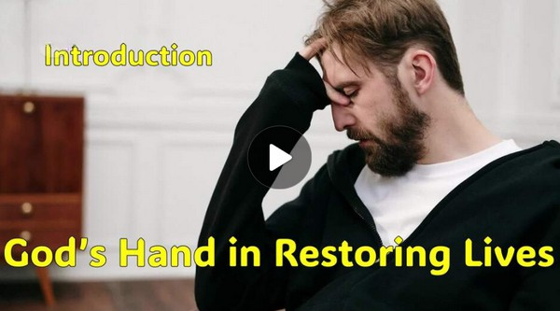
Video Introduction
View Video

Slide 3
Admit it now …
When have you literally or figuratively “misjudged a book by its cover”?
Today we look at a man who initially rejected Elisha’s ministry.
He ended up grudgingly going along with the instructions
He found (and we will find) God restores us as we are obedient to Him, no matter what we think initially.

Slide 4
Listen for an unlikely source of advice.
2 Kings 5:1-3 (NIV) Now Naaman was commander of the army of the king of Aram. He was a great man in the sight of his master and highly regarded, because through him the LORD had given victory to Aram. He was a valiant soldier, but he had

Slide 5
Listen for an unlikely source of advice.
leprosy. 2 Now bands from Aram had gone out and had taken captive a young girl from Israel, and she served Naaman's wife. 3 She said to her mistress, "If only my master would see the prophet who is in Samaria! He would cure him of his leprosy."

Slide 6
Listen for a Word from the Lord
What people are there and what are their roles in this scene?
What strengths did Naaman have that might have led him to believe he was above succumbing to sickness?
What made these things pale in significance and caused Naaman to be desperate?

Slide 7
Listen for a Word from the Lord
How do you think a skin disease with no known cure would affect a brave warrior? What kinds of attitudes would he have? What actions would he take?
What is remarkable about the wife’s servant girl sharing the help available from Elisha?

Slide 8
Listen for a Word from the Lord
How does it strike you that the first step toward Naaman’s healing came from a young Israelite slave girl? What does this say about how God uses unexpected people to accomplish His purposes?
What are some examples of how God could use someone unlikely in your life to point you toward Him or truth?

Slide 9
Listen for seven ducks in a muddy pond.
2 Kings 5:10-12 (NIV) Elisha sent a messenger to say to him, "Go, wash yourself seven times in the Jordan, and your flesh will be restored and you will be cleansed." 11 But Naaman went away angry and said, "I thought that he would surely come out to me and stand and call on the

Slide 10
Listen for seven ducks in a muddy pond.
name of the LORD his God, wave his hand over the spot and cure me of my leprosy. 12 Are not Abana and Pharpar, the rivers of Damascus, better than any of the waters of Israel? Couldn't I wash in them and be cleansed?" So he turned and went off in a rage.

Slide 11
Accept His Word as The Way
Naaman was a powerful man used to honor and ceremony. Why do you think he struggled with Elisha’s instructions?
What was Naaman expecting?
Why might Naaman have found the instruction to wash in the Jordan seven times offensive or beneath him?

Slide 12
Accept His Word as The Way
What does this reveal about human expectations versus God’s methods?
How can pride get in the way of obedience? How can our unwillingness to humble ourselves actually deprive us of good gifts from God?

Slide 13
Listen for good advice.
2 Kings 5:13-19a (NIV) Naaman's servants went to him and said, "My father, if the prophet had told you to do some great thing, would you not have done it? How much more, then, when he tells you, 'Wash and be cleansed'!" 14 So he went down and dipped himself in the Jordan seven times, as the

Slide 14
Listen for good advice.
man of God had told him, and his flesh was restored and became clean like that of a young boy. 15 Then Naaman and all his attendants went back to the man of God. He stood before him and said, "Now I know that there is no God in all the world except in Israel. Please accept now a gift from your servant." 16 The prophet

Slide 15
Listen for good advice.
answered, "As surely as the LORD lives, whom I serve, I will not accept a thing." And even though Naaman urged him, he refused. 17 "If you will not," said Naaman, "please let me, your servant, be given as much earth as a pair of mules can carry, for your servant will never again make burnt

Slide 16
Listen for good advice.
offerings and sacrifices to any other god but the LORD. 18 But may the LORD forgive your servant for this one thing: When my master enters the temple of Rimmon to bow down and he is leaning on my arm and I bow there also--when I bow down in the temple of Rimmon, may the LORD forgive your servant for this."

Slide 17
Obey His Word
Naaman’s servants gave good advice … what was it?
Naaman took the advice and was obedient to Elisha’s (God’s) direction. How did those around Naaman also experience the miracle of “7 ducks in a muddy pond?”

Slide 18
Obey His Word
Elisha refused Naaman’s gift or payment. What do you think Elisha wanted to communicate to Naaman by this refusal?
How can our obedience to God in the midst of illness or trouble impact those around us?

Slide 19
Application
Review.
Write down ways you demonstrate obedience to God during your weekly routine.
Beside each one, list a benefit you receive from your obedience.

Slide 20
Application
Request.
Spend time in prayer asking God to show you areas in your life where obedience is a struggle.
Pay close attention to those areas where pride can become a barrier.
Choose one area and make it a matter of ongoing prayer.

Slide 21
Application
Restore.
Enlist a brother or sister in Christ to hold you accountable for your obedience in an area in which it is difficult to obey.
Schedule meetings and give them permission to speak truthfully to you.

Slide 22
Family Activities
The Bureau’s decryption team is at a middle school end of semester retreat. They have created a coded message for you. This was one of their retreat learning activities. They also provided tech help and other Fun Family Activities at https://tinyurl.com/f8akfxpp

Slide 23
God’s Hand in Restoring Lives
May 18

