Slide 1

Jesus’ Teachings
at the Last Supper

Slide 2

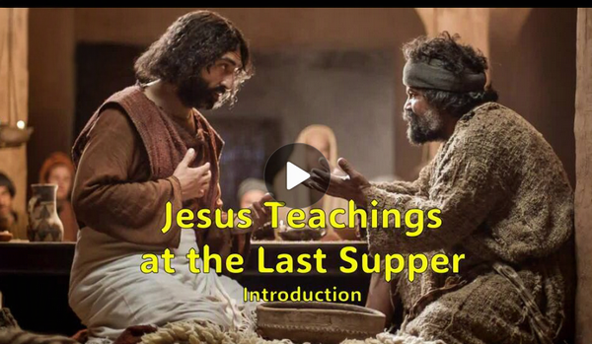
Video Introduction
View Video

Slide 3



It’s coming …
What activity or event are you looking forward to in the near future?

Slide 4
It’s coming …
What activity or event are you looking forward to in the near future?
We all have events in life that we anticipate with both expectation and maybe trepidation.
  One milestone event that faces every person in the world is the Second Coming of Jesus.
  Today we study Jesus teachings concerning this and other final communications to the disciples

Slide 5
1. Love Is the Mark Of Those
Who Belong to Jesus.

Slide 6
Listen for what is new.
John 13:34-35 (NIV) "A new command I give you: Love one another. As I have loved you, so you must love one another. 35 By this all men will know that you are my disciples, if you love one another."

Slide 7
Love One Another
Jesus previously confirmed this statement of the teacher of the law, 'Love your neighbor as yourself.' So what was new about this command (look at preceding verses)?
Jesus says, “Love as I have loved you.” How has God shown His love for you?

Slide 8
Love One Another
There were so many things the disciples needed to know. Why emphasize love?
What does it mean for you to love people as Jesus has loved them?
Why is it hard to show Jesus’ love to different kinds of individuals?

Slide 9
Love One Another
What are some tangible ways we can show that we love one another?
How does our love for one another point others to Christ?
How is love a sign that someone is a disciple of Christ?

Slide 10
2. Jesus Is the Only Way to the Father, and the One Who Prepares Our Eternal Home.

Slide 11
Listen for how to know the way.
John 14:1-6 (NIV) "Do not let your hearts be troubled. Trust in God; trust also in me. 2 In my Father's house are many rooms; if it were not so, I would have told you. I am going there to prepare a place for you. 3 And if I go and prepare a place for you, I will come back and take you to be with

Slide 12
Listen for how to know the way.
me that you also may be where I am. 4 You know the way to the place where I am going." 5 Thomas said to him, "Lord, we don't know where you are going, so how can we know the way?" 6 Jesus answered, "I am the way and the truth and the life. No one comes to the Father except through me.

Slide 13
Jesus, the Only Way
You have probably made various plans or preparations for the future. In what way is Jesus preparing you to be with Him?
How are you preparing to be with Jesus?
  Look up: Heb. 12:2, Col. 3:1, 2
  1 Peter 2:9, 1 Peter 3:15

Slide 14
Jesus, the Only Way
Why does it bother people when they are told there is only one way to God?
How do we answer someone who objects to this exclusiveness? They question how anyone could believe that a loving God would not accept everyone into heaven if they do their best to live right?

Slide 15
3. Prayer in Jesus’s Name
Reflects Trust in the Father’s Purposes.

Slide 16
Listen for an amazing promise.
John 14:12-14 (NIV) I tell you the truth, anyone who has faith in me will do what I have been doing. He will do even greater things than these, because I am going to the Father. 13 And I will do whatever you ask in

Slide 17
Listen for an amazing promise.
the Father. 13 And I will do whatever you ask in my name, so that the Son may bring glory to the Father. 14 You may ask me for anything in my name, and I will do it.

Slide 18
Prayer in Jesus’ Name
What is the unusual promise of Jesus in verse 12?
Consider how it is that we can do even greater works than Jesus did.
  Because He was going to the Father.
  Jesus as a human was limited by time and space …
  When the Holy Spirit came He would be omnipresent
  God’s power now dwells in every believer
  It will still be God’s power at work, doing miracles

Slide 19
Prayer in Jesus’ Name
Jesus states that He will do whatever we ask. What are the qualifying statements concerning the effectiveness of our praying and Jesus’s work through us?
So, what does it mean to pray “in Jesus name”?
Assuming one has a relationship with Jesus, what might be examples of prayers where we are acting as Jesus’ representative and asking for God’s will?

Slide 20
Application
Meditate.
  This week, read John 14:1-3 and meditate on these comforting words.
  We don’t need to be troubled by Jesus’s absence but be encouraged.
  He’s been preparing for our reunion for thousands of years.
  He is coming again. It must be an awesome new place for us all.

Slide 21
Application
Realign.
  Re-read John 14:6-7.
  Where do you need to realign your life with Jesus as the way to the Father?

Slide 22
Application
Share.
  Get together with some friends and talk about what you discovered from your readings from Matthew 24 and John 14:1-3.
  Spend some time praying together for friends who need salvation

Slide 23

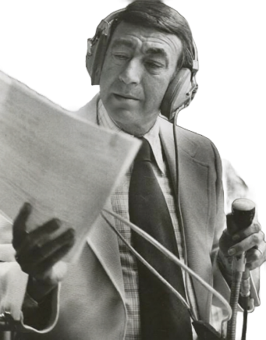
Family Activities
This is Howard Cosell, sharing with you an important challenge. A small house church in Jimar Rimar conveyed this message to a baseball team chaplain. We need your proficiency to decipher this dispatch. Technical assistance (and the crossword) is available at https://tinyurl.com/329j3ykz

Slide 24
Jesus’ Teachings
at the Last Supper

