Slide 1

Last Supper Teachings – Part 2

Slide 2

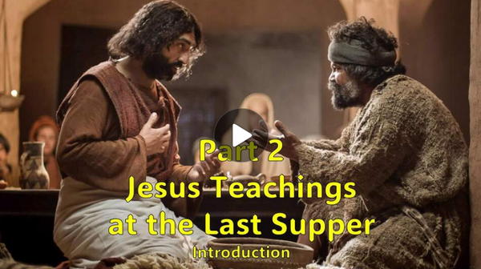
Video Introduction
View Video

Slide 3



Ah … so peaceful …
What people, things, or experiences in life bring you comfort and peace of mind?

Slide 4
Ah … so peaceful …
What people, things, or experiences in life bring you comfort and peace of mind?
Today we look at the ministries of the Holy Spirit.
  One of the Greek words used to describe His role can be translated “Comforter”
  We also will see “Counselor” and “Advocate”

Slide 5
1. Loving Jesus Demonstrates Obedience and Is Guided by the Counselor—the Holy Spirit.

Slide 6
Listen for terms Jesus uses to describe the Holy Spirit.
John 14:16-17, 26 (NIV) And I will ask the Father, and he will give you another Counselor to be with you forever-- 17 the Spirit of truth. The world cannot accept him, because it neither sees him nor knows him. But you

Slide 7

Listen for terms Jesus uses to describe the Holy Spirit.
know him, for he lives with you and will be in you. … 26 But the Counselor, the Holy Spirit, whom the Father will send in my name, will teach you all things and will remind you of everything I have said to you.

Slide 8
Obedience Guided by the Spirit
What words or terms did Jesus use to describe the Holy Spirit?
Note the first two terms (from different translations of the Scriptures) … “Counselor” and “Comforter” … How are these compatible? How could they be the translation of the same word from the Greek?

Slide 9
Obedience Guided by the Spirit
According to the passage, why does the world not know the Spirit – why do they have difficulty in understanding His existence?
Not unlike the fact that AM, FM, Bluetooth, cell tower, and Satellite radio waves are all around us
  Only when the proper receiver and amplifier are present can we become aware of their presence and what they are communicating.

Slide 10
Obedience Guided by the Spirit
Why do believers have difficulty depending on the Holy Spirit?
What needs to happen to overcome these difficulties?
Note how this parallels our salvation experience
  We can do nothing about our sin, Jesus substitutionary death provides our forgiveness
  We must confess, repent, receive it in faith.

Slide 11
2. Jesus Gives Peace through the Presence of the Comforter.

Slide 12
Listen for things that the Holy Spirit does that Jesus did.
John 14:27-31 (NIV) Peace I leave with you; my peace I give you. I do not give to you as the world gives. Do not let your hearts be troubled and do not be afraid. "You heard me say, 'I am going away and I am coming back to

Slide 13
Listen for things that the Holy Spirit does that Jesus did.
you.' If you loved me, you would be glad that I am going to the Father, for the Father is greater than I. I have told you now before it happens, so that when it does happen you will believe. I will not speak

Slide 14
Listen for things that the Holy Spirit does that Jesus did.
with you much longer, for the prince of this world is coming. He has no hold on me, [31] but the world must learn that I love the Father and that I do exactly what my Father has commanded me.

Slide 15
Peace through the Comforter
When unbelievers feel anxious, what/where do they often turn to for peace?
Consider John 14:27 (NLT2) “I am leaving you with a gift—-peace of mind and heart. And the peace I give is a gift the world cannot give. So don’t be troubled or afraid.
How did Jesus describe the difference between His peace and the world’s peace?

Slide 16
Peace through the Comforter
Note the extent of the peace that Jesus has given us.
  Peace with God (as sinners we are at odds with God)
  Peace with ourselves – we struggle with guilt of sin
  Peace with one another – no longer are we in competition – as believers we are members of one Body, the Body of Christ … the church

Slide 17
Peace through the Comforter
How can we experience the peace Jesus has given us?
What concerns trouble you or cause you to fear?
How should we deal with the fear in our lives?

Slide 18
3. The Holy Spirit, Our
Advocate, Convicts, Testifies, and Guides.

Slide 19
Listen for another task of the Spirit.
John 16:7-11 (NIV) But I tell you the truth: It is for your good that I am going away. Unless I go away, the Counselor will not come to you; but if I go, I will send him to you. 8 When he comes, he will convict the world of guilt in regard to sin and righteousness and

Slide 20
Listen for another task of the Spirit.
judgment: 9 in regard to sin, because men do not believe in me; 10 in regard to righteousness, because I am going to the Father, where you can see me no longer; 11 and in regard to judgment, because the prince of this world now stands condemned.

Slide 21
The Spirit Our Advocate
What advantage would come to the disciples only if Jesus went away to the Father?
Note the work of the Holy Spirit Jesus introduced and to three areas He applied it.
  Convict/convince the world of sin – unbelief
  Convince that righteousness living is possible
  Convince of judgment – Satan condemned, defeated

Slide 22
The Spirit Our Advocate
What are some other words your translations use for convict? What are some other synonyms?
Why is it a positive thing to be convicted (convinced) of your sin?
Convince
Reprove
Shame
Blame
Expose
Accuse

Slide 23
Application
Believers experience the presence of God in our lives
  This week when you read God’s Word, ask the Holy Spirit to make it plain to you
  Be sensitive to God speaking to you during the preaching and teaching each Sunday
  Ask God to empower you by His Spirit to live a victorious Christian life

Slide 24
Application
The world today is looking for peace
  No Jesus ⇨ no peace … Know Jesus ⇨ know peace
  Pray for neighbors, family members who have no peace with God
  Trust God for personal peace this week when you are troubled

Slide 25
Application
Devotional exercise
  Write out the answer to the question “If someone asked you why you choose to live the Christian life what would you tell them?”
  Explain how they could begin living in a personal relationship with God

Slide 26
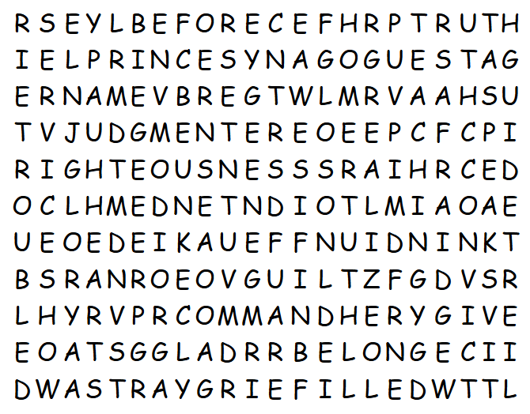

Family Activities
Some IDIOT left the I
off “IDIOT” That
Word Search Lady is going to have their head for that. You better stay on her good side and find all the words. Don’t tell her I said so, but help and the Crossword can be found at https://tinyurl.com/uuaubkr5

Slide 27
Last Supper Teachings – Part 2

