Slide 1

Last Supper Teachings – Part 3

Slide 2

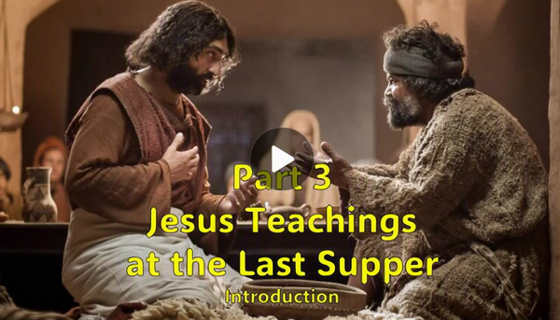
Video Introduction
View Video

Slide 3




If only …
If a fruit tree could talk, how might it complain when the gardener pruned its branches?
Why might the gardener prune it anyway?

Slide 4
God is the Gardener
Sometimes God acts as a Gardener in our lives.
  He will feed us Truth as spiritual nutrients
  He will prune and remove elements of our lives that are either harmful or unneeded
  He works to promote our spiritual growth and maturity

Slide 5
1. Spiritual Fruit Grows from Abiding in Christ.

Slide 6
Listen for gardening strategy.
John 15:1-8 (NIV) "I am the true vine, and my Father is the gardener. 2 He cuts off every branch in me that bears no fruit, while every branch that does bear fruit he prunes so that it will be even more fruitful. 3 You are already clean because of the word I have spoken to you. 4 Remain in me, and I will

Slide 7
Listen for gardening strategy.
remain in you. No branch can bear fruit by itself; it must remain in the vine. Neither can you bear fruit unless you remain in me. 5 "I am the vine; you are the branches. If a man remains in me and I in him, he will bear much fruit; apart from me you can do nothing. 6 If anyone does not remain in me, he is

Slide 8

Listen for gardening strategy.
like a branch that is thrown away and withers; such branches are picked up, thrown into the fire and burned. 7 If you remain in me and my words remain in you, ask whatever you wish, and it will be given you. 8 This is to my Father's glory, that you bear much fruit, showing yourselves to be my disciples.

Slide 9
Spiritual Fruit
Verse 2 speaks of the Father pruning fruitful branches so that they will bear more fruit. What are some ways God might work in a believer's life to help that person learn to demonstrate examples of the Fruit of the Spirit?
He cuts off every branch in me that bears no fruit, while every branch that does bear fruit he prunes so that it will be even more fruitful

Slide 10
Spiritual Fruit
Jesus repeats the idea of abiding in Him several times in these verses. What do you think it means to abide in Christ?
Why is it important to recognize that spiritual fruit is the result of abiding in Christ rather than merely the product of trying harder to be a good person?

Slide 11
Spiritual Fruit
What might be the difference in attitudes between serving God out of a sense of obligation and serving Him out of a growing relationship with Christ?
How might a fruitful Christian life influence the way other people think about God?
Obligation | Growing Relationship with Christ

Slide 12
2. Abiding in Christ Produces Sacrificial Love for Others.

Slide 13
Listen for a final command.
John 15:9-17 (NIV) "As the Father has loved me, so have I loved you. Now remain in my love. 10 If you obey my commands, you will remain in my love, just as I have obeyed my Father's commands and remain in his love. 11 I have told you this so that my joy may be in you and that your joy may be complete. 12 My

Slide 14
Listen for a final command.
command is this: Love each other as I have loved you. 13 Greater love has no one than this, that he lay down his life for his friends. 14 You are my friends if you do what I command. 15 I no longer call you servants, because a servant does not know his master's business. Instead, I have called you friends, for

Slide 15
Listen for a final command.
everything that I learned from my Father I have made known to you. 16 You did not choose me, but I chose you and appointed you to go and bear fruit--fruit that will last. Then the Father will give you whatever you ask in my name. 17 This is my command: Love each other.

Slide 16
Sacrificial Love
In verse 10, Jesus connects abiding in His love with keeping His commands. How are love and obedience related?
Why might someone think that following Jesus will make life less enjoyable, and what might that person be missing about the joy Jesus offers?
If you obey my commands, you will remain in my love, just as I have obeyed my Father's commands and remain in his love.

Slide 17
Sacrificial Love
In verse 14, Jesus connects being His friend with doing what He commands. What does this teach us about the relationship between love, friendship, and obedience?
You are my friends if you do what I command.

Slide 18
Sacrificial Love
In verse 16, Jesus reminds His disciples that He chose them and appointed them to bear fruit. How does this connect with the earlier teaching about abiding in Christ?
You did not choose me, but I chose you and appointed you to go and bear fruit--fruit that will last. Then the Father will give you whatever you ask in my name.

Slide 19
3. Faithfulness to Christ Invites Opposition from the World.

Slide 20
Listen for hate crimes.
John 15:18-25 (NIV) "If the world hates you, keep in mind that it hated me first. 19 If you belonged to the world, it would love you as its own. As it is, you do not belong to the world, but I have chosen you out of the world. That is why the world hates you. 20 Remember the words I spoke to you: 'No servant is greater than

Slide 21
Listen for hate crimes.
his master.' If they persecuted me, they will persecute you also. If they obeyed my teaching, they will obey yours also. 21 They will treat you this way because of my name, for they do not know the One who sent me. 22 If I had not come and spoken to them, they would not be guilty of sin. Now, however, they have no excuse for

Slide 22
Listen for hate crimes.
their sin. 23 He who hates me hates my Father as well. 24 If I had not done among them what no one else did, they would not be guilty of sin. But now they have seen these miracles, and yet they have hated both me and my Father. 25 But this is to fulfill what is written in their Law: 'They hated me without reason.'

Slide 23
Opposition from the World
What are some examples of Christian beliefs or values that may be unpopular in today's culture?
Why might people react negatively to such ideas?
How might remembering that some people oppose Christ because they do not truly know Him affect the way we treat those who disagree with us?

Slide 24




Opposition from the World
What is the difference between standing firmly for our faith and responding defensively or angrily when someone challenges it?
So, you want to go to Hell?
Well, I’m going to believe the Bible.

Slide 25
Application
What is God pruning in your life?
  Ask God what areas of your life need to be removed or changed
  Confess and repent of those attitudes or actions
  Trust God to make changes needed that will glorify Him in your life

Slide 26
Application
What fruit does God want to produce in your life?
  Surrender yourself to God’s Holy Spirit
  Allow Him to produce in you the Fruit of the Spirit – love, joy, peace, patience, kindness, goodness, gentleness, faithfulness, self-control
  Ask God to use those Fruit to change for good the way you relate to others

Slide 27
Application
Share.
  Find ways this week you can bring joy to others— in your workplace, family, school, or neighborhood. Even if they have disagreed with you.
  Bringing joy to others is a way to show Christ’s love, and it can pave the wave for a verbal witness.

Slide 28

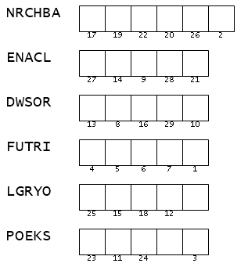
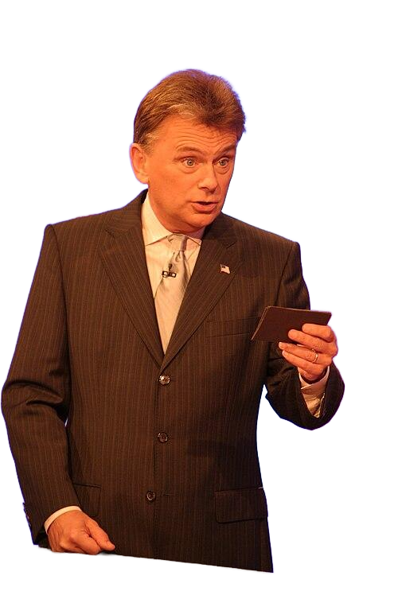
Family Activities
No need to spin the wheel again. You’ve got all the letters. The words are in your Bible lesson. Use the URL below to find help (and the crossword)
https://tinyurl.com/57yhrf23

Slide 29
Last Supper Teachings – Part 3

