Slide 1

The High Priestly Prayer

Slide 2

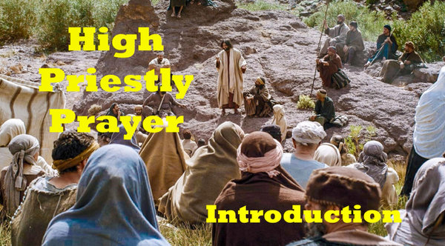
Video Introduction
View Video

Slide 3
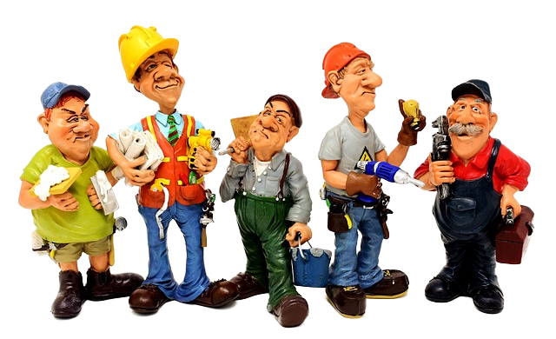
What do you think?
How can a group of people have different personalities, opinions, and abilities and still be genuinely united? What holds them together?

Slide 4
What do you think?
How can a group of people have different personalities, opinions, and abilities and still be genuinely united? What holds them together?
Jesus was soon to return to heaven.
  He prayed to energize the disciples to begin the church
  He prayed for a dozen or so unorganized people to eventually grow into a powerful worldwide movement.
  God answered their prayer … we are part of the answer to His prayer

Slide 5
1. Jesus Glorified the Father through Obedient Surrender.

Slide 6
Listen for what is eternal life.
John 17:1-5 (NIV) After Jesus said this, he looked toward heaven and prayed: "Father, the time has come. Glorify your Son, that your Son may glorify you. 2 For you granted him authority over all people that he might give eternal life to all those you have given him. 3 Now this is

Slide 7
Listen for what is eternal life.
eternal life: that they may know you, the only true God, and Jesus Christ, whom you have sent. 4 I have brought you glory on earth by completing the work you gave me to do. 5 And now, Father, glorify me in your presence with the glory I had with you before the world began.

Slide 8
Obedient Surrender
To what was Jesus referring with the phrase “the time is come”?
After Jesus said this, he looked toward heaven and prayed: "Father, the time has come. Glorify your Son, that your Son may glorify you.

Slide 9
Obedient Surrender
Why is it significant that Jesus prayed before His arrest and crucifixion?
What else might He have done instead?
How did Jesus reframe the idea of eternal life in verse 3?
Now this is eternal life: that they may know you, the only true God, and Jesus Christ, whom you have sent.

Slide 10
Obedient Surrender
What request does Jesus ask of the Father?
For what purpose did the Father send the Son to dwell among all flesh?
What does it mean to glorify God in our lives? How can we bring glory to God?
For you granted him authority over all people that he might give eternal life to all those you have given him. Now this is eternal life: that they may know you, the only true God, and Jesus Christ, whom you have sent. I have brought you glory on earth by completing the work you gave me to do. And now, Father, glorify me in your presence with the glory I had with you before the world began.

Slide 11
2. Jesus prayed for His disciples to have protection and unity.

Slide 12
Listen for a word repeated 3 times.
John 17:15 - 20 My prayer is not that you take them out of the world but that you protect them from the evil one. 16 They are not of the world, even as I am not of it. 17 Sanctify them by the truth; your word is truth. 18 As you sent

Slide 13
Listen for a word repeated 3 times.
me into the world, I have sent them into the world. 19 For them I sanctify myself, that they too may be truly sanctified. 20 "My prayer is not for them alone. I pray also for those who will believe in me through their message.

Slide 14
Prayer for Protection and Unity
Who does Jesus say He is praying for?
What are the prayer requests this time?
My prayer is not that you take them out of the world but that you protect them from the evil one. … Sanctify them by the truth; your word is truth … I have sent them into the world … that they too may be truly sanctified … also for those who will believe in me through their message,

Slide 15
Prayer for Protection and Unity
Why would Jesus pray for believers to remain in the world rather than being removed from it?
What does this tell us about our purpose?
How does the truth of God lead to our sanctification?

Slide 16
Prayer for Protection and Unity
How does dissention and division among believers hinder belief in Jesus?
Jesus prayed for unity, not uniformity. What’s the difference? Why is the distinction important in thinking of Jesus’ prayer?

Slide 17
3. Jesus Desired a Unified
Witness for the World.

Slide 18
Listen for our role in communicating God’s love.
John 17:24-26 (NIV) "Father, I want those you have given me to be with me where I am, and to see my glory, the glory you have given me because you loved me before the creation of the world. 25 "Righteous Father, though the world

Slide 19
Listen for our role in communicating God’s love.
does not know you, I know you, and they know that you have sent me. 26 I have made you known to them, and will continue to make you known in order that the love you have for me may be in them and that I myself may be in them."

Slide 20
Unified Witness
What was another desire Jesus expressed to the Father? What was the reason?
"Father, I want those you have given me to be with me where I am, and to see my glory, the glory you have given me because you loved me before the creation of the world

Slide 21
Unified Witness
How can believers receive more of the Father’s love?
How has prayer deepened your connection with God?
What are some ways we can help others know and experience the love of God?

Slide 22
Unified Witness
How might verse 24 refer not only to our existence in heaven but also to our life here and now on earth?
"Father, I want those you have given me to be with me where I am, and to see my glory, the glory you have given me because you loved me before the creation of the world

Slide 23
Application
Note what Jesus prayer was not for … it was not for
  Comfort, prosperity, freedom from suffering, worldly success
  The prayer was for , spiritual protection, sanctification, unity, effectiveness
  Consider how your prayers reflect Jesus desires or your own

Slide 24
Application
Consider praying based on Scripture
  Today’s passage provides prayer requests we could make for ourselves
  We could pray these things for our church … for believers worldwide

Slide 25
Application
For meditation this week, consider the following questions
  How can we get out into the world more when we are already so busy in the church?
  How can we be more distinctive in the world without coming across as legalistic?
  How can we work toward unity in our church and among the churches in our community?

Slide 26
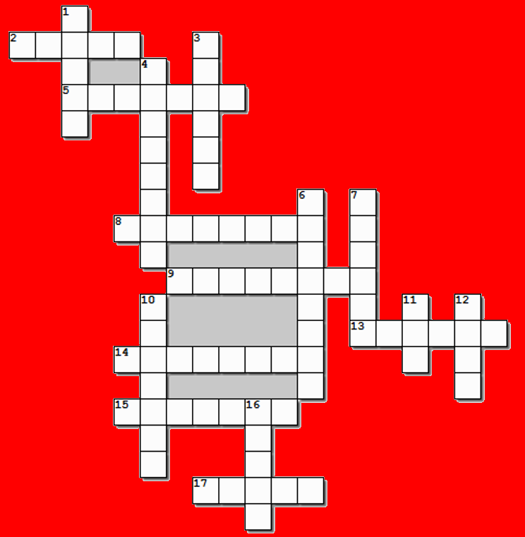



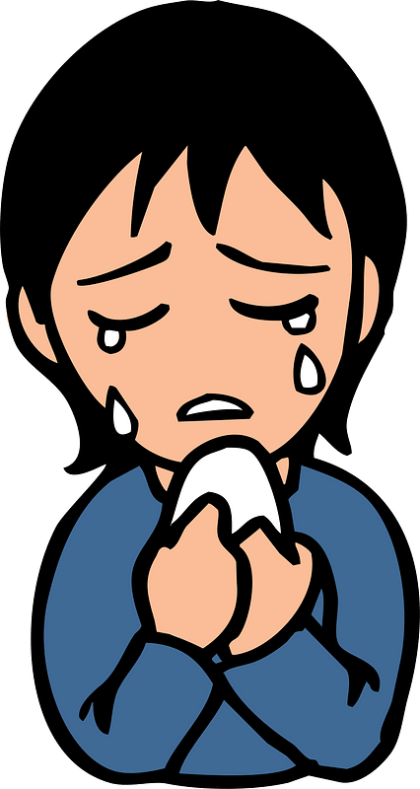
Family Activities
Not to worry … all the clues and words come from John Chapter 17
Oh my … some of those words are so LONG!!

Slide 27
The High Priestly Prayer

