Slide 1
Gracious Hospitality
September 16

Slide 2
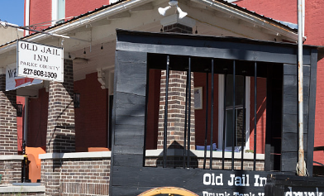
Remember the time …
What’s the most interesting place you’ve stayed on a trip?
How hospitable was the stay?
Actually, gracious hospitality is nothing new.
Peter emphasized that believers should ground our service and love in hospitality.

Slide 3
Listen for what “therefor” is there for.
1 Peter 4:7 (NIV) The end of all things is near. Therefore be clear minded and self-controlled so that you can pray.

Slide 4
Prayer: Groundwork for Hospitality
What did Peter instruct his readers to do based on the “therefore, the fact of the end of all things being near?
In what way is the end of all things even nearer now?
How did the early church’s anticipating Christ’s soon return affect their choices and approach to life?

Slide 5
Prayer: Groundwork for Hospitality
How would knowing that the world was going to end this year change the way you think or act?
Peter specifically mentions prayer. What steps can you take to be more disciplined in your prayer life?

Slide 6
Listen for another ministry.
1 Peter 4:8-9 (NIV) Above all, love each other deeply, because love covers over a multitude of sins. 9 Offer hospitality to one another without grumbling.

Slide 7
Lifestyle of Hospitality
What priority did Peter establish for the believers to whom he wrote?
What are some ways love covers a multitude of sins?
Why is it sometimes difficult to love other believers?

Slide 8
Lifestyle of Hospitality
Peter mentions hospitality … why do you suppose hospitality was a critical need among believers in the early church?
What obstacles can prevent us from demonstrating hospitality today, things that might even make us grumble?
What are some specific ministries that could be included as hospitality by our group or our church?

Slide 9
Listen for a gift given.
1 Peter 4:10-11 (NIV) Each one should use whatever gift he has received to serve others, faithfully administering God's grace in its various forms. 11 If anyone speaks, he should do it as one speaking the very words of God. If anyone serves, he should do it with the strength God provides, so that in all things God may be praised through Jesus Christ. To him be the glory and the power for ever and ever. Amen.

Slide 10
God Enables Loving Service
What goal did Peter want his audience to reach with all they did? How were Peter’s readers to use their spiritual gifts?
How were these believers to speak and serve?
What are some specific ministries that could be included in the category of speaking?

Slide 11
God Enables Loving Service
Consider Paul’s writings about spiritual gifts
Romans 12:6-8 (NIV) We have different gifts, according to the grace given us. If a man's gift is prophesying, let him use it in proportion to his faith. 7 If it is serving, let him serve; if it is teaching, let him teach; 8 if it is encouraging, let him encourage; if it is contributing to the needs of others, let him give generously; if it is leadership, let him govern diligently; if it is showing mercy, let him do it cheerfully.

Slide 12
God Enables Loving Service
Consider Paul’s writings about spiritual gifts
1 Corinthians 12:7-10 (NIV) Now to each one the manifestation of the Spirit is given for the common good. 8 To one there is given through the Spirit the message of wisdom, to another the message of knowledge by means of the same Spirit,

Slide 13
God Enables Loving Service
Consider Paul’s writings about spiritual gifts
9 to another faith by the same Spirit, to another gifts of healing by that one Spirit, 10 to another miraculous powers, to another prophecy, to another distinguishing between spirits, to another speaking in different kinds of tongues, and to still another the interpretation of tongues.

Slide 14
God Enables Loving Service
List gifts mentioned in these references
Note that these are not exhaustive lists. In today’s world we could include ministries such as web-master, bus mechanic, grounds keeping, maintenance, musician, etc.
Why must love be the driving force behind our spiritual gifts?

Slide 15
Application

Slide 16
Application
Greet.
Arrive at church a few minutes early this week.
Spend extra time in the area outside the worship room to make sure you say hello and meet people you don’t know.

Slide 17
Application
Host a group.
Look for an opportunity to host a small group in your home or …
Be a greeter in your Bible study group.

Slide 18
Application
Share a meal.
Dedicate one Sunday each month to be a day when you will invite someone into your home for lunch.
Make this a regular rhythm in your life.

Slide 19
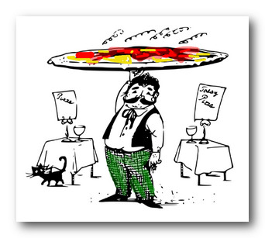
Family Activities
Say, grab one of my delicious pizza pies and have a family night. You can try some of the Family Activities at https://tinyurl.com/ybzebjhh

Slide 20
Gracious Hospitality
September 16

