Slide 1
How Should I Respond to Politics
July 19

Slide 2
Introduction Video
View Video

Slide 3
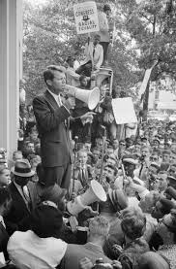
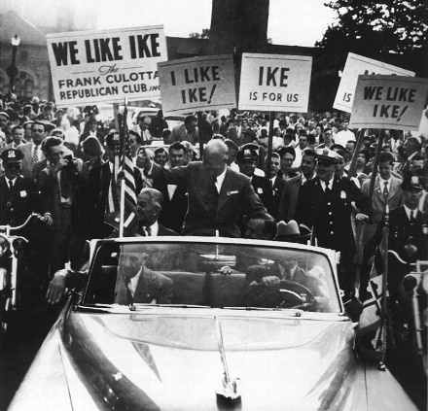
How do you remember it … ?
What do you recall about your initial experiences with a presidential election?
Politics can bring out best and worst of people.
You may feel passionate, you may feel cynical about the whole thing.
As believers, we are called to reflect Christ in how you interact with politics and government.

Slide 4
Listen for how to respond to government.
Romans 13:1-4 (NIV) Everyone must submit himself to the governing authorities, for there is no authority except that which God has established. The authorities that exist have been established by God. 2 Consequently, he who rebels against the authority is rebelling against what God has instituted, and those who do so will bring judgment on themselves. 3 For rulers

Slide 5
Listen for how to respond to government.
hold no terror for those who do right, but for those who do wrong. Do you want to be free from fear of the one in authority? Then do what is right and he will commend you. 4 For he is God's servant to do you good. But if you do wrong, be afraid, for he does not bear the sword for nothing. He is God's servant, an agent of wrath to bring punishment on the wrongdoer.

Slide 6
Obey the Government
According to this passage, what should a Christian do to maintain a good relationship with the government?
Why has God ordained government and laws?
What are some reasons the passage gives for submission to government authorities?

Slide 7
Obey the Government
What kinds of experiences in our culture can cause people to hesitate about submitting to governing authorities?
We should be very careful advocating resistance to civil authority … what Biblical examples can you think of that would give us guidelines?

Slide 8
Obey the Government
God said the government authority is actually a servant. Why is that title an appropriate title? How has the government been beneficial to you?

Slide 9
Listen for how to submit to government.
Romans 13:5-7 (NIV) Therefore, it is necessary to submit to the authorities, not only because of possible punishment but also because of conscience. 6 This is also why you pay taxes, for the authorities are God's servants,

Slide 10
Listen for how to submit to government.
who give their full time to governing. 7 Give everyone what you owe him: If you owe taxes, pay taxes; if revenue, then revenue; if respect, then respect; if honor, then honor.

Slide 11
Integrity, Respect, and Honor
What is another, and even better, motivation for making one’s self subject to the governing authorities?
What are specific ways in which Christians can fulfill their obligation toward the government?
What reason does Paul offer for doing so?

Slide 12
Integrity, Respect, and Honor
Why is it important for us to respect and honor those in authority, even when we don’t agree?
What is the Christian’s responsibility for maintaining a good government? What positive support should Christians give to government leaders?

Slide 13
Listen for what is the fulfillment of the law.
Romans 13:8-10 (NIV) Let no debt remain outstanding, except the continuing debt to love one another, for he who loves his fellowman has fulfilled the law. 9 The commandments, "Do not commit adultery," "Do not murder," "Do not

Slide 14
Listen for what is the fulfillment of the law.
steal," "Do not covet," and whatever other commandment there may be, are summed up in this one rule: "Love your neighbor as yourself." 10 Love does no harm to its neighbor. Therefore love is the fulfillment of the law.

Slide 15
Respond with Love
What inescapable obligations do believers have toward one another?
What is the relationship of love to the law?
What did Paul say love would not do?
How does loving others disarm an argument?

Slide 16
Respond with Love
How can we keep political differences from being divisive?
What specific acts of love can Christians show to friends, family, neighbors, and strangers especially during this political season?

Slide 17
Application
Practice love.
We are in a season of elections, so politics is a common topic of discussion.
At times, Christians may find themselves on opposite sides on an issue or debating with a candidate.
Maintain love for others in your discussions.

Slide 18
Application
Plunge into God’s Word.
The political issues we face today are not easy.
Study Scripture to see how it speaks into the issues.
Continually seek to be aligned with God, and do so with love and humility.

Slide 19
Application
Participate.
Are you an active participant or do you just complain from the sidelines?
It is important for Christians to influence the discourse in the public square and the political processes.
Get active and let your love for Christ be an influence.

Slide 20
Family Activities
We need YOU to solve the Double Puzzle … It will tell you how to vote! (Not really)
Also, there are other cool patriotic Family Activities at https://tinyurl.com/y8f6txjj

Slide 21
How Should I Respond to Politics
July 19

