Slide 1
Intimacy with Jesus
February 7

Slide 2
Video Introduction
View Video

Slide 3
Think about it …
What are some ways electronic media have affected our lives?
Electronic media do not always bring us close to other people.
Except for our electronic versions of Scripture, these devices don’t help much being closer to God
Prayer draws us closer to Jesus as our hearts align with His.

Slide 4
Listen for what is eternal life.
John 17:1-5 (NIV) After Jesus said this, he looked toward heaven and prayed: "Father, the time has come. Glorify your Son, that your Son may glorify you. 2 For you granted him authority over all people that he might give eternal life to all those you have given him. 3 Now this is eternal life:

Slide 5
Listen for what is eternal life.
that they may know you, the only true God, and Jesus Christ, whom you have sent. 4 I have brought you glory on earth by completing the work you gave me to do. 5 And now, Father, glorify me in your presence with the glory I had with you before the world began.

Slide 6
God’s Glory Be Seen
To what was Jesus referring with the phrase the hour is come?
What request does Jesus ask of the Father?
For what purpose did the Father send the Son to dwell among all flesh?

Slide 7
God’s Glory Be Seen
What is the nature and the source of eternal life?
What does it mean to glorify God in our lives? How can we bring glory to God?

Slide 8
Listen for the importance of unity.
John 17:21-23 (NIV) that all of them may be one, Father, just as you are in me and I am in you. May they also be in us so that the world may believe that you have sent me. 22 I have given them the glory that

Slide 9
Listen for the importance of unity.
you gave me, that they may be one as we are one: 23 I in them and you in me. May they be brought to complete unity to let the world know that you sent me and have loved them even as you have loved me.

Slide 10
Unity with God and among Believers
Who did Jesus expand His prayer to include?
What did He desire for them?
How could believers become one? How did Jesus want believers to be unified?
How do Christians today become divided? Why?

Slide 11
Unity with God and among Believers
How does dissention and division among believers hinder belief in Jesus?
Jesus prayed for unity, not uniformity. What’s the difference? Why is the distinction important in thinking of Jesus’ prayer?
In what ways can the demonstration of Christian unity (or the lack thereof) impact unbelievers?

Slide 12
Listen for our role in communicating God’s love.
John 17:24-26 (NIV) "Father, I want those you have given me to be with me where I am, and to see my glory, the glory you have given me because you loved me before the creation of the world. 25 "Righteous Father, though the

Slide 13
Listen for our role in communicating God’s love.
world does not know you, I know you, and they know that you have sent me. 26 I have made you known to them, and will continue to make you known in order that the love you have for me may be in them and that I myself may be in them."

Slide 14
God’s Love Be Known
What was another desire Jesus expressed to the Father? What was the reason?
How have those who believed come to know the Father?
How can believers receive more of the Father’s love?

Slide 15
God’s Love Be Known
How has prayer deepened your connection with God?
What are some ways we can help others know and experience the love of God?
How might verse 24 refer not only to our existence in heaven but also to our life here and now on earth?

Slide 16
Application
Pray for God’s glory.
Give up at least five minutes of social media time (or TV watching)
Replace with that additional time spent in prayer for God’s glory.

Slide 17
Application
Pray for unity.
Gather with others to spend time in concentrated prayer.
Pray for unity among believers in your church and around the world.

Slide 18
Application
Pray for God’s love to be known.
Set an alarm on your smartphone for 3:16 every afternoon and pray John 3:16 over at least three people who need to know the Lord.
Pray for the spread of the gospel around the world.
Pray for opportunities to share Christ through your social media outlets.

Slide 19
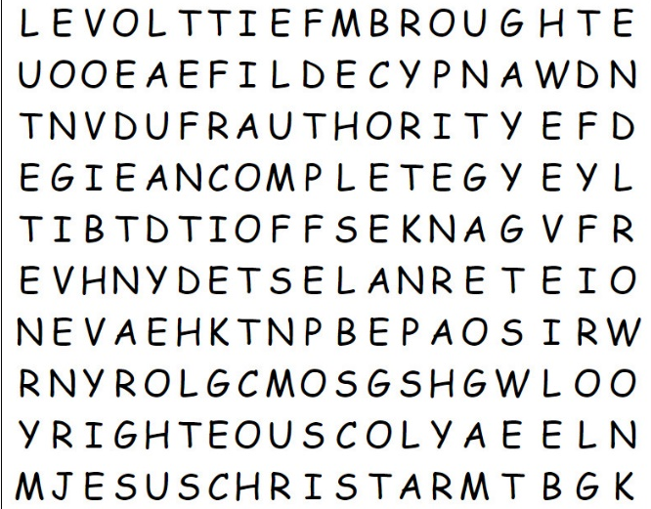
Family Activities
The Word Search Lady is here at the clinic for her Covid-19 vaccine. She asked me to remind you that when you finish the puzzle, you get busy with a book report. She added that if you wimp out and need help (humph!), go to https://tinyurl.com/y2o9f8xa. You’ll also find some other “unifying activities” for the whole family.

Slide 20
Intimacy with Jesus
February 7

