Slide 1
Is There A God?
December 8

Slide 2
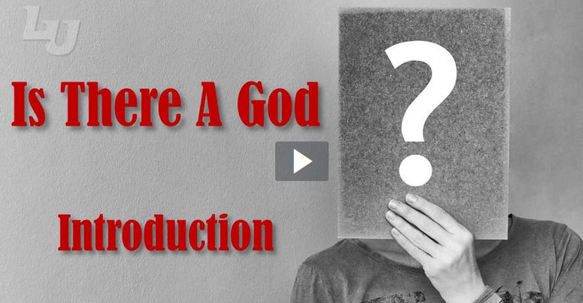
Introduction Video
View Video

Slide 3
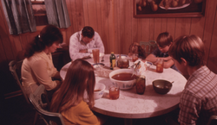
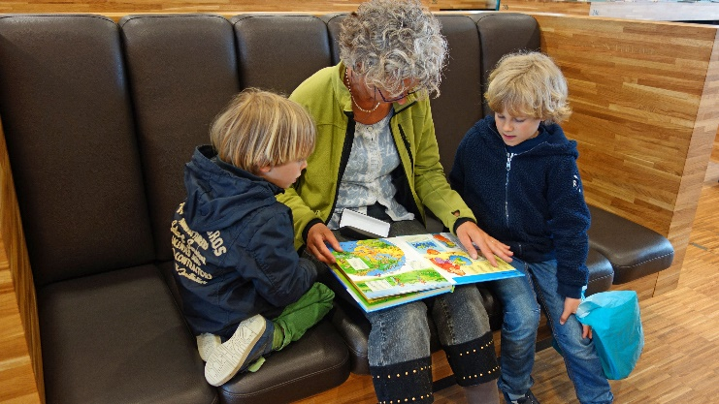
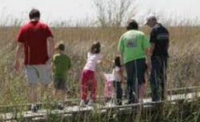
Remember …
Growing up, what did your family teach you about God?
Many of us had family to make sure we knew about God
We attended church from an early age
People in other cultures may not have those same opportunities
But, God has given all people ways to know He exists.

Slide 4
Listen for how God can be seen.
Psalm 19:1-6 (NIV) The heavens declare the glory of God; the skies proclaim the work of his hands. 2 Day after day they pour forth speech; night after night they display knowledge. 3 There is no speech or language where their voice is not heard. 4 Their voice goes out into all the earth, their words

Slide 5
Listen for how God can be seen.
to the ends of the world. In the heavens he has pitched a tent for the sun, 5 which is like a bridegroom coming forth from his pavilion, like a champion rejoicing to run his course. 6 It rises at one end of the heavens and makes its circuit to the other; nothing is hidden from its heat.

Slide 6
Nature Points to God
What messages do the heavens declare?
What supports this declaration, this proclamation?
How widespread is the message?
Why and how might the psalmist have called particular attention to the sun as an element of the Lord’s orderly creation?

Slide 7
Nature Points to God
What phenomenon in nature points you to God? When is it easy to see God’s glory in nature?
When is it hard to see God’s glory in nature?
Why is acknowledging the existence of God based on observing nature not enough for a person to be rightly related to Him?

Slide 8
Listen for another way God reveals Himself.
Psalm 111:7-9 (NIV) The works of his hands are faithful and just; all his precepts are trustworthy. 8 They are steadfast for ever and ever, done in faithfulness and uprightness. 9 He provided redemption for his people; he ordained his covenant forever-- holy and awesome is his name.

Slide 9
Scripture Reveals God
What two means through which God reveals Himself are identified in this psalm?
What words does the psalmist use to characterize God’s spoken/written Word?
How do those words apply to God as well?

Slide 10
Scripture Reveals God
What is the relationship between the veracity of God’s Word and His act to redeem His people?
How have you found the Bible to be trustworthy?
What have you learned about God through Scripture?

Slide 11
Listen for how to gain wisdom, insight.
Psalm 111:10 (NIV) The fear of the LORD is the beginning of wisdom; all who follow his precepts have good understanding. To him belongs eternal praise.

Slide 12
Rightly Acknowledge God
Who is the source of wisdom for living?
How do we access that wisdom?
What comes from obeying God’s Word, Gods communication to us?
How would you describe a God-fearing person? What does it mean to fear the Lord?

Slide 13
Rightly Acknowledge God
What do you consider the strongest evidence for the existence of God?
What are some practical ways our group can impact our community’s understanding of who God is?

Slide 14
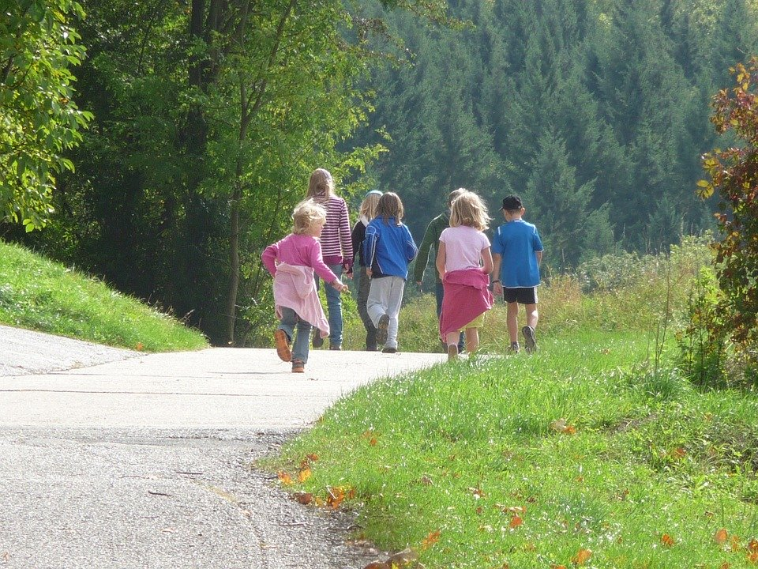
Application
Take a walk.
Get outside and observe nature around you.
Gaze up at the night sky.
Consider how all that you see points to God. Give God the glory for His creation.

Slide 15
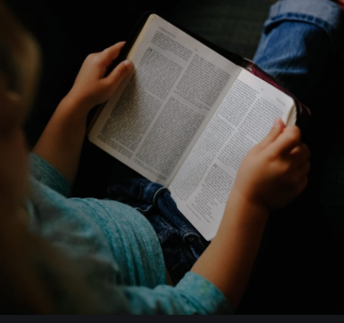
Application
Read the Word.
Commit to regular reading of God’s Word.
As you read and learn more about God and His ways, commit to live out the truths you discover.

Slide 16
Application
Have a conversation.
Discuss with someone why you are convinced God exists.
Explain what He has revealed to you through the created order and through His Word

Slide 17
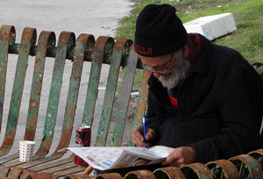
Family Activities
This is great! It’s the Crossword Puzzle. ‘Bout time! But if you like the Fallen Phrases puzzle, it’s an amusing quote. And the Family Discussion looks good too. Check them out at https://tinyurl.com/tg23rzn

Slide 18
There Is A God!
December 8

