Slide 1
Isaac and Rebekah: Family Favorites
October 27

Slide 2
Video Introduction
View Video

Slide 3
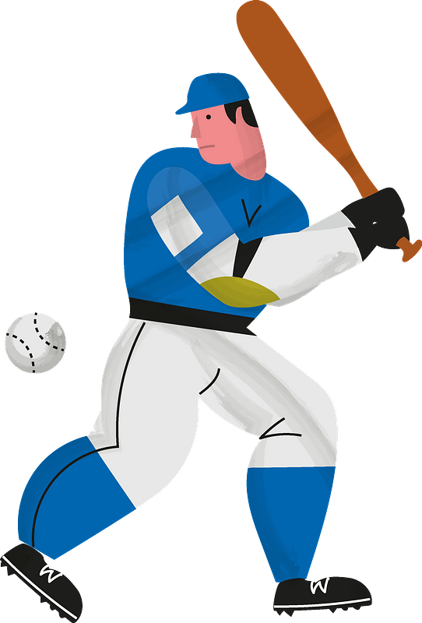
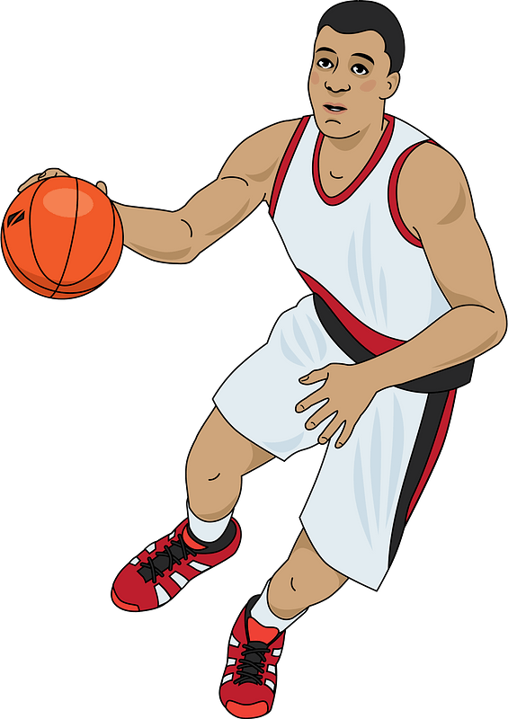
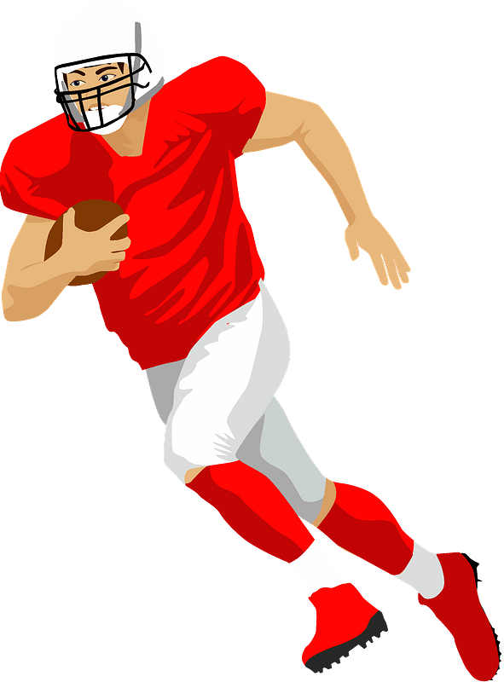
In your humble opinion …
What are some areas of life where you definitely have favorites?
Maybe you’ve had a pet that liked one person in the family more than the others.
It’s OK for a pet to have a favorite among family members.
But, in general, love should be without favoritism within the family.

Slide 4
Listen for contrasts.
Genesis 25:24-28 (NIV) When the time came for her to give birth, there were twin boys in her womb. 25 The first to come out was red, and his whole body was like a hairy garment; so they named him Esau. 26 After this, his brother came out, with his hand grasping Esau's heel; so he was named

Slide 5
Listen for contrasts.
Jacob. Isaac was sixty years old when Rebekah gave birth to them. 27 The boys grew up, and Esau became a skillful hunter, a man of the open country, while Jacob was a quiet man, staying among the tents. 28 Isaac, who had a taste for wild game, loved Esau, but Rebekah loved Jacob.

Slide 6
Differences and Favoritism
Describe the differences in the birth of the two boys born to Rebekah and Isaac.
What makes children even today from the same home turn out so differently?
Esau | Jacob

Slide 7
Differences and Favoritism
What do we learn about the relationship of the parents, Isaac and Rebekah, to the two sons, Esau and Jacob, as the sons became adults?
Isaac | Rebekah

Slide 8
Differences and Favoritism
How might these preferences have impacted the family dynamics?
Why do parents today sometimes favor one child over another?
What are possible consequences when parents show favoritism?

Slide 9
Listen for a sneaky plot.
Genesis 27:5-10 (NIV) Now Rebekah was listening as Isaac spoke to his son Esau. When Esau left for the open country to hunt game and bring it back, 6 Rebekah said to her son Jacob, "Look, I overheard your father say to your

Slide 10
Listen for a sneaky plot.
brother Esau, 7 'Bring me some game and prepare me some tasty food to eat, so that I may give you my blessing in the presence of the LORD before I die.' 8 Now, my son, listen carefully and do what I tell you: 9 Go out

Slide 11
Listen for a sneaky plot.
to the flock and bring me two choice young goats, so I can prepare some tasty food for your father, just the way he likes it. 10 Then take it to your father to eat, so that he may give you his blessing before he dies."

Slide 12
Secrecy and Deception
What were the instructions Rebekah overheard Isaac giving to Esau?
What plan did she devise in response and how did she draw Jacob into it?
What conclusions do you draw about the quality of the relationships that existed in this family between siblings, parents, and offspring?

Slide 13
Secrecy and Deception
Why is honesty so vital in healthy family relationships?
What effect might favoritism and deception have had in shaping Jacob’s character?

Slide 14
Listen for the plot to thicken
Genesis 27:11-13 (NIV) Jacob said to Rebekah his mother, "But my brother Esau is a hairy man, and I'm a man with smooth skin. 12 What if my father touches me? I would appear to be tricking

Slide 15
Listen for the plot to thicken
him and would bring down a curse on myself rather than a blessing." 13 His mother said to him, "My son, let the curse fall on me. Just do what I say; go and get them for me."

Slide 16
Bad Influence and Defiance
Rebekah had an answer to Jacob’s objections. In what sense was her willingness to take the blame still not adequate?
What makes lying and deception so difficult to overcome in a family?
How can we exemplify life without favoritism in our families?

Slide 17
Bad Influence and Defiance
How does sinful behavior among family members impact the entire family?
How do you maintain a spirit of honesty, integrity, and transparency, so that you will not be guilty of family mistrust?

Slide 18
Application
Read.
This week read 1 Corinthians 13.
It provides a template for love and respect in families.

Slide 19
Application
Reflect.
Journal and reflect on when you have felt wounded in times when others seemed to be more valuable and appreciated than you.
How did you overcome those feelings? How did you respond?

Slide 20
Application
Practice.
Seek to rectify the favoritism in your own life (James 2:1,3,9).
Do you think you may have been guilty of showing favoritism in your family?
Set aside a time to have a conversation with the family member whom you may have harmed through favoritism.

Slide 21
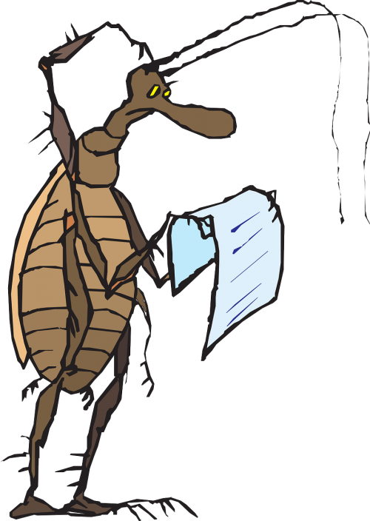
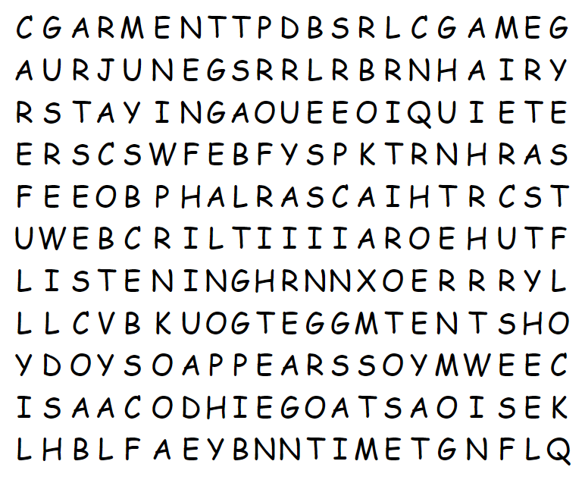
Family Activities
Well, I see “SOAP” in the grid, but not in the list of words. Guess I better check for help at https://tinyurl.com/3c8hnbk3 I’ll bet you gentlemen in the back could find the Crossword or the Family Discussion there too.

Slide 22
Isaac and Rebekah: Family Favorites
October 27

