Slide 1
Jacob and Esau Family Rivalry
November 3

Slide 2
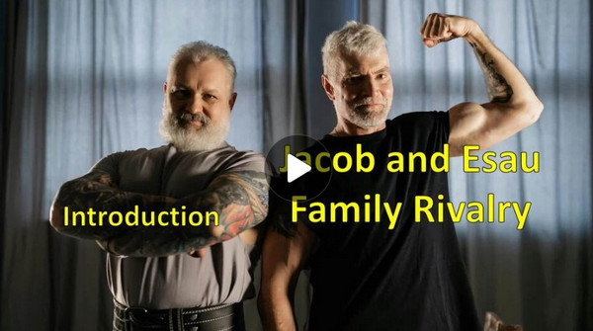
Video Introduction
View Video

Slide 3
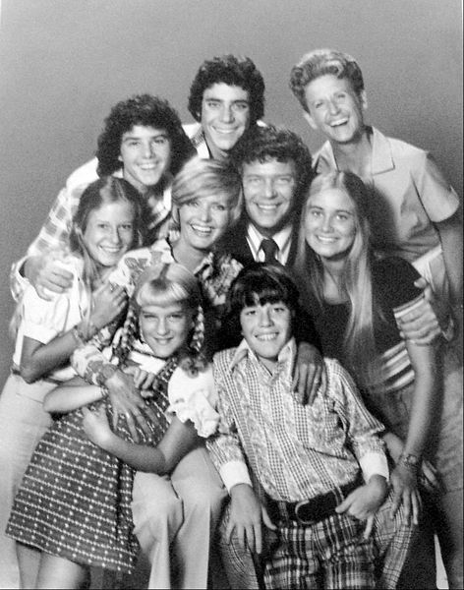
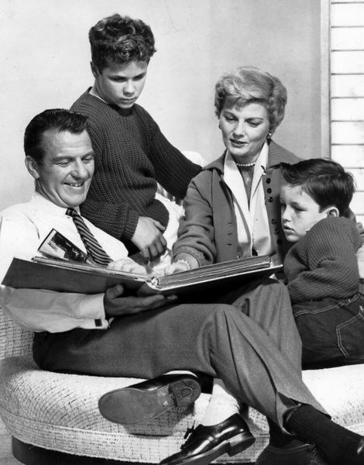
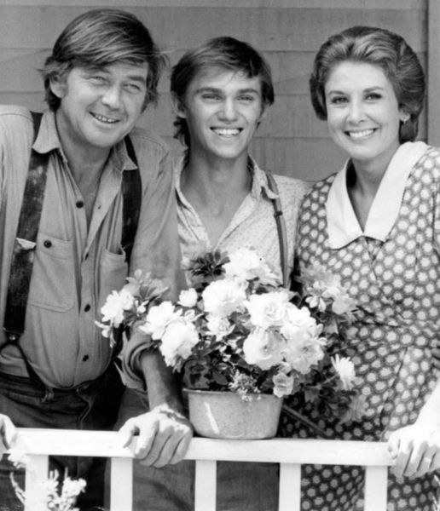
Who was your favorite?
Who are some siblings from movies or TV you found entertaining?
Most of the time, the families got along. By the end of the episode everyone was getting along.
Showing humility was usually part of the solution
It is critical to restoring broken relationships

Slide 4
Listen for revenge planned.
Genesis 27:35-37, 41 (NIV) But he said, "Your brother came deceitfully and took your blessing." 36 Esau said, "Isn't he rightly named Jacob? He has deceived me these two times: He took my birthright, and now he's taken my

Slide 5
Listen for revenge planned.
blessing!" Then he asked, "Haven't you reserved any blessing for me?" 37 Isaac answered Esau, "I have made him lord over you and have made all his relatives his servants, and I have sustained him with grain and new wine. So

Slide 6
Listen for revenge planned.
what can I possibly do for you, my son?" … 41 Esau held a grudge against Jacob because of the blessing his father had given him. He said to himself, "The days of mourning for my father are near; then I will kill my brother Jacob."

Slide 7
Asserting Hate
What did Esau intend to do in retaliation for Jacob’s deception?
What attitudes were at the center of both brothers’ actions?
What is appealing about holding a grudge?

Slide 8
Asserting Hate
In what ways could Jacob and Esau each rationalize their actions?
What do you think that Jacob and Esau’s parents could have done differently to help the brothers get along better?
Jacob | Esau

Slide 9
Asserting Hate
What might the brothers each have done to make things come out better?
Be thinking about your own family … do you have conflicts with a brother and sister that you need to acknowledge? (whether or not you plan to wring their neck!!)
Jacob | Esau

Slide 10
Listen for a family reunion.
Genesis 33:1-4 (NIV) Jacob looked up and there was Esau, coming with his four hundred men; so he divided the children among Leah, Rachel and the two maidservants. 2 He put the maidservants and their children in front, Leah and her children next, and

Slide 11
Listen for a family reunion.
Rachel and Joseph in the rear. 3 He himself went on ahead and bowed down to the ground seven times as he approached his brother. 4 But Esau ran to meet Jacob and embraced him; he threw his arms around his neck and kissed him. And they wept.

Slide 12
Choosing Humility
What were some thoughts and emotions that may have surfaced in Jacob’s mind when he saw Esau coming with a large group of men?
What precautions did Jacob take that suggest he was motivated by his old mindset of self-centeredness?
How did Jacob demonstrate humility?

Slide 13
Choosing Humility
How did Esau respond to Jacob?
What do you imagine were some of the emotions, feelings evident between the brothers when they were reconciled?
In contrast to these feelings at reconciliation, what feelings do people hold when they are in conflict with one another?

Slide 14
Choosing Humility
What significance do you see in the fact that God initiated the reconciliation through Jacob? Why might it not have been quite as meaningful had Esau taken the lead?

Slide 15
Choosing Humility
God wants families to be reconciled …
He has been in the business of reconciliation from the start
He made the supreme effort to reconcile us to Himself
We must do the same
We cannot hold ill will in our hearts for actual family or church family

Slide 16
Listen for restoration.
Genesis 33:8-11 (NIV) Esau asked, "What do you mean by all these droves I met?" "To find favor in your eyes, my lord," he said. 9 But Esau said, "I already have plenty, my brother. Keep what you have for yourself." 10 "No, please!" said Jacob. "If I have found favor in your

Slide 17
Listen for restoration.
eyes, accept this gift from me. For to see your face is like seeing the face of God, now that you have received me favorably. 11 Please accept the present that was brought to you, for God has been gracious to me and I have all I need." And because Jacob insisted, Esau accepted it.

Slide 18
Deciding to Restore
Esau asked two questions …
Who are all these people with you?
What were the flocks and herds I met?
How did Jacob’s answers help advance reconciliation between the two brothers?
Consider that Jacob appears more dominant one in the exchange recorded in these verses? How can you tell?

Slide 19
Deciding to Restore
God had been gracious to both men, and they said so. God has been good to you also. What are some ways you can humbly acknowledge that graciousness to others?

Slide 20
Deciding to Restore
Consider that we might not be accepted by the person to whom we humble ourselves.
Even if rejected by people, God accepts our humble attitude, and He is pleased
Humility always wins because it pleases God

Slide 21
Application
Take responsibility.
Identify some of your learned behaviors from your family.
Begin humbly to address them.

Slide 22
Application
Forgive.
After humbly dealing with our sins and shortcomings, among the most significant things we can do is forgive those who have offended us or caused us harm or grief.
Your forgiveness does not excuse their behavior; it is you letting go of the offense.

Slide 23
Application
Choose to forgive.
Do all that you can do to reconcile.
Take the initiative to reconcile a broken relationship in your life.
This is tough, but it pays tremendous dividends.
Doing your due diligence to maintain a clear conscience can help prevent future conflicts.
Take steps now to move toward reconciliation.

Slide 24
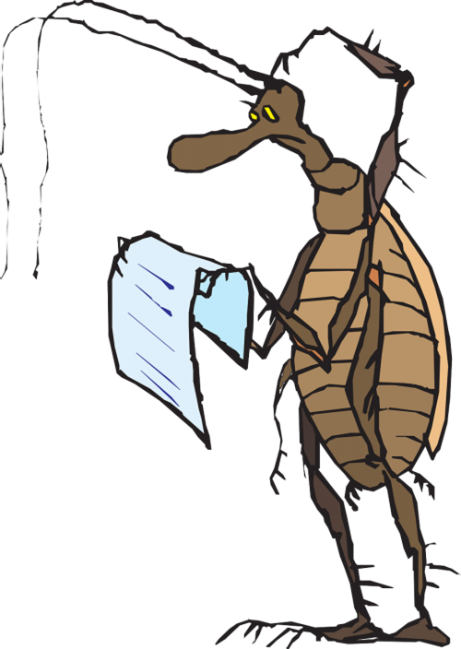
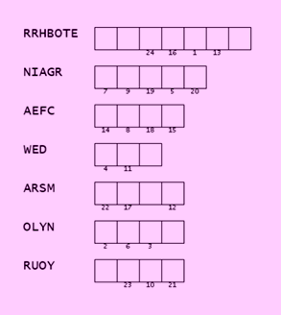
Family Activities`
That middle word looks already unscrambled, but I bet that’s not what we want. Is it in that Bible passage? Once they are unscrambled, use numbers to find where the letters go in the message. Help is found at https://tinyurl.com/395x2ck5
Oh, and the color page is also there for you folks in the back.

Slide 25
Jacob and Esau Family Rivalry
November 3

