Slide 1
Jesus Lives and You Can Too
April 17 Easter Sunday

Slide 2
Video Introduction
View Video

Slide 3
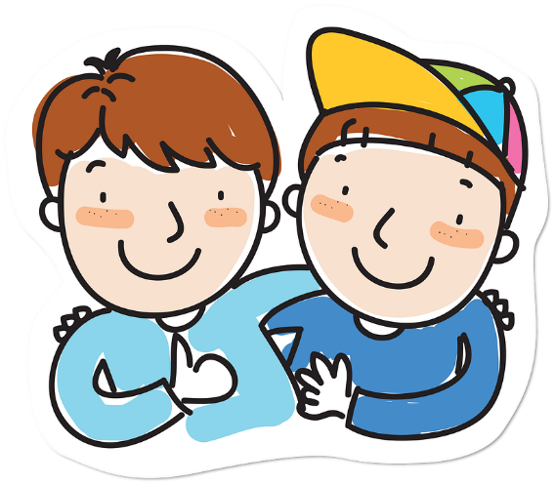
Remember that person?
When have you been surprised to run into someone unexpectedly?
Today we look at how Jesus’ followers were surprised on Easter morning.
They were surprised by the empty tomb, and then by the appearance of Jesus
Because of who they saw and heard and spoke to in person, we can be confident of the reality of the resurrection.

Slide 4
Listen for phenomenal events.
Matthew 28:1-5 (NIV) After the Sabbath, at dawn on the first day of the week, Mary Magdalene and the other Mary went to look at the tomb. 2 There was a violent earthquake, for an angel of the Lord came down from heaven and, going to the tomb, rolled back the stone and sat on it.

Slide 5
Listen for phenomenal events.
His appearance was like lightning, and his clothes were white as snow. 4 The guards were so afraid of him that they shook and became like dead men. 5 The angel said to the women, "Do not be afraid, for I know that you are looking for Jesus, who was crucified.

Slide 6
The Event
If you can mentally place yourself at the tomb of Christ on that first “Easter morning,” what emotions would you be feeling as you approached?
When does it appear the women returned to the tomb?
What does the passage say was the reason they returned to the tomb?

Slide 7
The Event
Note: Jesus’ body had been removed from the cross and placed in the tomb late on Friday.
This was the beginning of the Sabbath
The tasks to properly deal with the typical burial tasks could not be completed because of the religious rules regarding the Sabbath
So the women probably were bringing burial spices put around the corpse

Slide 8
The Event
What phenomenal events does Matthew describe in this account?
God is at work here in a powerful way. When have you seen the power of God demonstrated?
What is the significance of the fact that the tomb was already empty when the stone was first rolled away?

Slide 9
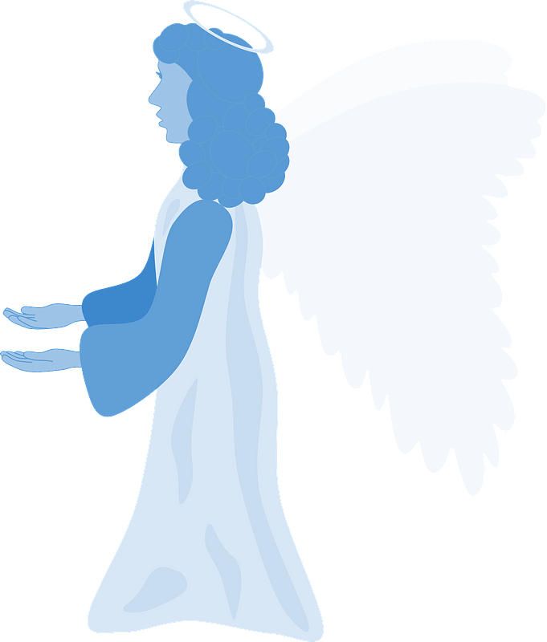
The Event
The angel had to tell them (as always), “Don’t be afraid.” Why do you think fear is often our first response when we don’t understand something God is doing?
Fear not!

Slide 10
Listen for instructions from the angel.
Matthew 28:6-7 (NIV) He is not here; he has risen, just as he said. Come and see the place where he lay. 7 Then go quickly and tell his disciples: 'He has risen from the dead and is going ahead of you into Galilee. There you will see him.' Now I have told you."

Slide 11
The Evidence Can Be Investigated
What was the message announced by the angel?
The angel reminded them that Jesus had told them this would happen. Why do you think they needed to be told again? Why do we need to be reminded often of what God wants for us?
How did the women’s experience at the tomb contrast with what they expected?
What They Expected | What Actually Happened

Slide 12
The Evidence Can Be Investigated
What were the women invited to do?
What were they commissioned to do?
How did the invitation and the commission relate to each other?

Slide 13
Listen for the women’s reaction.
Matthew 28:8-10 (NIV) So the women hurried away from the tomb, afraid yet filled with joy, and ran to tell his disciples. 9 Suddenly Jesus met them. "Greetings," he said. They came to him, clasped his feet and worshiped him. 10 Then Jesus said to them, "Do not be afraid. Go and tell my brothers to go to Galilee; there they will see me."

Slide 14
Share the Good News
When the women met the living Jesus, what was their immediate response?
What words of challenge and comfort did the women receive?
What difference would the certainty that Jesus rose from death make in all their lives?

Slide 15
Share the Good News
How can being certain that Jesus rose from the dead make an ongoing difference in our lives?
In what sense are we eyewitnesses to the reality of the resurrection, to new life?
The women met personally with the Risen Lord. How can we meet personally with the Risen Lord?

Slide 16
Application
Realize.
Thank Jesus for His gift of eternal life, made possible by His victory over death.

Slide 17
Application
Memorize.
Memorize Matthew 28:6, “He is not here. For he has risen, just as he said. Come and see the place where he lay.”
Let this verse become a source of joy and strength for you as you seek to follow Jesus daily

Slide 18
Application
Exercise.
Share your story of making the decision to follow Jesus with someone you know who is far from God.

Slide 19
Family Activities
I’m in trouble! They stopped me at the Ribrutanesu boarder with this coded message. I must return the decryption to the nearest Baptist church before I can cross. Can you help? I heard there was assistance at https://tinyurl.com/2s4b3xzu While you’re there check out the additional educational family stuff you will find.

Slide 20
Jesus Lives and You Can Too
April 17 Easter Sunday

