Slide 1
Jethro and Moses
June 4

Slide 2
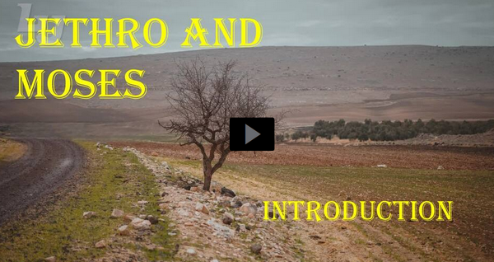
Video Introduction
View Video

Slide 3
Think about it …
What are some interesting words of advice you have heard?
Today we consider advice given to that great leader, Moses.
Be ready to give and receive godly wisdom.

Slide 4
Listen for praise to the Lord.
Exodus 18:9-11 (NIV) Jethro was delighted to hear about all the good things the LORD had done for Israel in rescuing them from the hand of the Egyptians. 10 He said, "Praise be to the LORD, who rescued you from

Slide 5
Listen for praise to the Lord.
the hand of the Egyptians and of Pharaoh, and who rescued the people from the hand of the Egyptians. 11 Now I know that the LORD is greater than all other gods, for he did this to those who had treated Israel arrogantly."

Slide 6
Acknowledge God at Work
Jethro was Moses’ father-in-law. Over what did he rejoice?
What kinds of God given victories could a family be celebrating?
Why is it so important to acknowledge God’s work?

Slide 7
Listen for Jethro’s evaluation.
Exodus 18:14-18 (NIV) When his father-in-law saw all that Moses was doing for the people, he said, "What is this you are doing for the people? Why do you alone sit as judge, while all these people stand around you from morning till evening?" 15 Moses answered him,

Slide 8
Listen for Jethro’s evaluation.
"Because the people come to me to seek God's will. 16 Whenever they have a dispute, it is brought to me, and I decide between the parties and inform them of God's decrees and laws." 17 Moses' father-in-law replied, "What you are doing is not good.

Slide 9
Listen for Jethro’s evaluation.
You and these people who come to you will only wear yourselves out. The work is too heavy for you; you cannot handle it alone.

Slide 10
Constructive Criticism
What observation did Jethro make about the work of Moses?
How did Moses seek to explain—maybe even try to justify—his work?
What appeared to be Jethro’s concern?
What are signs of burnout in ministering to others?

Slide 11
Constructive Criticism
What are the dangers of trying to do too much by yourself?
What are some examples of the difference between constructive criticism and just being critical?
Being Critical – Instead of saying … | Constructive Criticism – Better to say …
“You’re stupid” ? | ? “You should pace yourself.”

Slide 12
Listen for Jethro’s advice.
Exodus 18:19-21 (NIV) Listen now to me and I will give you some advice, and may God be with you. You must be the people's representative before God and bring their disputes to him. 20 Teach them the decrees and laws, and show them the way to live and the duties they are to perform.

Slide 13
Listen for Jethro’s advice.
But select capable men from all the people--men who fear God, trustworthy men who hate dishonest gain--and appoint them as officials over thousands, hundreds, fifties and tens.

Slide 14
Encourage with Sound Counsel
What advice did Jethro give?
In what ways was Jethro a help?
What qualities was Moses to look for in his selection of individuals to assist him in the work?
Why are the personal qualities of a leader important to working with people?

Slide 15
Encourage with Sound Counsel
Why do our friends sometimes see problems and solutions that we do not?
We need this kind of friend … someone who would counsel us through problems.
What chances do you take when you offer this kind of friendship to someone you know?
We need to be this kind of friend, willing to offer loving, constructive counsel.

Slide 16
Application
Pray.
Over the next week, pray each day that God would either lay on your heart someone you want to learn from.
Or someone you could help.

Slide 17
Application
Seek.
Intentionally search out someone who could serve as a mentor to you.
Ask this person to prayerfully consider walking alongside you and helping you grow.

Slide 18
Application
Invest.
Choose to mentor someone else.
Ask someone if he or she would be willing to walk alongside you and allow you to speak into his or her life.

Slide 19
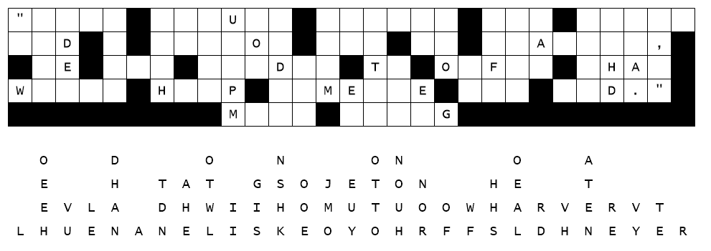
Family Activities
Oh, please help us fix it. All the letters fell out of their columns, straight down. If you get stuck go to https://tinyurl.com/4ubhutss. There are other Fun Family Activities there also.

Slide 20
Jethro and Moses
June 4

