Slide 1
John the Baptist:
A Faith that
Challenges Others
June 29

Slide 2

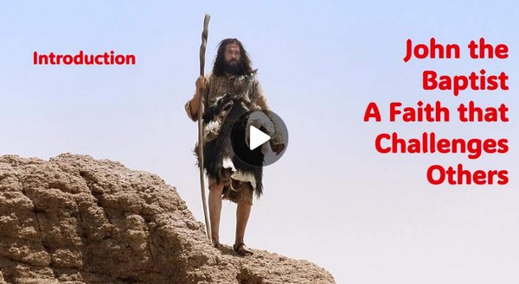
Video Introduction
View Video

Slide 3


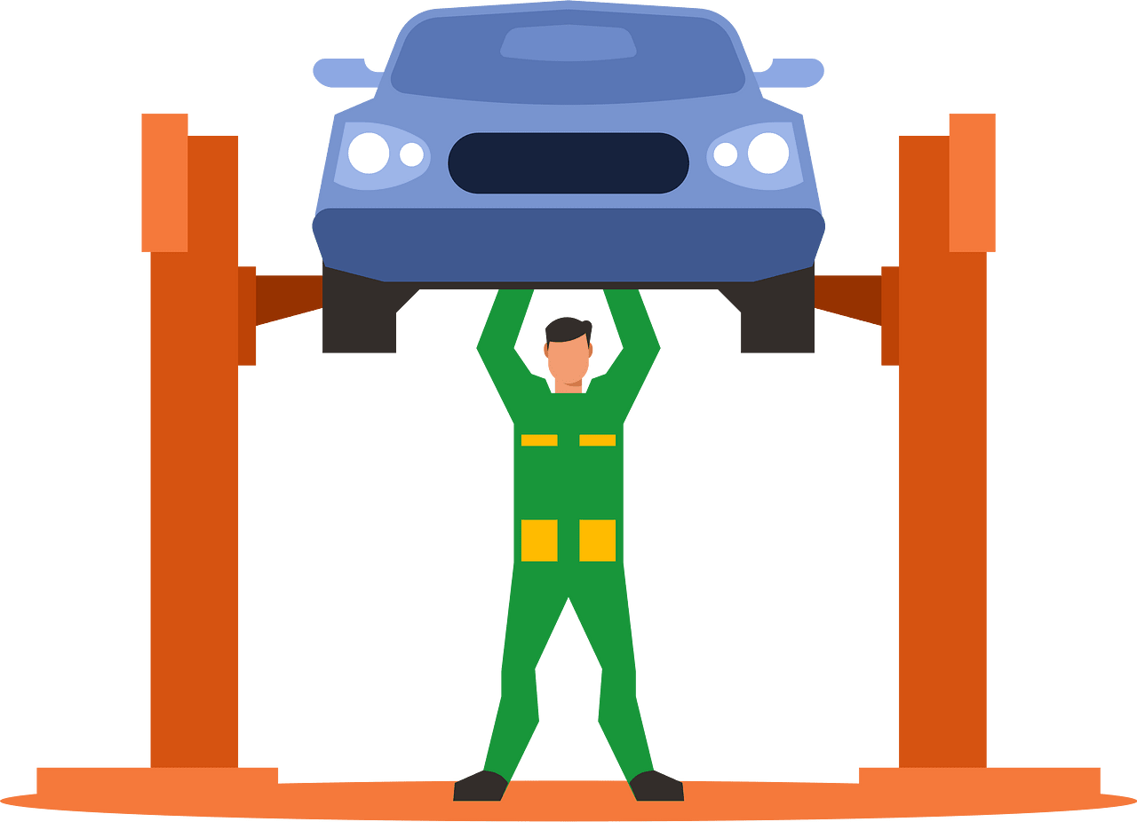
It was a big mistake …
When has someone failed to take advice from an expert and later paid the price for refusing it?
Jesus gave us “expert advice” to be involved in the Great Commission.
  We must be involved in communicating the Truth of the Gospel
  Our faith stands unwaveringly on that Truth.

Slide 4
Listen for an eccentric.
Matthew 3:1-6 (NIV) In those days John the Baptist came, preaching in the Desert of Judea 2 and saying, "Repent, for the kingdom of heaven is near." 3 This is he who was spoken of through the prophet Isaiah: "A voice of one calling in the desert, 'Prepare the way for the Lord, make straight

Slide 5
Listen for an eccentric.
paths for him.'" 4 John's clothes were made of camel's hair, and he had a leather belt around his waist. His food was locusts and wild honey. 5 People went out to him from Jerusalem and all Judea and the whole region of the Jordan. 6 Confessing their sins, they were baptized by him in the Jordan River.

Slide 6
A Voice
What do verses 1–3 tell us about John's mission and message?
What might his appearance and place of ministry represent?
Why do you think John lived such an eccentric life?

Slide 7
A Voice
What specific things did John the Baptist say or do in this passage that show boldness or fearlessness?
What kinds of reactions might he have risked?
How can our faith make us stand out from the world?

Slide 8
A Voice
Note the meanings of some of the key words in the passage:
Repent
  Change direction in your life
  Turn around
  Give up sinning
  Live a life of righteousness

Slide 9

A Voice
Note the meanings of some of the key words in the passage:
Kingdom of Heaven
  Kingdom of God
  Realm where God rules
  Challenge to allow God to rule in your life

Slide 10
A Voice
Note the meanings of some of the key words in the passage:
Confessing
  Agree with God that you are a sinner
  Declare that you know that you do wrong

Slide 11
A Voice
Note the meanings of some of the key words in the passage:
Baptizing
  The word “baptize” means “immerse”
  Metaphor for Jesus’ burial and resurrection
  Demonstrates spiritual cleansing that has taken place
  Is a testimony to others, both believers and unbelievers

Slide 12
Listen for “in your face” comments.
Matthew 3:7-10 (NIV) But when he saw many of the Pharisees and Sadducees coming to where he was baptizing, he said to them: "You brood of vipers! Who warned you to flee from the coming wrath? 8 Produce fruit in keeping with repentance. 9 And do not think you

Slide 13
Listen for “in your face” comments.
can say to yourselves, 'We have Abraham as our father.' I tell you that out of these stones God can raise up children for Abraham. 10 The ax is already at the root of the trees, and every tree that does not produce good fruit will be cut down and thrown into the fire.

Slide 14
Speak Out !
John directed part of his message of truth to the Pharisees and Sadducees. How did he characterize them?
Why do you think he didn’t hold back?
What does this teach us about speaking the truth in love?
What did he say was required of them?

Slide 15

Speak Out !
To what would they be subject if they refused to confess and repent?
How can believers strike the balance between confronting people lovingly but boldly?

Slide 16
Listen for a prophecy.
Matthew 3:11-12 (NIV) "I baptize you with water for repentance. But after me will come one who is more powerful than I, whose sandals I am not fit to carry. He will baptize you with the Holy Spirit and with fire. 12 His winnowing fork is in his hand, and he will clear his threshing floor, gathering his wheat into the barn and burning up the chaff with unquenchable fire."

Slide 17
Proclaim Jesus
Verse 11 refers to the Holy Spirit and fire. How might the Holy Spirit help us overcome fear and speak with courage?
What two contrasts does John offer between himself and the mighty One to come?

Slide 18
Proclaim Jesus
What is the significance of the images "winnowing fork," "gathering His wheat," and "burning up the chaff"?
In what ways can remembering that we are preparing the way for the Lord (like John) help us speak more confidently?

Slide 19
Application
Ask.
  Ask God to help you become a person who stands for truth, no matter the cost.
  Ask Him to give you courage for the journey.

Slide 20
Application
Analyze.
  Look at your life.
  Are you willing to let go of disobedience to God’s Word that is keeping you from telling others about your faith in Jesus Christ?
  Make a list of those things that are obstacles right now and pray for God to remove them.

Slide 21
Application
Act.
  Don’t wait for the perfect time, place, or opportunity.
  Put into practice the things you have learned about sharing your faith and do it.
  Practice with a family member or friend.
  The more you act, the more comfortable you will become in being a soul-winner.

Slide 22
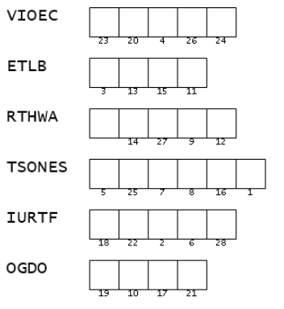

Family Activities
This image was beamed to us from the far away galaxy, Theris Puof . The persecuted church there sent it to us in two parts. This part is the key words taken from your Bible passage. Unscramble them to give you the letters for the message. Technical assistance is available at https://tinyurl.com/yjwyu4mj where you will also find other Fun Family Activities

Slide 23
John the Baptist:
A Faith that
Challenges Others
June 29

