Slide 1
Joining God’s Work
February 28

Slide 2
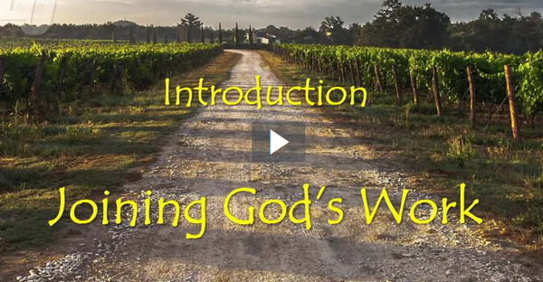
Video Introduction
View Video

Slide 3
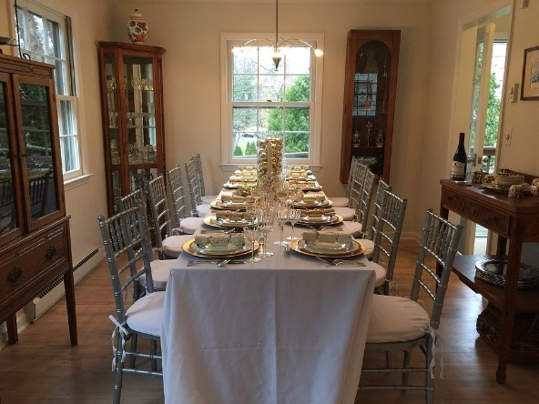
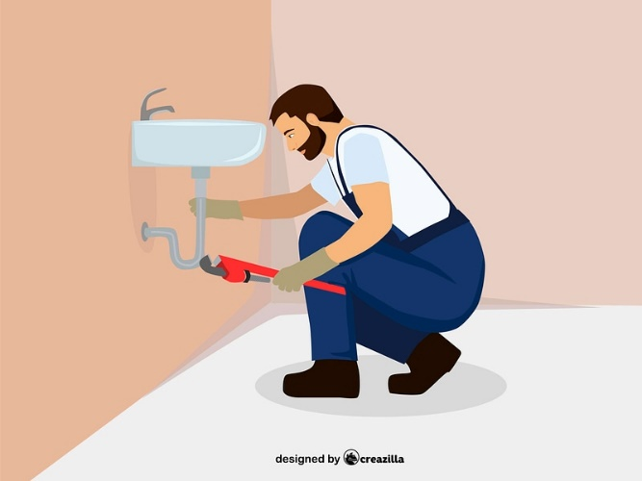
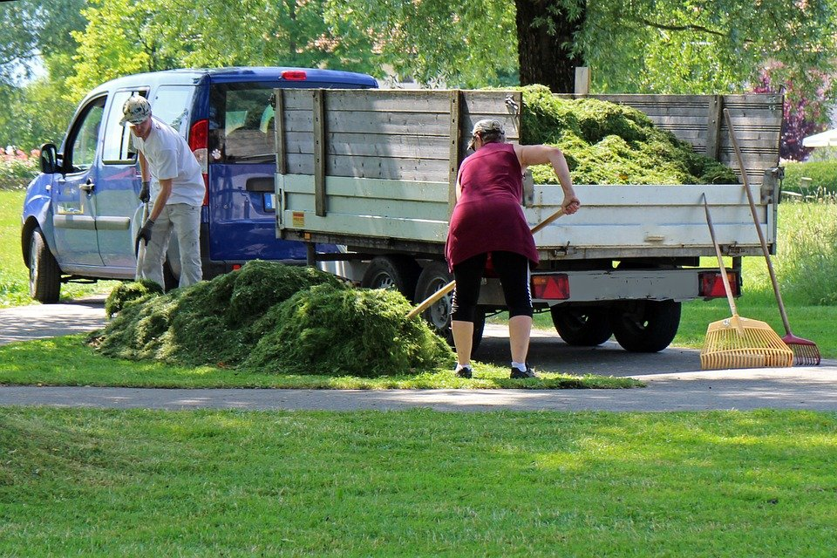
Remember that time …
When has a task looked bigger than your ability to get it done?
We know that believers are to join God’s work in both the church and the world.
We may well feel that the task to be beyond our abilities.
We must realize we are not alone. God will be working through us.

Slide 4
Listen for an analogy.
John 15:1-3 (NIV) "I am the true vine, and my Father is the gardener. 2 He cuts off every branch in me that bears no fruit, while every branch that does bear fruit he prunes so that it will be even more fruitful. 3 You are already clean because of the word I have spoken to you.

Slide 5
God’s Expectation
Consider the three personalities spoken of in the passage, God the Father, Jesus, and believers. What is the role of each as specified by the passage?
Role of God the Father | Jesus’ Role | Believer’s Role

Slide 6
God’s Expectation
In gardening, what is the purpose of pruning?
What are some common types of “pruning” that Christians need?
In what ways might God be wanting to remove "dead" or useless pieces in our lives?
What are some things that God expects believers to produce? What does it mean to bear fruit as a Christian?

Slide 7
Listen for an essential connection.
John 15:4-5 (NIV) Remain in me, and I will remain in you. No branch can bear fruit by itself; it must remain in the vine. Neither can you bear fruit unless you remain in me. 5 "I am the vine; you are the branches. If a man remains in me and I in him, he will bear much fruit; apart from me you can do nothing.

Slide 8
Our Relationship with Jesus
What is essential if one is to be spiritually effective, or fruitful?
How does Jesus describe the relationship between Himself and believers?
What did He say that makes it clear that believers are completely dependent on Him?

Slide 9
Our Relationship with Jesus
What does it mean to “remain in” or “abide” in Christ? What does this look like in a practical sense in one’s life?
What are some ways the world’s advice differs from that of Jesus in 15:4?
The World’s Advice | Jesus’ Advice

Slide 10
Our Relationship with Jesus
Jesus says apart from Him we can do nothing. How would you answer someone who brags to you of his or her list of accomplishments?
When is it difficult to develop and maintain a personal relationship with Jesus?
What are practical things we do to stay connected to Jesus? How do spiritual disciplines help us remain/abide in Jesus?

Slide 11
Listen for the fate of fruitless branches.
John 15:6-8 (NIV) If anyone does not remain in me, he is like a branch that is thrown away and withers; such branches are picked up, thrown into the fire and burned. 7 If you remain in me and my words

Slide 12
Listen for the fate of fruitless branches.
remain in you, ask whatever you wish, and it will be given you. 8 This is to my Father's glory, that you bear much fruit, showing yourselves to be my disciples.

Slide 13
God Is Glorified
What did Jesus say would happen to the branches that did not remain in Him?
Whom or what do you think the withered branches represent?
What privilege was given to the branches that remained in the vine?

Slide 14
God Is Glorified
What is the ultimate purpose for bearing fruit?
How does the fruit we produce bring glory to God?
When have you seen God glorified through the spiritual fruit of believers?

Slide 15
Application
Remain in Christ.
Surrender your plans and choose to remain in Christ, living in Him and in His power.
Pray for open eyes to see the ministry opportunities He places before you.

Slide 16
Application
Mentor.
If you are already involved in a ministry, offer to mentor someone who is not.
Disciple them in the discipline of abiding in Christ.
Help them discover how they can minister too.

Slide 17
Application
Lead.
If God is calling you to ministry leadership, accept His call.
Talk with your pastor about this calling and your next steps.

Slide 18
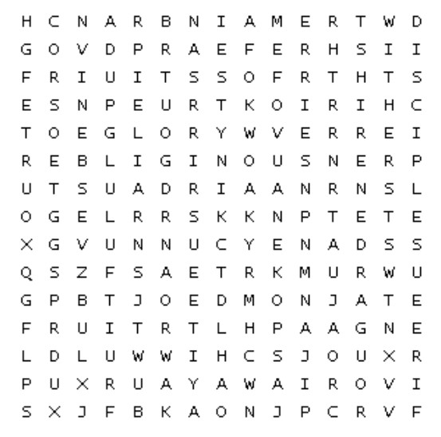
Family Activities
And I appreciate that! We need help to forward this message to the Qanei Swilesan representative on the Mission Board. Further fruitfulness can be found at https://tinyurl.com/2ulh89t2
Humph! If it weren’t for the lesson on the members of the Body helping one another …

Slide 19
Joining God’s Work
February 28

