Slide 1
Joseph & His Brothers: Family Reconciliation
November 17

Slide 2
Video Introduction
View Video

Slide 3
What do you think?
How would you describe the taste of bitterness?
Sometimes the harsh, disagreeable feeling comes in relationships
Joseph could have felt that way but was willing to forgive his brothers.
Forgiveness can lead to family healing and restoration.

Slide 4
Listen for Jacob’s reservations.
Genesis 42:3-5 (NIV) Then ten of Joseph's brothers went down to buy grain from Egypt. 4 But Jacob did not send Benjamin, Joseph's brother, with the others, because he was afraid that harm might come to him. 5 So Israel's sons were among those who went to buy grain, for the famine was in the land of Canaan also.

Slide 5
Good Out of Crisis
Why did Jacob send only ten of his sons to secure food in Egypt?
How do past experiences shape decisions?
What kinds of concerns might the brothers have had as they set off traveling a long way to get famine relief?

Slide 6
Good Out of Crisis
What do you suppose the brothers thought about why Benjamin was not told to go with them?
Jacob’s decision to keep Benjamin home could have been due to a lack of trust in God’s protection, or simply a father’s fear. How do we balance practical caution with faith in times of uncertainty?

Slide 7
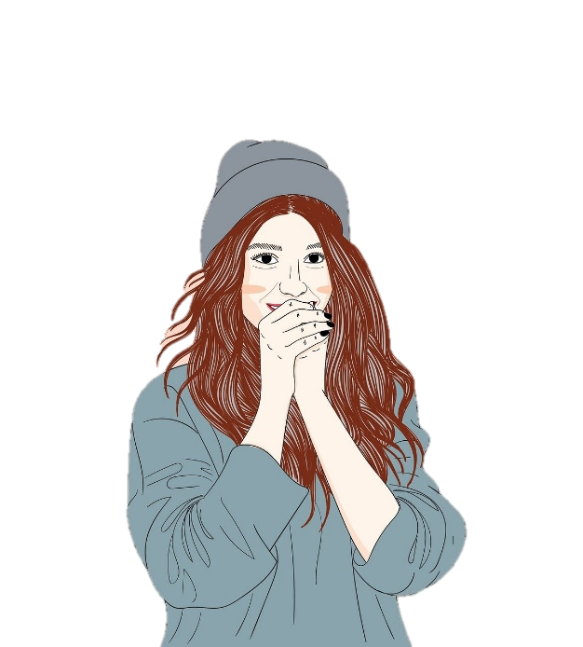
Good Out of Crisis
Reflect on a time when you or someone else had to step out of a comfort zone in response to a need. How did faith and relationships influence the journey?

Slide 8
Listen for “I told you so”
Genesis 42:21-24a (NIV) They said to one another, "Surely we are being punished because of our brother. We saw how distressed he was when he pleaded with us for his life, but we would not listen; that's why this distress has come upon us." 22 Reuben replied, "Didn't I tell you not

Slide 9
Listen for “I told you so”
to sin against the boy? But you wouldn't listen! Now we must give an accounting for his blood." 23 They did not realize that Joseph could understand them, since he was using an interpreter. 24 He turned away from them and began to weep, but then turned back and spoke to them again.

Slide 10
I Was Wrong
Why do you think the brothers immediately remember their treatment of Joseph when they face trouble in Egypt?
Consider how guilt and unresolved issues from the past can resurface. How might this experience affect their conscience or sense of justice?

Slide 11
I Was Wrong
What obstacles often prevent us from admitting that we’re wrong?
What are the benefits of repenting?
Reflect on the emotional complexity of Joseph’s position. What might this moment mean for him in terms of forgiveness, empathy, or unresolved hurt?

Slide 12
Listen for a big surprise.
Genesis 45:1-5 (NIV) Then Joseph could no longer control himself before all his attendants, and he cried out, "Have everyone leave my presence!" So there was no one with Joseph when he made himself known to his brothers. 2 And he wept so loudly that the Egyptians heard

Slide 13
Listen for a big surprise.
him, and Pharaoh's household heard about it. 3 Joseph said to his brothers, "I am Joseph! Is my father still living?" But his brothers were not able to answer him, because they were terrified at his presence. 4 Then Joseph said to his brothers, "Come close

Slide 14
Listen for a big surprise.
to me." When they had done so, he said, "I am your brother Joseph, the one you sold into Egypt! 5 And now, do not be distressed and do not be angry with yourselves for selling me here, because it was to save lives that God sent me ahead of you.

Slide 15
Let Go of the Past
Imagine that you are Joseph and your brothers show up. What reasons might you have for not telling them right away who you are?
Why would the brothers have been troubled by Joseph’s identifying himself to them?

Slide 16
Let Go of the Past
Note what Joseph told his brothers …
Don’t be distressed, don’t be angry
It was to save lives that God sent me ahead of you
God sent me ahead of you to save your lives, to deliver you
God put me here as an adviser to Pharaoh and gave me great authority

Slide 17
Let Go of the Past
Why is it important to forgive others?

Slide 18
Application
Using an online Bible, do a quick search for scriptures on forgiveness.
Write one on a sticky note and place it on your mirror.
Let it be a reminder to always choose forgiveness over bitterness.

Slide 19
Application
Journal
Write down a personal story of forgiveness with a family member or friend.
What was the outcome?

Slide 20
Application
Who do you need to forgive today?
Ask God to lead you as you seek reconciliation and forgiveness this week.
Be the initiator of the process this week.

Slide 21
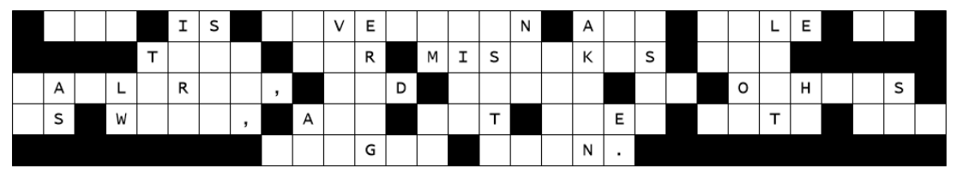
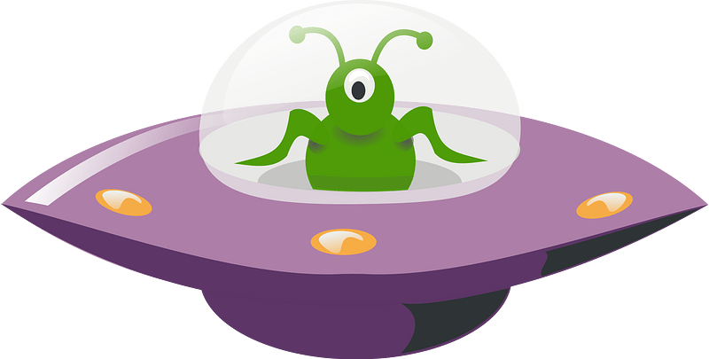
Family Activities
There he goes … leaving a mess behind. Can you pick up the letters and put them back? They fell straight down. Get help at https://tinyurl.com/44un8bje Check out other Fun Family Activities there also.

Slide 22
Joseph & His Brothers: Family Reconciliation
November 17

