Slide 1
Joseph and His Brothers: Family Jealousy
November 10

Slide 2
Video Introduction
View Video

Slide 3
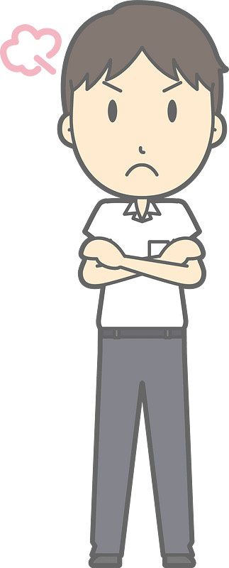
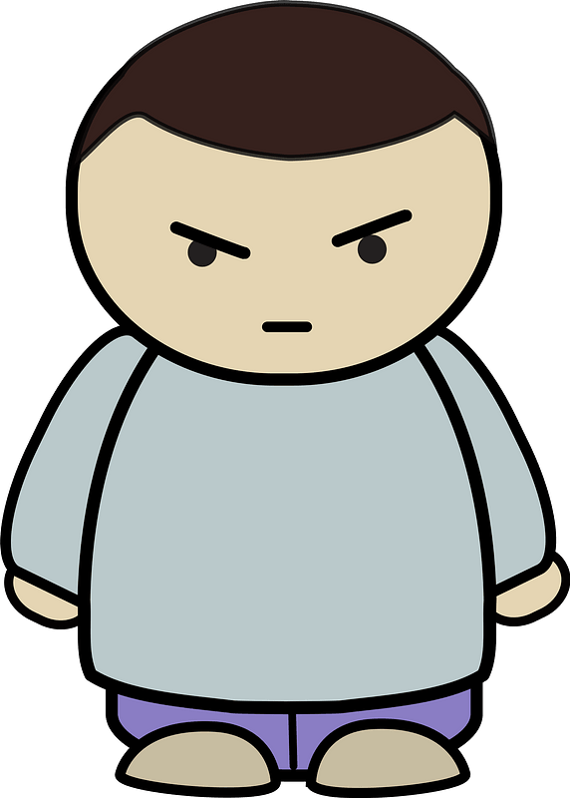
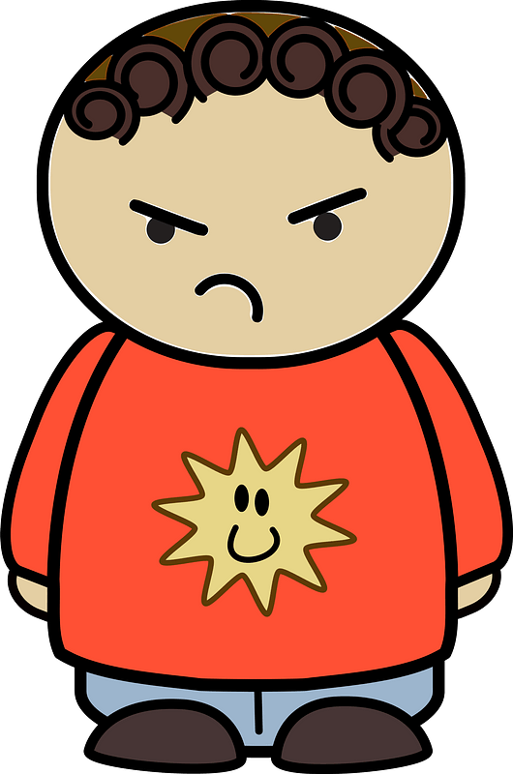
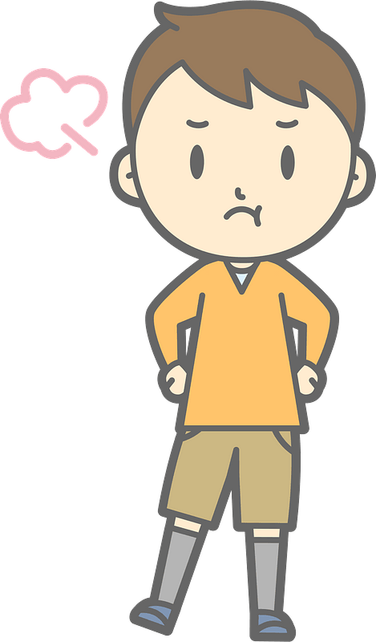
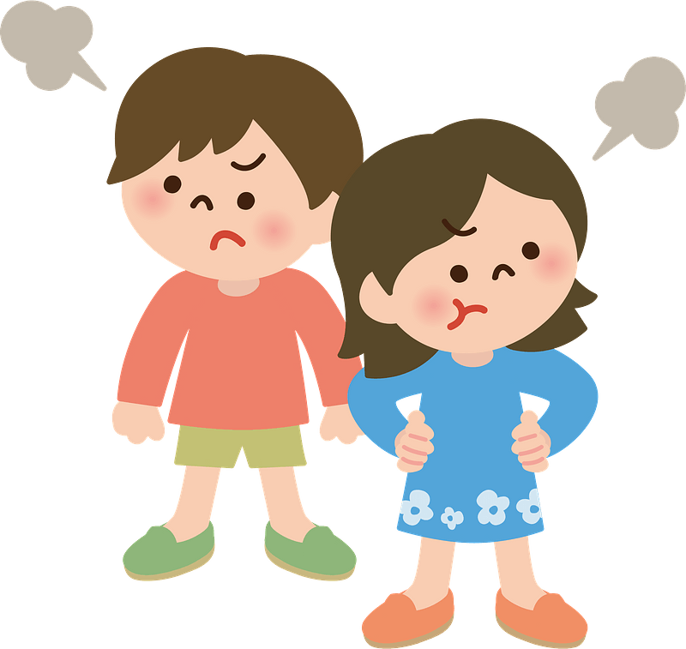
Admit it, now …
What did sibling rivalry look like in your family?
Some of these are inevitable … some avoidable.
Today we look at sibling rivalry in Jacob’s sons
We see that unchecked animosity can lead to great harm within the family

Slide 4
Listen for who was the favorite.
Genesis 37:1-4 (NIV) Jacob lived in the land where his father had stayed, the land of Canaan. 2 This is the account of Jacob. Joseph, a young man of seventeen, was tending the flocks with his brothers, the sons of Bilhah and the sons of Zilpah, his father's wives, and he brought their father a bad report about

Slide 5
Listen for who was the favorite.
them. 3 Now Israel loved Joseph more than any of his other sons, because he had been born to him in his old age; and he made a richly ornamented robe for him. 4 When his brothers saw that their father loved him more than any of them, they hated him and could not speak a kind word to him.

Slide 6
Bad Reports and Favoritism
Why might a parent favor one child over another?
What reasons do you see for conflict between Joseph and his brothers?
What other kinds of things cause jealousy between siblings?
How does boasting get people like Joseph into trouble?

Slide 7
Bad Reports and Favoritism
You are one of the brothers. How do you feel about Joseph? What thoughts would you have?
Thinking of cause and effect, do you think hatred was the cause or the result of this conflict?
How can parents avoid fueling jealousy between their children?

Slide 8
Listen for plans of betrayal.
Genesis 37:18-24 (NIV) But they saw him in the distance, and before he reached them, they plotted to kill him. 19 "Here comes that dreamer!" they said to each other. 20 "Come now, let's kill him and throw him into one of these cisterns and say that a ferocious animal devoured him. Then

Slide 9
Listen for plans of betrayal.
we'll see what comes of his dreams." 21 When Reuben heard this, he tried to rescue him from their hands. "Let's not take his life," he said. 22 "Don't shed any blood. Throw him into this cistern here in the desert, but don't lay a hand on him." Reuben said this to rescue him from

Slide 10
Listen for plans of betrayal.
them and take him back to his father. 23 So when Joseph came to his brothers, they stripped him of his robe--the richly ornamented robe he was wearing-- 24 and they took him and threw him into the cistern. Now the cistern was empty; there was no water in it.

Slide 11
Jealousy, Animosity, Betrayal
Based on the fancy coat and the bragging, why did Joseph’s brothers hold him in such contempt?
What emotional reaction do you have to Joseph’s betrayal by the brothers?
What makes jealousy such a powerful emotion?

Slide 12
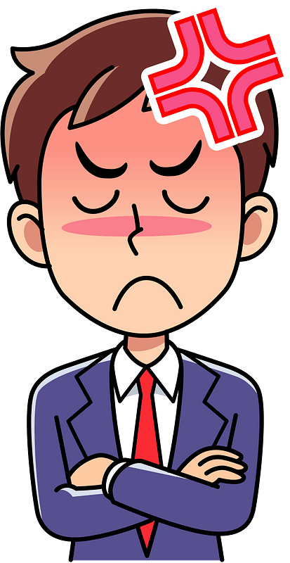
Jealousy, Animosity, Betrayal
How can you keep anger or jealousy from taking root in your life? How should we deal with feelings of jealousy?

Slide 13
Listen for deceit.
Genesis 37:31-34 (NIV) Then they got Joseph's robe, slaughtered a goat and dipped the robe in the blood. 32 They took the ornamented robe back to their father and said, "We found this. Examine it to see whether it is your son's

Slide 14
Listen for deceit.
robe." 33 He recognized it and said, "It is my son's robe! Some ferocious animal has devoured him. Joseph has surely been torn to pieces." 34 Then Jacob tore his clothes, put on sackcloth and mourned for his son many days.

Slide 15
Deception and Grief
Why did the brothers feel they could let their father believe that Joseph was dead, rather than simply admitting they sold him?
How might keeping this secret have impacted their relationship with their father in the future?

Slide 16
Deception and Grief
How does this event fit into the larger story of God’s plan for Joseph and his family?
What does this passage show us about how God can work through even the darkest moments of deception and loss?

Slide 17
Application
Pray.
Pray for God to keep you from all forms of animosity and resentment.
We must not tolerate attitudes of unkindness toward others.
Left unchecked, the root of our wrong attitudes can grow into harmful actions with bitter consequences.

Slide 18
Application
Share.
Contemplate what you can do to stop these types of issues from taking root in your heart.
Connect with a friend who knows you well and share with them your struggles.

Slide 19
Application
Forgive.
With God’s help begin the process of forgiving someone from a past hurt.
Start the process of reconciliation with that individual (Eph. 4:31-32).

Slide 20
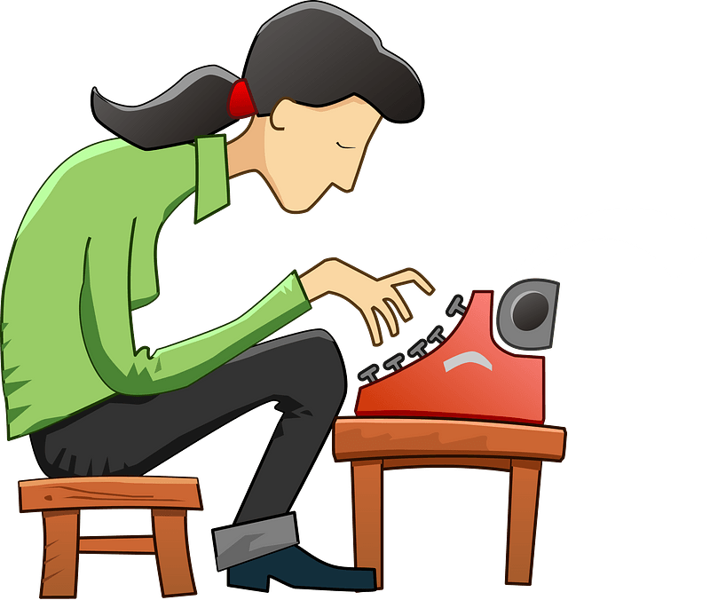
Family Activities
I sure hope you have the other half of this message, the key. The church in Janofzertish has an important exhortation for you. If you get stuck, help is available at https://tinyurl.com/2s3hrf8u You can also find the crossword there (you guys in the back row).

Slide 21
Joseph and His Brothers: Family Jealousy
November 10

