Slide 1
Joshua: A Faith Rooted in God’s Word
June 8

Slide 2
Video Introduction
View Video

Slide 3
In your humble opinion …
What are some important leadership traits?
Today ⇨ we look at new leader for the children of Israel … Joshua
God gives assurance that He will be with Joshua
Joshua accepts leadership, trusting in what God promises

Slide 4
Listen for promises.
Joshua 1:1-5 (NIV) After the death of Moses the servant of the LORD, the LORD said to Joshua son of Nun, Moses' aide: 2 "Moses my servant is dead. Now then, you and all these people, get ready to cross the Jordan River into the land I am about to give to them--to the Israelites. 3 I will give you every place where you set your

Slide 5
Listen for promises.
foot, as I promised Moses. 4 Your territory will extend from the desert to Lebanon, and from the great river, the Euphrates--all the Hittite country--to the Great Sea on the west. 5 No one will be able to stand up against you all the days of your life. As I was with Moses, so I will be with you; I will never leave you nor forsake you.

Slide 6
Those Who Preceded Us
Why was the death of Moses a major event for the people of Israel?
For what major challenge did the Lord want Joshua to get the Israelites prepared?
What mixed feelings might Joshua have had in this leadership transition?

Slide 7
Those Who Preceded Us
Joshua might have felt inadequate. What kinds of things cause you to feel discouraged or inadequate?
What assurances or promises were given to Joshua that the task was achievable and victory assured?
What are some assurances and promises from God that you can claim?

Slide 8
Listen for a repeated challenge.
Joshua 1:6-9 (NIV) "Be strong and courageous, because you will lead these people to inherit the land I swore to their forefathers to give them. 7 Be strong and very courageous. Be careful to obey all the law my servant Moses gave you; do not turn from it to the right or to the left, that you may be successful wherever you go. 8 Do not

Slide 9
Listen for a repeated challenge.
let this Book of the Law depart from your mouth; meditate on it day and night, so that you may be careful to do everything written in it. Then you will be prosperous and successful. 9 Have I not commanded you? Be strong and courageous. Do not be terrified; do not be discouraged, for the LORD your God will be with you wherever you go."

Slide 10
Center Your Life on God’s Word
God said three times, “be strong and courageous.” Why do you think God would repeat Himself?
What specific steps did the Lord instruct Joshua to take in order to be successful?
Why do you think obedience is so important to God?

Slide 11
Center Your Life on God’s Word
Joshua needed to be intimate with God’s Word to be a good leader. What would be the value of hearing God’s commands and promises from God, Himself?
Consider that God still speaks to us … maybe not audibly, but how?

Slide 12
Listen for commitments made.
Joshua 1:16-18 (NIV) Then they answered Joshua, "Whatever you have commanded us we will do, and wherever you send us we will go. 17 Just as we fully obeyed Moses, so we will obey you. Only may

Slide 13
Listen for commitments made.
the LORD your God be with you as he was with Moses. 18 Whoever rebels against your word and does not obey your words, whatever you may command them, will be put to death. Only be strong and courageous!"

Slide 14
You Become the Example
What did the people commit themselves to do?
What did they expect of Joshua in return?
What is the relationship between their willingness to follow Joshua and their conviction that he was leading from the presence of the Lord?

Slide 15
You Become the Example
The people affirmed their commitment to follow Joshua. Why is it important to have godly people affirm us as we follow God?
What are some ways we can display a consistent example of faith?

Slide 16
Application
Observe.
Faith can be strengthened by observing people who live a faith-based life.
Choose someone in your life who walks with God and carefully observe how this person follows Him.
Perhaps you could shadow this individual for a day and learn from him or her.

Slide 17
Application
Focus.
Observing others’ beliefs is a great first step, but ultimately your faith should be centered on God’s Word.
Focus your attention on God’s Word, and your faith will grow in a manner that pleases God.
Read, study, and make God’s Word the foundation of your faith.
If you don’t have a plan for Bible study, ask for help from your group leader.

Slide 18
Application
Display.
Let your faith practice be an example for other people to follow.
Seek out others to mentor and be their example of living a life of faith.
Remember to be strong and courageous.

Slide 19
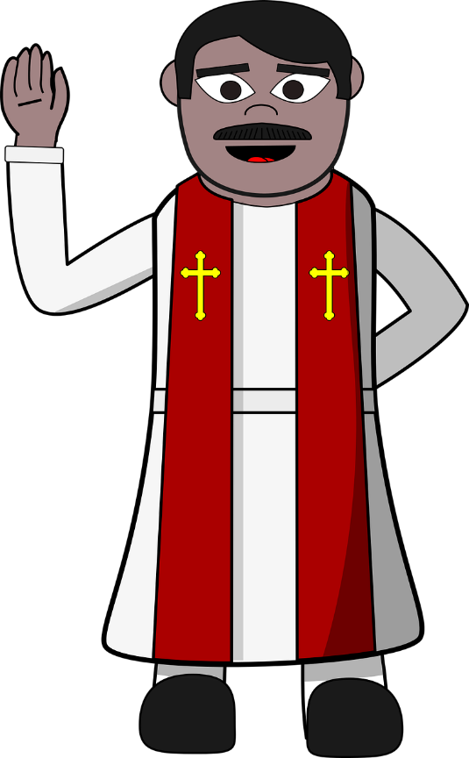
Family Activities
Here in Bamoacay believers must be strong and courageous. We have sent you a coded message. Help your cryptanalyst to decode it. He has provided the instructions. You might also find further Family Activities along with help with the decoding at https://tinyurl.com/4b55dc42

Slide 20
Joshua: A Faith Rooted in God’s Word
June 8

