Slide 1
Looking Forward to Peace
December 8

Slide 2
Video Introduction
View Video

Slide 3
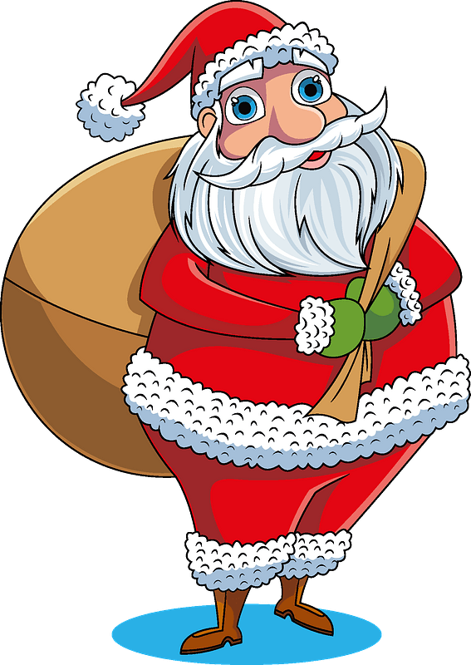
Admit it now …
What are some Christmas movies you can remember seeing?
Perfect, peaceful endings usually happen in these movies
They are harder to come by in real life
We have true peace when we have Christ.

Slide 4
Listen for problems of the people.
Isaiah 8:19-22 (NIV) When men tell you to consult mediums and spiritists, who whisper and mutter, should not a people inquire of their God? Why consult the dead on behalf of the living? [20] To the law and to the testimony! If they do not speak according to this word, they have no light of

Slide 5
Listen for problems of the people.
dawn. [21] Distressed and hungry, they will roam through the land; when they are famished, they will become enraged and, looking upward, will curse their king and their God. [22] Then they will look toward the earth and see only distress and darkness and fearful gloom, and they will be thrust into utter darkness.

Slide 6
No God, No Peace
The Israelites were looking for direction and peace in the wrong places.
Mediums, spiritists
Consulting the dead
Where do people in our culture look for peace and hope in life?

Slide 7
No God, No Peace
Why do we often consult God last?
According to the passage, what would be some of the results for the Israelites of not looking to God’s Law?
How do these results work out in our modern lives today?

Slide 8
No God, No Peace
How have you seen people who don’t worship God blame or curse God when they encounter hardship?
Note the key phrase … “don’t worship God”
When I don’t discover the greatness, the power, the authority and the love of God, then I will be quick to depend on self and blame God
I should be depending on God and admitting/confessing the blame for myself

Slide 9
Listen for light on the horizon.
Isaiah 9:1-5 (NIV) Nevertheless, there will be no more gloom for those who were in distress. In the past he humbled the land of Zebulun and the land of Naphtali, but in the future he will honor Galilee of the Gentiles, by the way of the sea, along the Jordan-- 2 The people walking in

Slide 10
Listen for light on the horizon.
darkness have seen a great light; on those living in the land of the shadow of death a light has dawned. 3 You have enlarged the nation and increased their joy; they rejoice before you as people rejoice at the harvest, as men rejoice when dividing the plunder. 4 For as in the

Slide 11
Listen for light on the horizon.
day of Midian's defeat, you have shattered the yoke that burdens them, the bar across their shoulders, the rod of their oppressor. 5 Every warrior's boot used in battle and every garment rolled in blood will be destined for burning, will be fuel for the fire.

Slide 12
Know God, Know Peace
We see some contrasts … what happens in each contrasting situation
In the past … vs … in the future?
Darkness, shadow of death … vs … Light

Slide 13
Know God, Know Peace
Consider how some of these phrases might be interpreted in the context as Messianic prophecy.
Phrase from the Passage | Possible Implication
People walking in darkness? People living in shadow of death? See a great light? Rejoicing over plunder Shattered the yoke that burdens? Battle uniforms burned? | No knowledge of Gospel message We stand condemned for our sinfulness Jesus, the light of the world Rejoicing over new life, abundant life Freed from the power of sin over our lives Old sinful life put away, taken off

Slide 14
Know God, Know Peace
God will give light when you pursue knowing and worshiping Him, putting Him in charge of your life, submitting to Him
Think about a time when you were physically walking in a dark place … how was it different when the light came on?
What about a time when you were trying to proceed with a complete lack of understanding or wisdom as to what you should do? How was it different when God gave you “light” and revealed His direction?

Slide 15
Listen for titles given.
Isaiah 9:6-7 (NIV) For to us a child is born, to us a son is given, and the government will be on his shoulders. And he will be called Wonderful Counselor, Mighty God, Everlasting Father, Prince of Peace. 7 Of the increase of his government

Slide 16
Listen for titles given.
and peace there will be no end. He will reign on David's throne and over his kingdom, establishing and upholding it with justice and righteousness from that time on and forever. The zeal of the LORD Almighty will accomplish this.

Slide 17
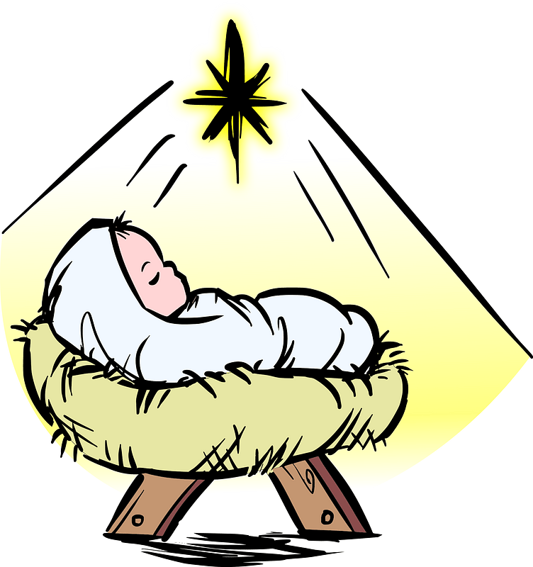
Promise Made, Promise Kept
This was the “light of the world” that God is promising … how do you think people might have responded to the promise that this would be a child?

Slide 18
Promise Made, Promise Kept
Note the titles that would be given to this special child
Wonderful Counselor
Mighty God
Everlasting Father
Prince of Peace
What are the implications or characteristics suggested by the titles?

Slide 19
Promise Made, Promise Kept
The Jews anticipated a political or military leader. What did they hope He would do?
In actuality, what kind of ruler was (is) Jesus?
In what ways does the Messiah want to rule in our lives?

Slide 20
Application
Listen.
In your time with God, read and listen to the song, “I Heard the Bells on Christmas Day,”
Reflect on the peace God gives in times of conflict.

Slide 21
Application
Meditate.
Jesus said, “Peace I leave with you. My peace I give to you. I do not give to you as the world gives. Don’t let your heart be troubled or fearful” (John 14:27).
Spend a minute reflecting of the unique peace God gives.

Slide 22
Application
Reconcile.
As we reflect on the concept of shalom, ask God to reveal to you someone with whom you should reconcile.
This week, initiate reconciliation in one relationship and leave the results to God.

Slide 23
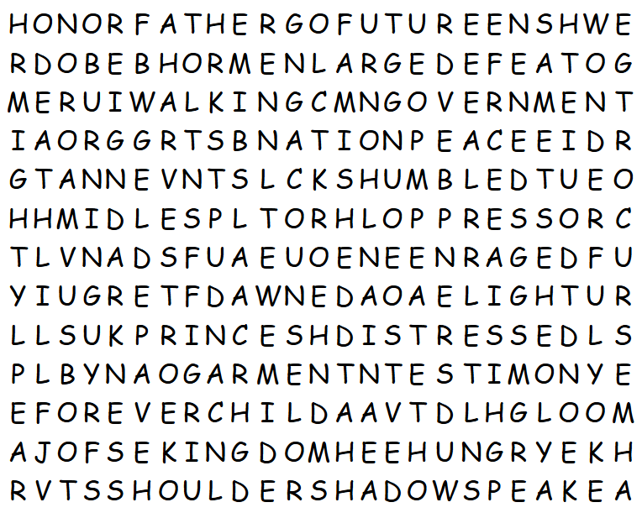
Family Activities
I heard the Word Search Lady was in a mood … surprise, surprise. But, at least she’s not given us backwards words. Whew! I heard Santa’s elves could help you at https://tinyurl.com/muuayhez
Don’t tell her, but you can get the Crossword instead if you want!

Slide 24
Looking Forward to Peace
December 8

