Slide 1
Mary’s Trust
December 16

Slide 2
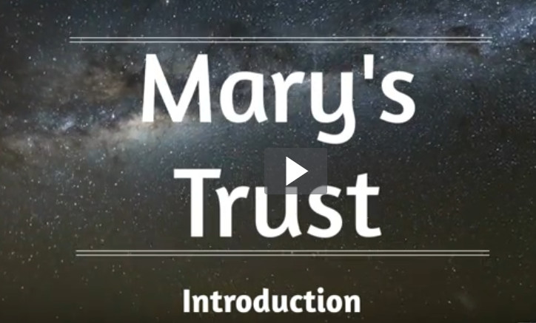
Introduction
View Video

Slide 3
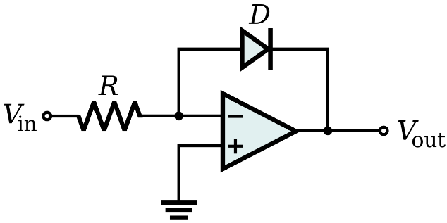
Be honest, now …
What are some things you trust to work even though you don’t know how they work?
Fortunately, understanding how something works is not a prerequisite for using it.
Mary didn’t completely understand God’s working in her life, but she embraced God’s call.
Likewise we must embrace God’s call on our lives.

Slide 4
Listen for a startling revelation.
Luke 1:26-30 (NIV) In the sixth month, God sent the angel Gabriel to Nazareth, a town in Galilee, 27 to a virgin pledged to be married to a man named Joseph, a descendant of David. The virgin's name was Mary. 28 The angel went to her and said, "Greetings,

Slide 5
Listen for a startling revelation.
you who are highly favored! The Lord is with you." 29 Mary was greatly troubled at his words and wondered what kind of greeting this might be. 30 But the angel said to her, "Do not be afraid, Mary, you have found favor with God.

Slide 6
Trust God’s Presence
How could we describe Mary, based on this passage?
What does it mean to be “espoused”? Why is that an important detail of the narrative?
Why was Mary troubled?
On what grounds did Gabriel urge Mary not to be afraid?

Slide 7
Trust God’s Presence
Since Luke did not cite any Old Testament reference to a virgin birth, what might have been the significance of Luke’s identifying Mary as a virgin?
Since Jesus existed before time, why is it significant that He come as a baby?

Slide 8
Trust God’s Presence
How/why do you think God specifically chose Mary?
How about today … how does God choose people today? How does He favor us and choose us for special tasks?

Slide 9
Listen for titles and descriptions given.
Luke 1:31-34 (NIV) You will be with child and give birth to a son, and you are to give him the name Jesus. 32 He will be great and will be called the Son of the Most High. The Lord God will give him the throne of his father David, 33 and he will reign over the house of Jacob forever; his kingdom will never end." "How will this be," Mary asked the angel, "since I am a virgin?"

Slide 10
Trust God’s Plan
What description to we see here about the child Mary would bear?
What is the significance of the names and titles given to this child?
Name | Significance
Jesus
Son of the Most High
Given the throne of David
Kingdom include House of Jacob

Slide 11
Trust God’s Plan
Note that the “Kingdom of God” is the realm where God rules. Therefore, in what way is Jesus to be King today?
How is this kingdom different from other kingdoms?
We experience few apparent angel appearances today. How do believers, this kingdom’s subjects, know what the King wants of them?

Slide 12
Listen for evidence of God’s power.
Luke 1:35-38 (NIV) The angel answered, "The Holy Spirit will come upon you, and the power of the Most High will overshadow you. So the holy one to be born will be called the Son of God. 36 Even Elizabeth your relative is going to have a child

Slide 13
Listen for evidence of God’s power.
in her old age, and she who was said to be barren is in her sixth month. 37 For nothing is impossible with God." 38 "I am the Lord's servant," Mary answered. "May it be to me as you have said." Then the angel left her.

Slide 14
Trust God’s Power
What are some reactions by the world to the concept of Jesus being born to a virgin?
How did Gabriel explain Mary’s conception?
Why, then, was it so important that Jesus be conceived by and born of a virgin? What did this have to do with salvation?

Slide 15
Trust God’s Power
List some of the emotions she was probably experiencing.
So, with all those emotions, how did Mary respond to the angels message?
How can we similarly respond to God’s call on our lives?

Slide 16
Application
View Video

Slide 17
Application
Commit.
List fears you struggle to overcome and commit them to the Lord.
You might even say out loud, “Lord, I commit the fear of _____________ to you.”

Slide 18
Application
Obey.
If you feel you’re facing an impossible situation, maybe there’s a step of obedience that needs to be your first step.
Meditate on the verse: “For nothing will be impossible with God.”
Step out in trust as God empowers you to obey Him.

Slide 19
Application
Serve.
Opportunities abound to selflessly meet the needs of someone else.
Ask God to open your eyes to a way you can serve someone.

Slide 20
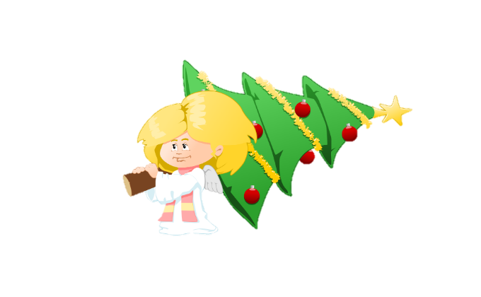
Family Activities
May God bless you and encourage your trust in Him this Christmas season. To enrich your family’s Christmas, check out the Family activities at https://tinyurl.com/y6v2qw4m

Slide 21
Mary’s Trust
December 16

