Slide 1
Nehemiah Protect
August 12

Slide 2
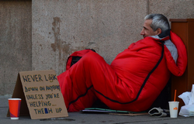
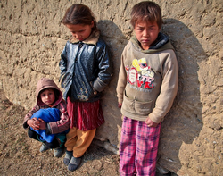
What do you think?
What are some reasons people choose not to get involved in social issues?
Nehemiah was confronted by people in significant need, today we study how he responded.
As Christians, we cannot separate who we are from what we do.
We are called to respond to those in need around us, also.

Slide 3
Listen for struggles.
Nehemiah 5:1-5 (NIV) Now the men and their wives raised a great outcry against their Jewish brothers. 2 Some were saying, "We and our sons and daughters are numerous; in order for us to eat and stay alive, we must get grain." 3 Others were saying, "We are mortgaging our fields, our vineyards and our homes to get grain during the famine." 4 Still others were saying, "We have had to borrow

Slide 4
Listen for struggles.
money to pay the king's tax on our fields and vineyards. 5 Although we are of the same flesh and blood as our countrymen and though our sons are as good as theirs, yet we have to subject our sons and daughters to slavery. Some of our daughters have already been enslaved, but we are powerless, because our fields and our vineyards belong to others."

Slide 5
Don’t Take Advantage
What issues are identified as creating hardship for some people?
Think about what is going on in this story of Nehemiah’s project. What caused the Israelites’ these problems?
Why might those who suffered feel trapped in an endless cycle of despair?
How does discord among God’s people interrupt God’s work?

Slide 6
Don’t Take Advantage
Why are “enemies” among us and within us more difficult to deal with than enemies from the outside?

Slide 7
Don’t Take Advantage
Consider Leviticus 25:35-38 (NIV) If one of your countrymen becomes poor and is unable to support himself among you, help him as you would an alien or a temporary resident, so he can continue to live among you. 36 Do not take interest of any kind from him, but fear your God, so that your countryman may continue to live among you. 37 You must not lend him money at interest or sell him food at a profit. 38 I am the LORD your God, who brought you out of Egypt to give you the land of Canaan and to be your God.

Slide 8
Don’t Take Advantage
So, why is what the rich returnees had done to the poor so wrong?
Can you think of any ways in which the church can exploit or take advantage of inequalities between members? Take a look in James 2.
How should your identity in Christ affect your business dealings?

Slide 9
Listen for Nehemiah’s response.
Nehemiah 5:6-11 (NIV) When I heard their outcry and these charges, I was very angry. 7 I pondered them in my mind and then accused the nobles and officials. I told them, "You are exacting usury from your own countrymen!" So I called together a large meeting to deal with them 8 and said: "As far as possible, we have bought back our Jewish

Slide 10
Listen for Nehemiah’s response.
brothers who were sold to the Gentiles. Now you are selling your brothers, only for them to be sold back to us!" They kept quiet, because they could find nothing to say. 9 So I continued, "What you are doing is not right. Shouldn't you walk in the fear of our God to avoid the reproach of our Gentile enemies? 10 I and my brothers and my men are also

Slide 11
Listen for Nehemiah’s response.
lending the people money and grain. But let the exacting of usury stop! 11 Give back to them immediately their fields, vineyards, olive groves and houses, and also the usury you are charging them--the hundredth part of the money, grain, new wine and oil."

Slide 12
Honor God with Your Actions
Nehemiah "was very angry". Why is this a proper response?
If we don’t feel anger at sin, what is wrong?
Why was the second step of “pondering in his mind” a wise response. What happens if we don’t do that before we act?

Slide 13
Honor God with Your Actions
Nehemiah was intolerant of sin. Why is this important, even for us today?

Slide 14
Listen for the people’s response.
Nehemiah 5:12-13 (NIV) "We will give it back," they said. "And we will not demand anything more from them. We will do as you say." Then I summoned the priests and made the nobles and officials take an oath to do what they had promised. 13 I also shook out the folds of my robe and said,

Slide 15
Listen for the people’s response.
"In this way may God shake out of his house and possessions every man who does not keep this promise. So may such a man be shaken out and emptied!" At this the whole assembly said, "Amen," and praised the LORD. And the people did as they had promised.

Slide 16
Repent – Turn Away from Sin
How did those guilty of abusing their brothers respond to Nehemiah’s exhortation?
What did he lead them to do to confirm their commitment?
What did Nehemiah symbolize by the acting of shaking out the folds of his robe?

Slide 17
Repent – Turn Away from Sin
How would you define ‘repentance’ for someone who’s never heard of it?
The nobles and officials repented as a group. What are the benefits of corporate repentance for a group or church?

Slide 18
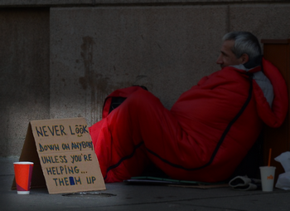
Repent – Turn Away from Sin
What should motivate us to get involved in social issues?
How do you think Christians should be involved in social issues?

Slide 19
Application
Reflect.
Reflect on times you have been selfish.
Think how your view of God will help you become more selfless.

Slide 20
Application
Repent.
Confess and repent of any sin in your life.
Be specific and ask God to help you develop a lifestyle of repentance.

Slide 21
Application
Restore.
Identify someone you have used for your own advantage.
Ask for forgiveness.
Work to restore the relationship by doing something sacrificial for this person.

Slide 22
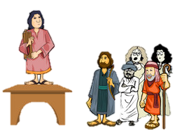
Family Activities
Yep, what Nehemiah said was right. You can share his message with your kids, your in-laws, and your outlaws at
https://tinyurl.com/y8nlabzo

Slide 23
Nehemiah Protect
August 12

