Slide 1
The Poor Widow: Faith that Gives
June 30

Slide 2
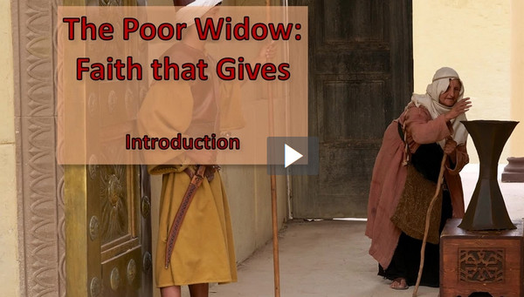
Video Introduction
View Video

Slide 3
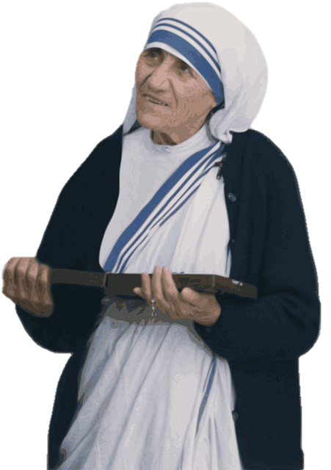
How ‘bout you?
To what charities or special causes do you like giving, even giving sacrificially?
Today we consider contrasting attitudes towards generosity and giving.
We will find that giving reflects your faith and trust in Christ

Slide 4
Listen for Jesus’ warning.
Luke 12:13-15 (NIV) Someone in the crowd said to him, "Teacher, tell my brother to divide the inheritance with me." 14 Jesus replied, "Man, who appointed me a judge or an arbiter between you?" 15 Then he said to them, "Watch out! Be on your guard against all kinds of greed; a man's life does not consist in the abundance of his possessions."

Slide 5
Abundance vs. Abundant Life
Who interrupted Jesus’ teaching and what was his issue?
What insight does Jesus give to His purpose for coming to the world?
Against what did Jesus caution the man?
What are some things other than money and possessions for which people can be greedy?

Slide 6
Abundance vs. Abundant Life
Jesus is saying that wanting all of these things is a great mistake … why so?
How might greed affect our decisions regarding the distribution of our assets after death?
Is saving money the same as being greedy?

Slide 7
Abundance vs. Abundant Life
What does it mean to “watch out” for greed? What steps can believers take to “be on guard” against greed?

Slide 8
Listen for a tragic end to the story.
Luke 12:16-21 (NIV) And he told them this parable: "The ground of a certain rich man produced a good crop. 17 He thought to himself, 'What shall I do? I have no place to store my crops.' 18 "Then he said, 'This is what I'll do. I will tear down my barns and build bigger ones, and there I will store all my grain and my goods. 19 And I'll say to myself,

Slide 9
Listen for a tragic end to the story.
"You have plenty of good things laid up for many years. Take life easy; eat, drink and be merry."' 20 "But God said to him, 'You fool! This very night your life will be demanded from you. Then who will get what you have prepared for yourself?' 21 "This is how it will be with anyone who stores up things for himself but is not rich toward God."

Slide 10
Have An Eternal Perspective
What good situation did the rich man in the parable Jesus told find himself in?
What was his solution?
How did the rich man’s thinking prove to be flawed?
What parts of the parable make you uncomfortable?

Slide 11
Have An Eternal Perspective
In what ways do we act as if we will live for many, many years?
How can we be guilty of “building bigger barns”?
What do you think God meant by the term “rich toward God”?
How do we make eternal investments?

Slide 12
Listen for a contrast to the rich fool.
Luke 21:1-4 (NIV) As he looked up, Jesus saw the rich putting their gifts into the temple treasury. 2 He also saw a poor widow put in two very small copper coins. 3 "I tell you the truth," he said, "this poor widow has put in more than all the others. 4 All these people gave their gifts out of their wealth; but she out of her poverty put in all she had to live on."

Slide 13
Sacrifice and Trusting God
What words and phrases does Jesus use to contrast the rich and poor people giving their offerings?
Rich | Poor

Slide 14
Sacrifice and Trusting God
Why is giving out of our wealth a relatively easy thing to do?
Why do you think the widow gave all the money that she had to live on?
How might she be criticized by the world for what she did?
What would it look like to follow this woman’s example in today’s world?

Slide 15
Application
Give.
Ask the Lord to give you an opportunity to financially bless someone in need this week.
Keep extra cash in your wallet so you are prepared when the need arises. Give without an expectation of being repaid.
See if you can remain anonymous in your giving.

Slide 16
Application
Memorize.
Matthew 6:2- 4: “So when you give to the needy, do not announce it with trumpets, as the hypocrites do in the synagogues and on the streets, to be honored by others. Truly I tell you, they have received their reward in full. But when you give to the needy, do not let your left hand know what your right hand is doing, so that your giving may be in secret. Then your Father, who sees what is done in secret, will reward you”

Slide 17
Application
Increase.
Evaluate your current charitable giving and how you are supporting your local church.
Is your giving consistent? Is it sacrificial?
Challenge yourself to give more for the sake of kingdom work.

Slide 18
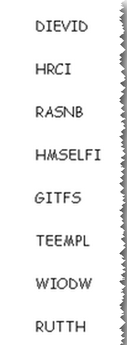
Family Activities
Woe unto us ! The words are all messed up. We need to straighten them out to decode the message. If you need help, go to https://tinyurl.com/yycsc7dw
There’s other cool activities for the whole family, too.

Slide 19
The Poor Widow: Faith that Gives
June 30

