Slide 1
Pray with Passion
September 10

Slide 2
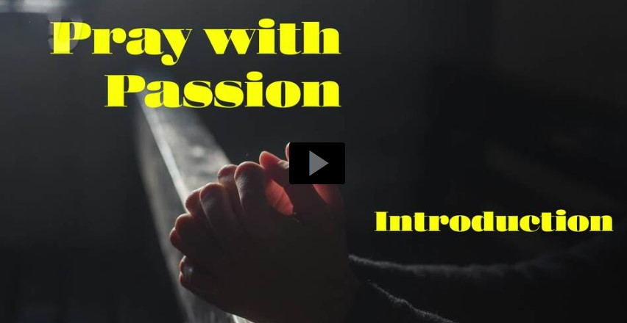
Video Introduction
View Video

Slide 3
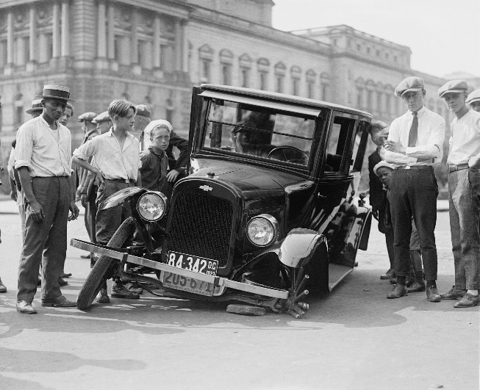
Admit it, now …
When have you felt clueless about how to fix something?
There are plenty of things in our lives that we cannot fix.
But God can fix them if we only trust Him
When we talk to God about our problems, prayers really do make a difference.

Slide 4
Listen for Daniel in danger.
Daniel 2:13-16 (NIV) So the decree was issued to put the wise men to death, and men were sent to look for Daniel and his friends to put them to death. 14 When Arioch, the commander of the king's guard, had gone out to put to death the wise men of Babylon,

Slide 5
Listen for Daniel in danger.
Daniel spoke to him with wisdom and tact. 15 He asked the king's officer, "Why did the king issue such a harsh decree?" Arioch then explained the matter to Daniel. 16 At this, Daniel went in to the king and asked for time, so that he might interpret the dream for him.

Slide 6
Seek God
What situation created this threat of execution for Daniel and his friends?
What words and phrases describe how Daniel responded to the threat he faced?
Why do you think this was a good request?

Slide 7
Seek God
Where do people in secular culture today turn with concerns about the future?
What about Christians – where can/should believers go when they are concerned about the future?

Slide 8
Listen for what Daniel asked of his friends.
Daniel 2:17-19 (NIV) Then Daniel returned to his house and explained the matter to his friends Hananiah, Mishael and Azariah. 18 He urged them to plead for mercy from the God of heaven concerning this mystery,

Slide 9
Listen for what Daniel asked of his friends.
so that he and his friends might not be executed with the rest of the wise men of Babylon. 19 During the night the mystery was revealed to Daniel in a vision. Then Daniel praised the God of heaven

Slide 10
Pray Expectantly
What did Daniel and his friends ask of God in the midst of a desperate situation?
Once they had prayed, how did Daniel then respond to the crisis?
Daniel enlisted the prayers of his friends. What are the benefits of praying as a community?

Slide 11
Pray Expectantly
How can we demonstrate in our lives the importance of prayer?
So … you’re in a crisis, you pray with together others for God’s guidance, then God reveals to you what He is doing in a dream as you sleep. What might you be tempted to do when you wake up?
In the next passage we will see what Daniel did.

Slide 12
Listen for the content of Daniels praise.
Daniel 2:20-23 (NIV) and said: "Praise be to the name of God for ever and ever; wisdom and power are his. 21 He changes times and seasons; he sets up kings and deposes them. He gives wisdom to the wise and knowledge to the discerning. 22 He reveals deep and hidden things;

Slide 13
Listen for the content of Daniels praise.
he knows what lies in darkness, and light dwells with him. 23 I thank and praise you, O God of my fathers: You have given me wisdom and power, you have made known to me what we asked of you, you have made known to us the dream of the king." 27-28a Daniel replied,

Slide 14
Listen for the content of Daniels praise.
"No wise man, enchanter, magician or diviner can explain to the king the mystery he has asked about, 28 but there is a God in heaven who reveals mysteries. He has shown King Nebuchadnezzar what will happen in days to come.

Slide 15
Acknowledge God’s Work
What does Daniel do immediately after the dream is revealed to him?
What are some of the attributes for which Daniel praised God?
Why were those attributes relevant to Daniel’s situation?

Slide 16
Acknowledge God’s Work
What are some ways we can honor God when He answers our prayers?
How does this passage show God’s involvement in the political process?
Give some specific ways in our life we can apply what we learn from Daniel here.

Slide 17
Application
Start a prayer journal.
Begin a personal prayer journal in which you record your prayer concerns.
Include information about the concern, the date you added each entry, and space for how God answers your prayers.

Slide 18
Application
Enlist a prayer partner.
Invite someone to be your prayer partner for a specific concern in your life.
Explain your concern and how you are praying for this issue.
Make sure to give updates about how God is working in the situation, even if you are still waiting for Him to act.

Slide 19
Application
Write a response of praise.
Think back to a time when God has answered a prayer for you.
Write out your response of praise for how He worked in this situation.
Say your words out loud to Him, as an offering of worship

Slide 20
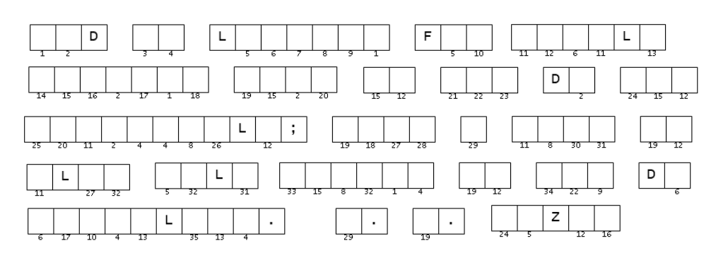
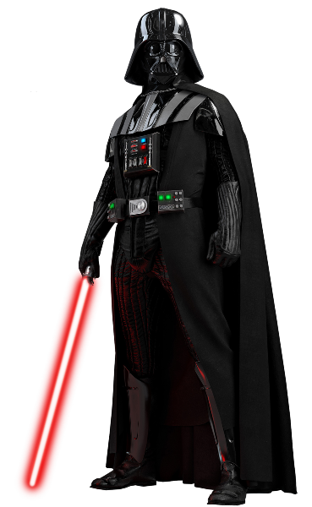
Family Activities
The message has come from Poresan Jipinesmon in your galaxy. You must first solve the clue words that make up the key. Then use the numbers to fill in the letters of the message form. If you insist on doing the crossword, I find your lack of cooperation disturbing. However, you will find helps and other activities at https://tinyurl.com/yck36n89

Slide 21
Pray with Passion
September 10

