Slide 1
Purpose Lived
September 22

Slide 2
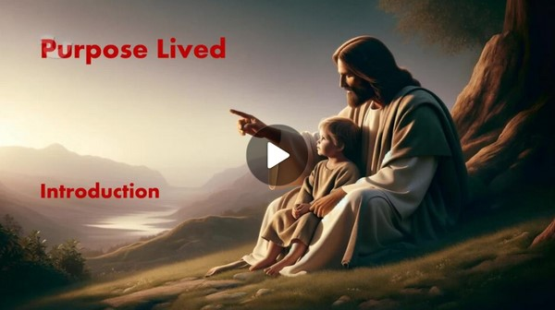
Video Introduction
View Video

Slide 3
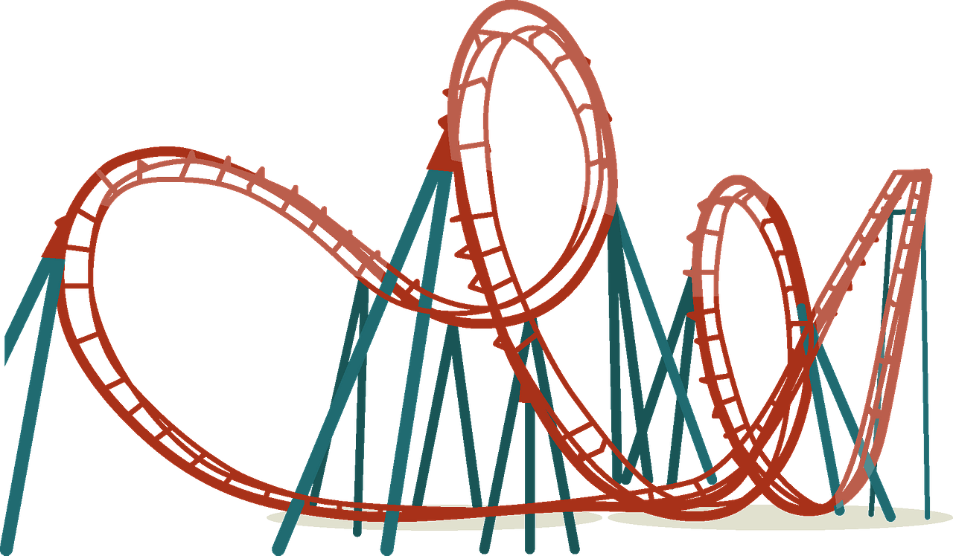
And proud of it …
What is something that people in your hometown love to brag about?
The purpose of having a community is to provide an infrastructure that benefits everyone.
One’s purpose as an individual is improved (or hindered) by the community
One’s spiritual purpose is fulfilled as we surrender to and are led by God’s Holy Spirit.

Slide 4
Listen for a conflict.
Galatians 5:16-18 (NIV) So I say, live by the Spirit, and you will not gratify the desires of the sinful nature. 17 For the sinful nature desires what is contrary to the Spirit, and the Spirit what is contrary to the sinful nature. They are in conflict with each other, so that you do not do what you want. 18 But if you are led by the Spirit, you are not under law.

Slide 5
End Following Sinful Desires
What two admonitions does Paul give the Galatian readers?
What is the conflict he speaks of and what is the result?
Some translations use the word “flesh”. What does that word refer to?

Slide 6
End Following Sinful Desires
Consider examples of how our flesh, our sinful nature enjoys indulging itself in sin.
It pleases our flesh to vent off steam by complaining.
It pleases our sinful nature to get revenge by shouting at someone we are angry with
Sexual sins are pleasurable during the moment.
Lazily sleeping late instead of working is very enjoyable

Slide 7
End Following Sinful Desires
These things give a temporary fun factor
Later they bring guilt.
They produce bad consequences.
They show a distant or broken relationship with God.

Slide 8
End Following Sinful Desires
Paul talks about “the law”. What were some of the laws the Jews lived by?
What do you think Paul means (or does not mean) about not being under the law?
What are some of the obstacles to our living “by the Spirit”?

Slide 9
End Following Sinful Desires
But … when God’s Spirit is ruling within our lives, we are set free from the power of sin over us

Slide 10
Listen for the results of walking in the flesh.
Galatians 5:19-21 (NIV) The acts of the sinful nature are obvious: sexual immorality, impurity and debauchery; 20 idolatry and witchcraft; hatred, discord, jealousy, fits of rage, selfish ambition, dissensions, factions 21 and envy; drunkenness, orgies, and the like. I warn you, as I did before, that those who live like this will not inherit the kingdom of God.

Slide 11
Do Not Walk in the Flesh
How can a person be identified as living in the flesh?
Note the actions, attitudes, and behaviors Paul identified as works of the flesh.
Sexual immorality, impurity,
Debauchery, idolatry, witchcraft,
Hatred, discord, jealousy ….

Slide 12
Do Not Walk in the Flesh
How do we know Paul’s list not exhaustive?
Note the two sins that have to do with the spiritual realm – idolatry and witchcraft. Most of us don’t burn incense to wooden carvings or ceramic images. So, how might even a Christian family get caught up in idols or witchcraft?
Idols | Witchcraft

Slide 13
Do Not Walk in the Flesh
Why or how do acts of the sinful nature tend to entangle us?

Slide 14
Listen for Christlike attributes.
Galatians 5:22-26 (NIV) But the fruit of the Spirit is love, joy, peace, patience, kindness, goodness, faithfulness, 23 gentleness and self-control. Against such things there is no law. 24 Those who belong to

Slide 15
Listen for Christlike attributes.
Christ Jesus have crucified the sinful nature with its passions and desires. 25 Since we live by the Spirit, let us keep in step with the Spirit. 26 Let us not become conceited, provoking and envying each other.

Slide 16
Walking by the Spirit
How does the concept of the fruit of the Spirit differ from the concept of the “works” of the flesh?
If we have life in the Spirit, then what difference should that make in the way we live?

Slide 17
Walking by the Spirit
Paul says the sinful nature with its affections and lusts of the flesh has been crucified.
Or don't you know that all of us who were baptized into Christ Jesus were baptized into his death? We were therefore buried with him through baptism into death in order that, just as Christ was raised from the dead through the glory of the Father, we too may live a new life.

Slide 18
Walking by the Spirit
Paul is saying …
Our sinful nature died on the cross with Jesus.
We must appropriate that reality, that Truth as an act of faith.
We need not yield or pay attention to that old nature which is dead.
Instead, we have a new nature that God seeks to control, He wants to sit on the “throne” of your life

Slide 19
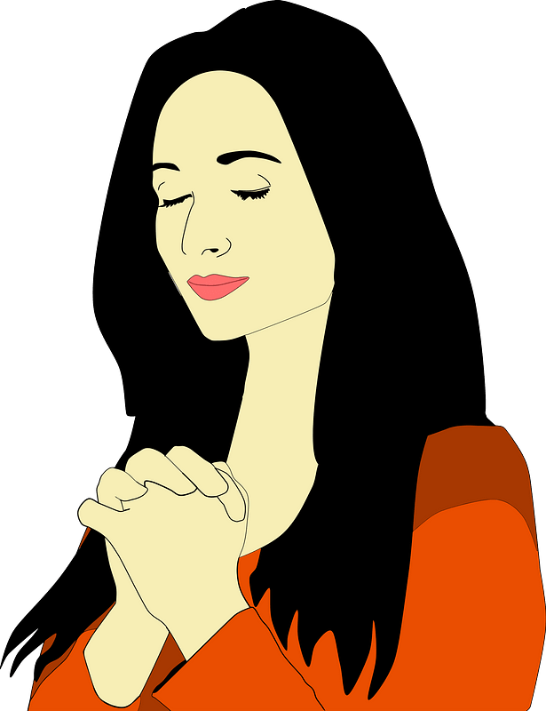
Walking by the Spirit
What are some practical ways believers can keep in step with the Spirit?

Slide 20
Application
Assess your walk.
Examine your life for areas where you follow the flesh.
Confess those sins, turn from them, and ask God to fill you with His Holy Spirit.
Commit to following Christ and letting His Spirit work His godly character in you.

Slide 21
Application
Invest time.
Walking by the Spirit requires setting aside time for Him.
Determine when and where you can meet God each day.
Make it an unwavering habit to spend time with God every day.

Slide 22
Application
Redirect your thoughts.
Begin the habit of relying on the Spirit, so that your thoughts are honoring to Christ.
Toward this end, memorize Philippians 4:8: “Finally brothers and sisters, whatever is true, whatever is honorable, whatever is just, whatever is pure, whatever is lovely, whatever is commendable—if there is any moral excellence and if there is anything praiseworthy—dwell on these things.”

Slide 23
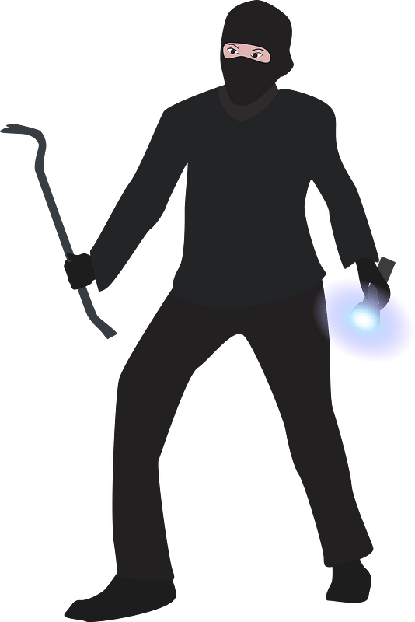
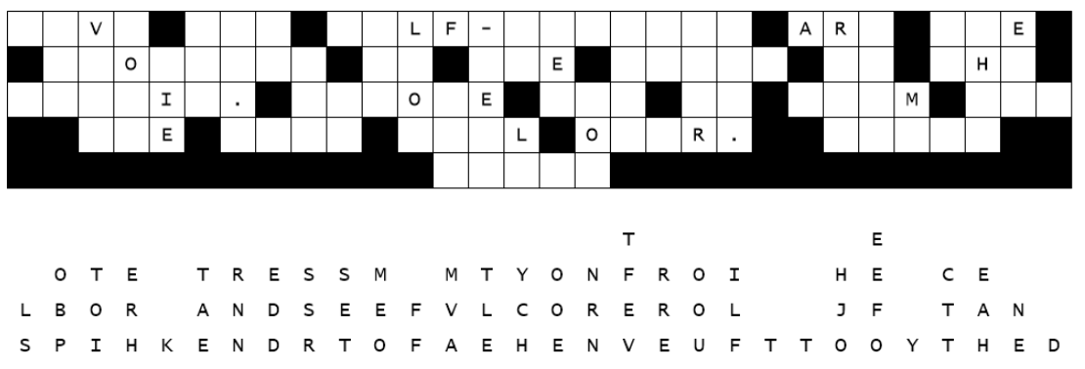
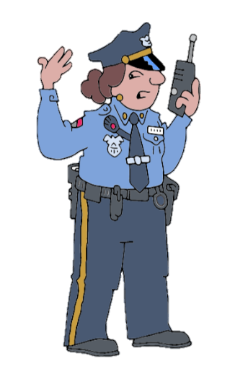
Family Activities
No space aliens this time. It’s our own local Billboard Bandit. Follow the instructions on your copy of the billboard and fallen letters. If you get stuck go to https://tinyurl.com/5n8w4tzy There’s also the Crossword there for you ladies in the back row.

Slide 24
Purpose Lived
September 22

