Slide 1
Pursue Godliness
July 21

Slide 2
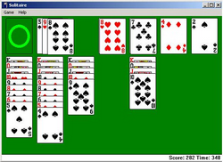
Admit it, now …
What are some things you enjoy being distracted by?
There are many diversions in our lives that can distract us.
Some of them can too easily distract us from our relationship with God
Today we consider ways to keep God the focus of your life.

Slide 3
Listen for Asa’s goal.
2 Chronicles 14:1-2 (NIV) And Abijah rested with his fathers and was buried in the City of David. Asa his son succeeded him as king, and in his days the country was at peace for ten years. 2 Asa did what was good and right in the eyes of the LORD his God.

Slide 4
Seek to Please God
Asa was the successor to his father Abijah as king. At least initially, how effective was Asa’s leadership?
The reason for his success as king was his focus on pleasing God. What would you say a God-focused life looks like?

Slide 5
Seek to Please God
What kind of peace would result from being “God-focused”?
Asa was said to have done “what was good and right”. How did he, how do we know what is good and right?

Slide 6
Listen for specific actions Asa took as king
2 Chron. 14:3-5 (NIV) He removed the foreign altars and the high places, smashed the sacred stones and cut down the Asherah poles. 4 He commanded Judah to seek the LORD, the God of their fathers, and to obey his laws and commands. 5 He removed the high places and incense altars in every town in Judah, and the kingdom was at peace under him.

Slide 7
Remove Barriers to Godliness
What action did Asa lead the people to undertake in an effort to remove barriers that could tempt them to false worship?
What positive action did he challenge them to take?
What prohibition from the Lord may have been behind the effort to remove the high places and the images from all the cities of Judah?

Slide 8
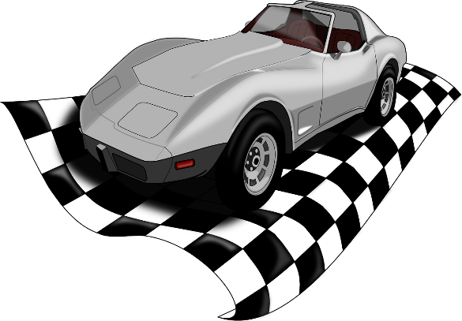
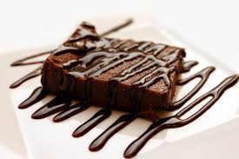
Remove Barriers to Godliness
What resulted from these efforts?
Where do you see evidence of idolatry in our culture?

Slide 9
Remove Barriers to Godliness
But … some of these things are so much a part of our lives – we have to work for a living … TV and social media are important elements of communication and entertainment ... gaining knowledge and education are necessary … we need transportation.
How do we do away with them being idols in our lives?

Slide 10
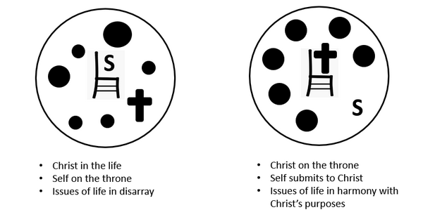
Remove Barriers to Godliness
Why is it true that Godly living leads to spiritual peace and rest?
Contrast carnal life with Spirit filled life

Slide 11
Listen for how Asa led the people during this season of peace.
2 Chronicles 14:6-8 (NIV) He built up the fortified cities of Judah, since the land was at peace. No one was at war with him during those years, for the LORD gave him rest. 7 "Let us build up these towns," he said to Judah, "and put walls around them, with towers, gates and bars. The land is still ours, because we have sought the LORD our God; we sought

Slide 12
Listen for how Asa led the people during this season of peace.
him and he has given us rest on every side." So they built and prospered. 8 Asa had an army of three hundred thousand men from Judah, equipped with large shields and with spears, and two hundred and eighty thousand from Benjamin, armed with small shields and with bows. All these were brave fighting men.

Slide 13
Guard against Temptations
What did Asa do during the years of peace to strengthen Judah?
What did God do for Judah when the people sought God?
How did Asa prepare militarily? How big was Asa’s army?

Slide 14
Guard against Temptations
Why was it important to take these actions at the current time?
What are some walls of protection we can build to guard against spiritual adversaries?
How can we enjoy a season of God-given rest without becoming complacent?

Slide 15
Application Video
View Video

Slide 16
Application
Memorize.
Commit to memory Matthew 6:33: “But seek first the kingdom of God and his righteousness, and all these things will be given to you.”
Allow the truth of this verse to penetrate your heart and mind; let it be a driving force in your pursuit of godliness.

Slide 17
Application
List.
Identify areas in your own life that have become idols and false gods. Develop a plan to purposely rid yourself of them.
Enlist the help and support of other believers.

Slide 18
Application
Recruit.
Join together with a small group of people to serve as your army of “valiant warriors”
They will stand guard with you when attacks come from the enemy.

Slide 19
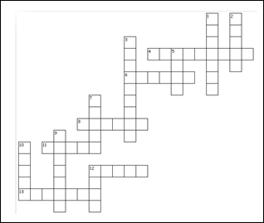
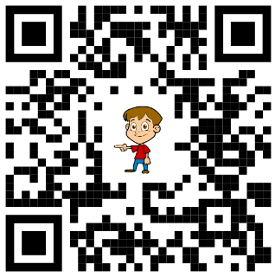
Family Activities
Those clues look clueless! Oh … wait … it says here you need to read 2 Chronicles 14 in the NIV. And that QR code points you to more fun activities.
Across
4. they built and _?_
6. towns given _?_, gates, and bars
8. what kind of stones were smashed?
11. the kingdom was at _?_ under him
12. Asa did what was good and _?_
13. army equipped with large _?_

Slide 20
Pursue Godliness
July 21

